Slide 1
Weather Patterns of the Pacific Coast
Rain and Snowfall Patterns

Slide 2
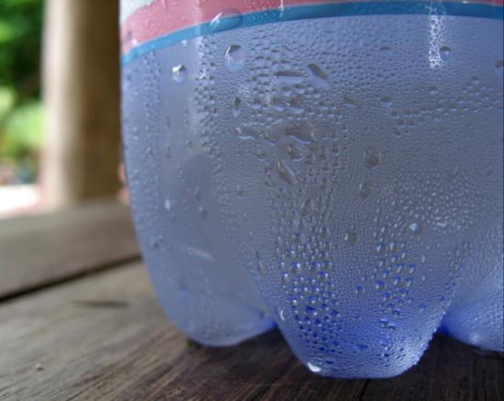
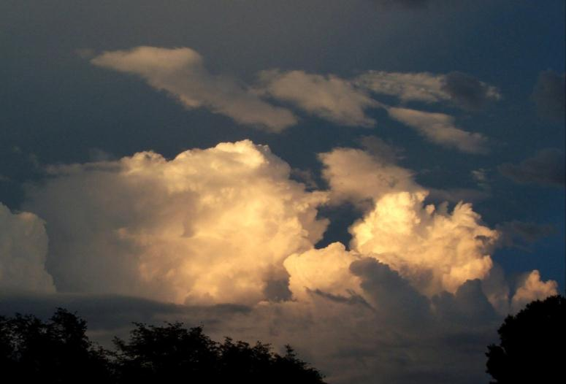
Water from the Sky
Notes:
Dew point is the temperature at which water vapor will condense into liquid. As warm moist air from the ocean runs into and rises above the coastal mountains, the cooler air causes the water vapor to condense into tiny droplets that form clouds. The dew point temperature varies depending on the absolute humidity (quantity of water vapor molecules in the air) and air pressure (quantity of air molecules for a given volume). But, when dew point is reached, the relatively humidity is 100% and any additional water vapor must condense.
Relative humidity is the percentage of water vapor in the air compared to the amount that can be held in the air at that temperature. If relative humidity is 50%, then the air can hold two times more moisture than it currently has. A relative humidity of 100% means the air can hold no more moisture.
The top image shows how warm humid air condenses onto the colder water bottle that can hold less moisture. The lower-left image shows large convection clouds forming in Arizona as they rise to the point where the temperature is cool enough for the vapor to condense. The lower-right shows clouds condensing on Maui at 4,000 feet elevation. That is the elevation where the temperature is at the dew point and relative humidity is at 100%. Below that elevation, the humidity is not high enough for condensation, so conditions remain dry and sunny. Notice that the land is brown at low elevation and green up high. Ask the students why.

Slide 3
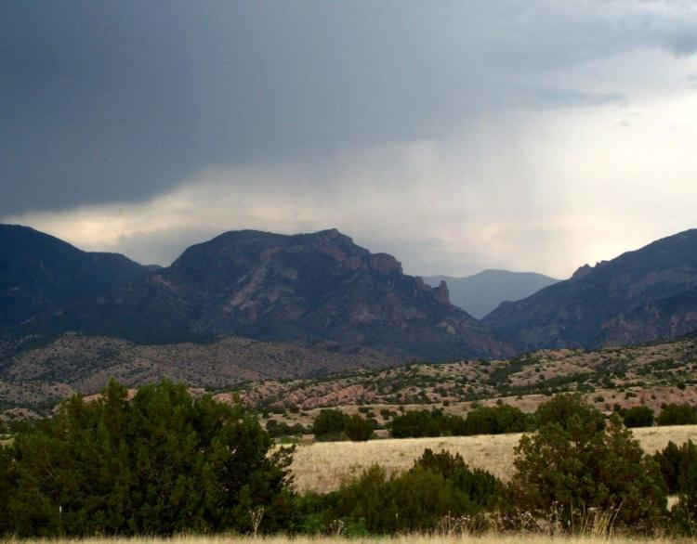
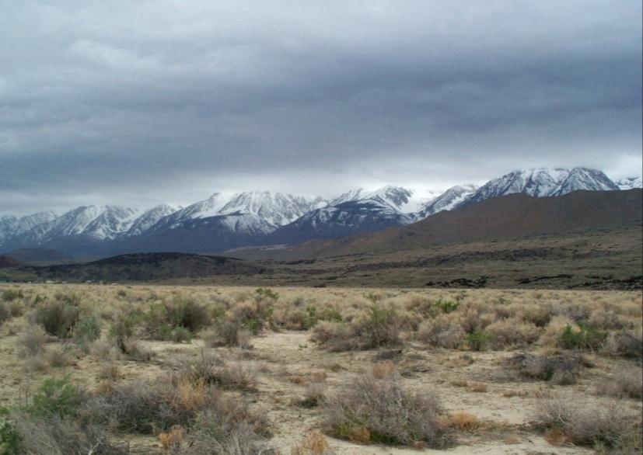
Topographic Lifting, Condensation, and Rainfall
Clouds form anytime that moist air rises and cools below the dew point.
As the water droplets get larger, some get so heavy, they fall to the sky as rain.
If the temperature gets cold enough, it can fall as snow.
Notes:
The image at left shows the beginnings of a rain shower in the Mogollon mountains of New Mexico. The clouds became dense enough and the droplets heavy enough that they began to fall as rain.
The image at right shows the eastern Sierra Nevada mountains. The elevation where the dew point temperature has been reached is about 10,000 feet. Snow has fallen on the mountains, but conditions in the valley are desert-like because temperatures remain above the dew point temperature.

Slide 4
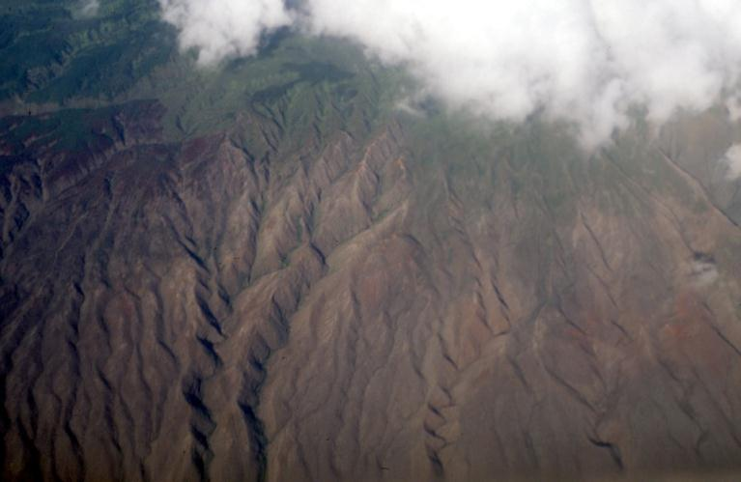
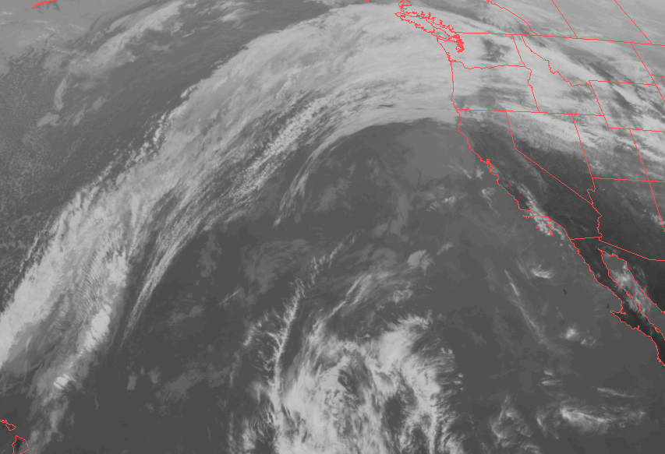
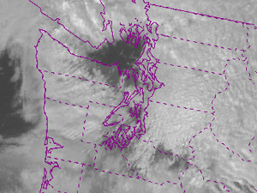
Rainshadow Effect
Windward
Leeward
Rainshadow Desert
Ocean
Coastal rainforests
Drier
intermountain trough
Notes:
As clouds pass over the mountains, they drop precipitation on the windward side. But, when the air drops on the leeward side, it warms up, causing the clouds to evaporate again into vapor due to the temperature rising above the dew point temperature. This adiabatic heating and cloud evaporation results in drier conditions on the leeward side of the mountains. This is the rainshadow effect.
The image at top left shows the leeward side of Molokai in Hawaii. The top of the mountain is a rainforest at 300” of rain per year. On the dry slopes, it drops to less than 30”. But, notice the gullies carved by runoff from the rainforest above.
The image in the lower left shows the rainshadow effect of the Cascade mountains resulting in dry conditions in eastern Washington. Image in lower right shows the rainshadow effect of the Olympic Mountains, resulting in the “blue hole” in the Dungeness valley and north Puget Sound.

Slide 5
Rainshadow Effect
Notes:
Animation of the Rainshadow effect

Slide 6
Precipitation Map of Washington
Notes:
The Olympic temperate rainforests are located on the western slopes (windward side) of the Olympic mountains. The rainshadow effect in the northeastern part of the peninsula is obvious. In addition, the intermountain trough of the Puget Sound is also drier that the mountains to the west and east. Rainfall increases again on the windward slopes of the Cascade range. In addition, the rainshadow effect is particularly strong in the Columbia basin in eastern Washington, where conditions are desert-like.

Slide 7
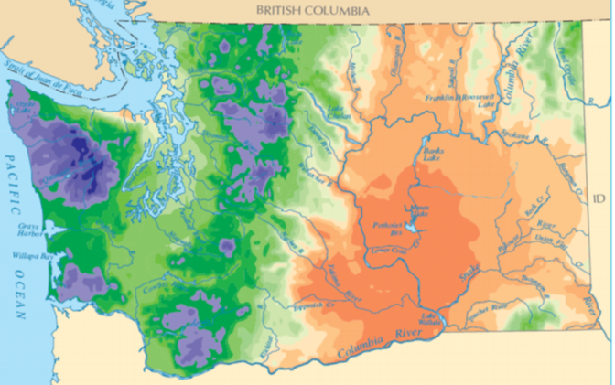
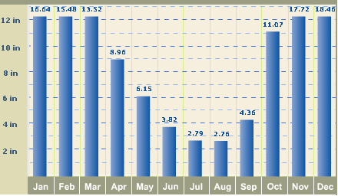
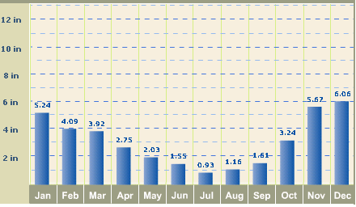
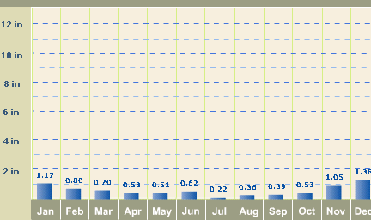
Precipitation Patterns and Snow Pack
Cool Wet Winters and Warm Dry Summers
Forks, WA
Seattle, WA
Moses Lake, WA
Notes:
In the Pacific Northwest, most precipitation falls in the fall and winter seasons (October-March) and summers are very dry (particularly in July and August). Because most precipitation comes in winter, much of it falls as snow in the mountains above 2,000 feet elevation. Thus, much of the precipitation is “stored” as snow until it begins to melt in the summer.
So, despite the long summer drought, rivers originating in the mountains do not dry up completely in summer, as they are continually fed by this melting snow. However, these rivers reach their lowest water levels in late August and September, when most of the snow is melted and the Autumn rains have yet to begin.

Slide 8
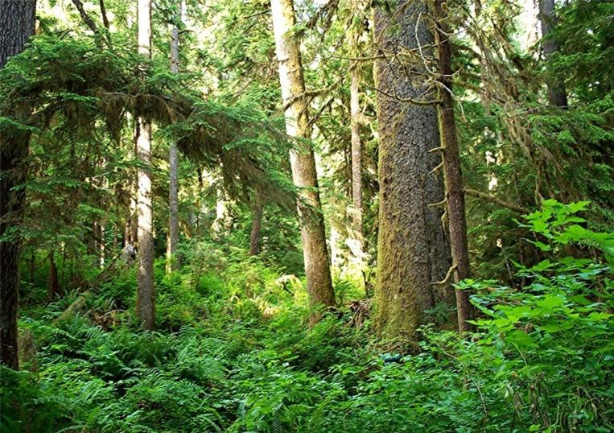
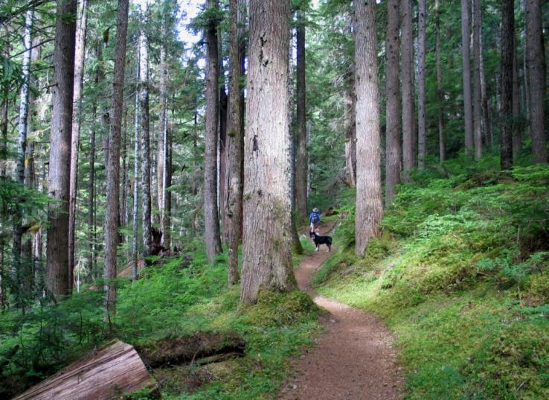
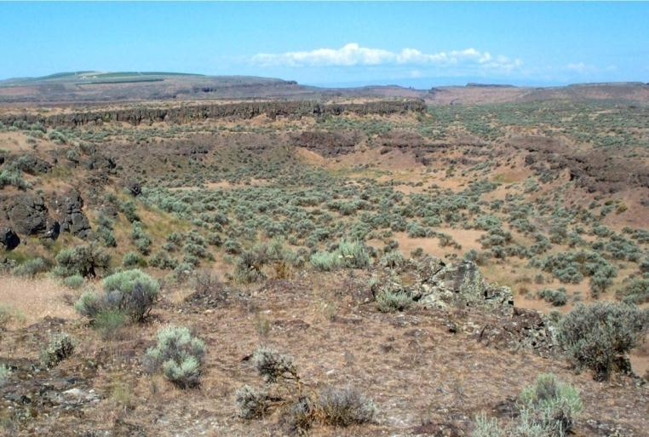
Rainshadow Effect Cross-Section
Notes:
This is a clockwise cross-section across the State of Washington starting with the Hoh rainforest (150”) in the upper left. Next is an old-growth forest in the eastern Olympics mountains (60”), a ponderosa pine forest on the east slopes (leeward side) of the Cascade range (30”), and the deserts of eastern Washington (10”).

Slide 9
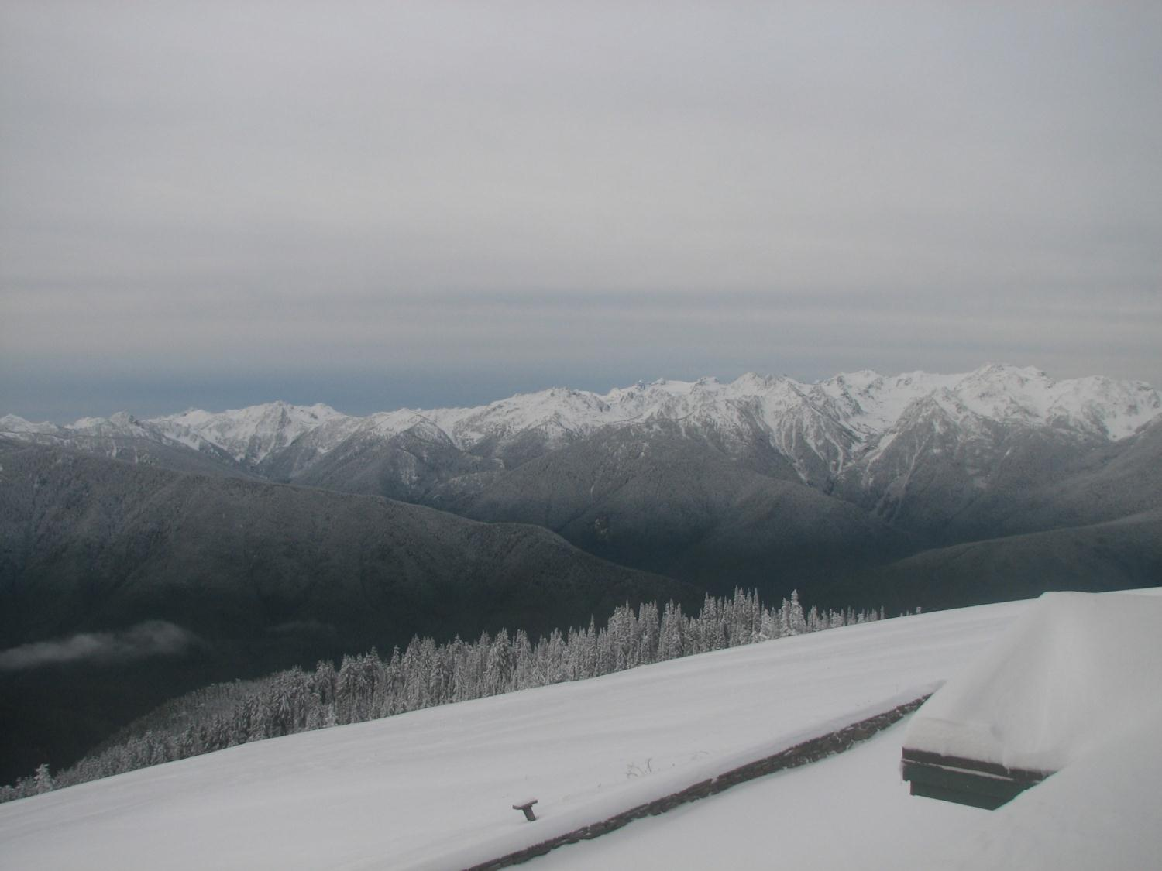
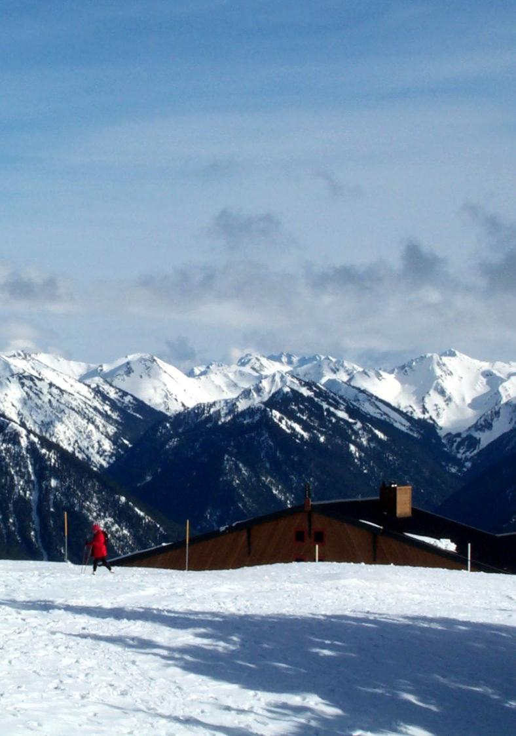
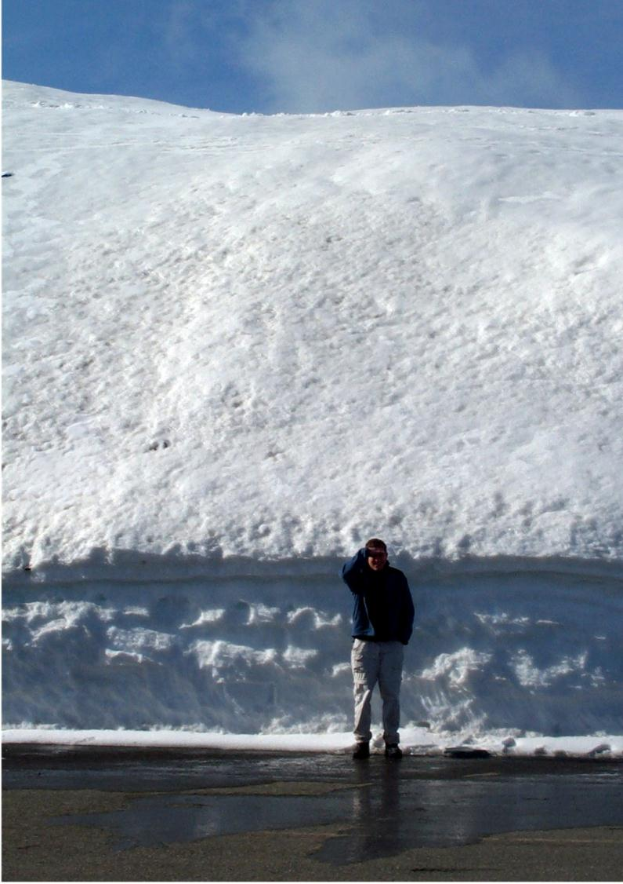
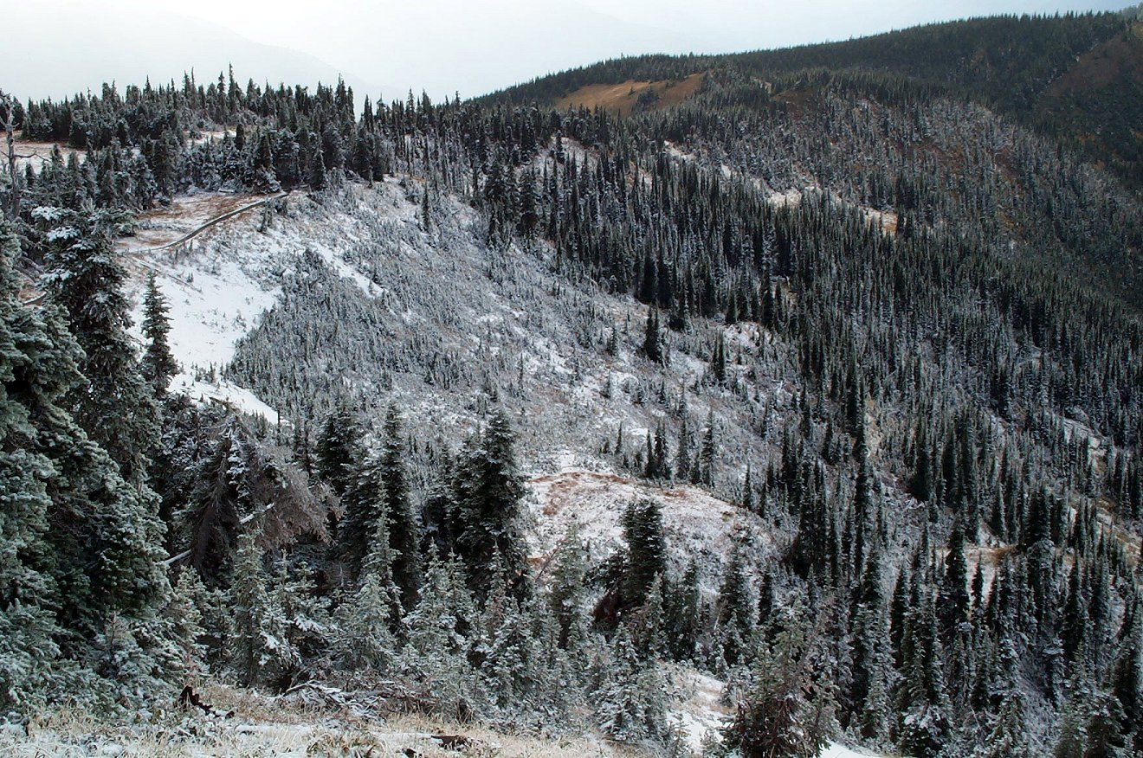
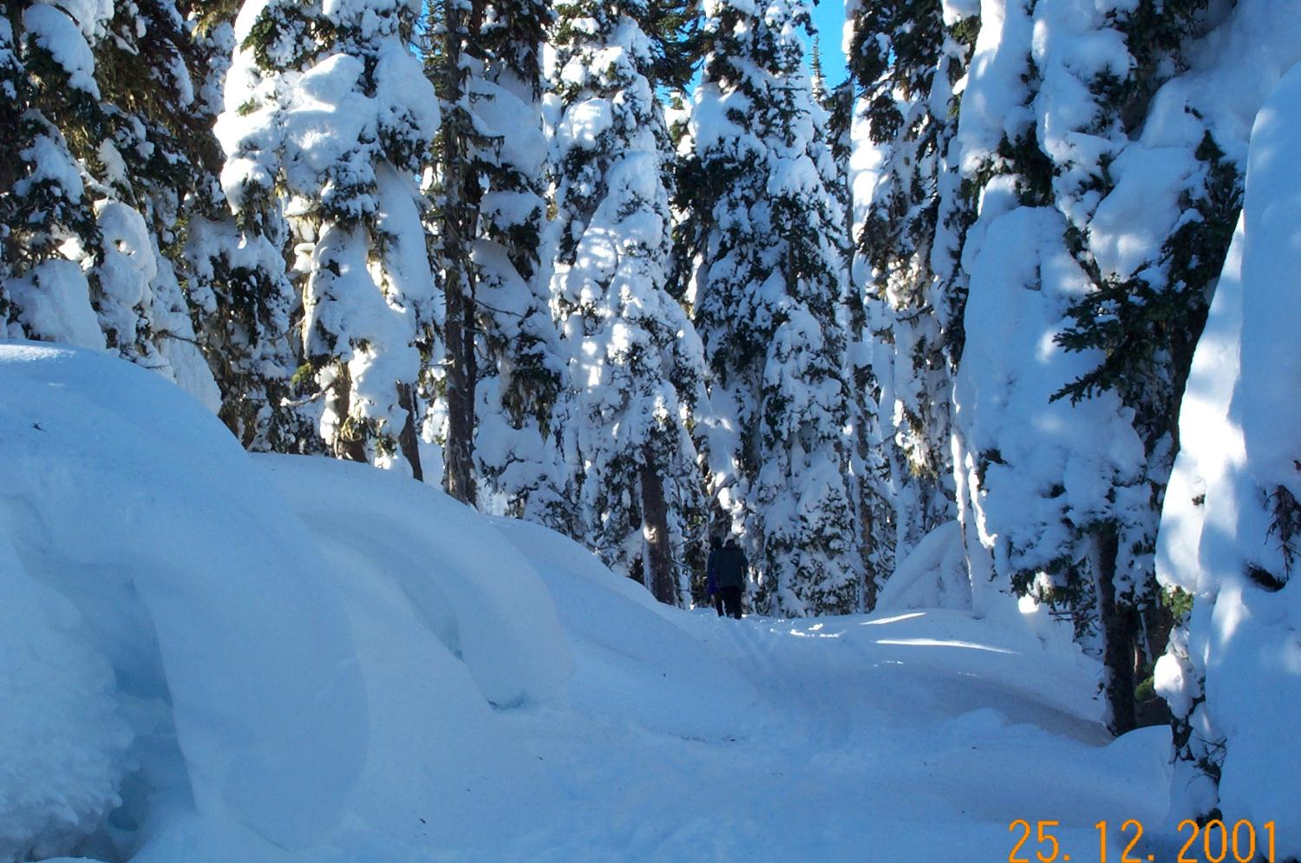
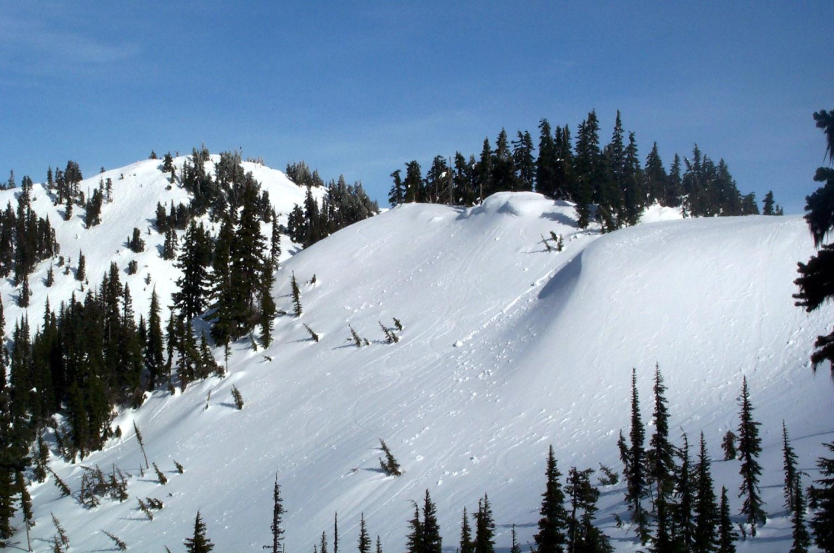
Late March
The Build Up of Winter Snowpack
Late November
October
Late March
Late December
Notes:
First Image: The is the first snowfall of the year at Hurricane Ridge (elevation 5,200 feet) in mid-October. This dusting will not last long, as typically it snows and melts off several times in the early fall while temperatures are still relatively mild. It will not be till late-November or December that snow starts to stick for good.
Second Image: By late November, the snow usually starts to accumulate for the winter. The typical “snow line” is about 2,000 feet in the Pacific Northwest in the winter. Below 2,000 feet, precipitation will fall as rain. Although the freezing level will vary dramatically from storm-to-storm (from sea level to above 9,000 feet), typically about 2,000 feet is where you’ll run into the first long-term winter snow pack during the winter months.
Third Image: By late-December or January, deep snow has accumulated following a series of powerful winter storms. In certain locations, strong winds will blow the snow into drifts 10-20 feet deep, while exposing other areas.
Fourth Image: By March, 20-30 foot snow banks have piled up at Hurricane Ridge, but warmer early spring temperatures have begun to melt the snow off the darker-colored trees. Dark spots melt out faster, because they absorb more solar radiation. Often a deep hole in the snow forms around pine cones or rocks that fall on the snow surface.
Fifth and Sixth Images: Approximately 400 inches of snow falls at Hurricane Ridge in a typical winter and as much as 1000+ inches on Mount Olympus. This makes for some thick piles of snow in the parking lot and a lot of work for the snow plows.

Slide 10
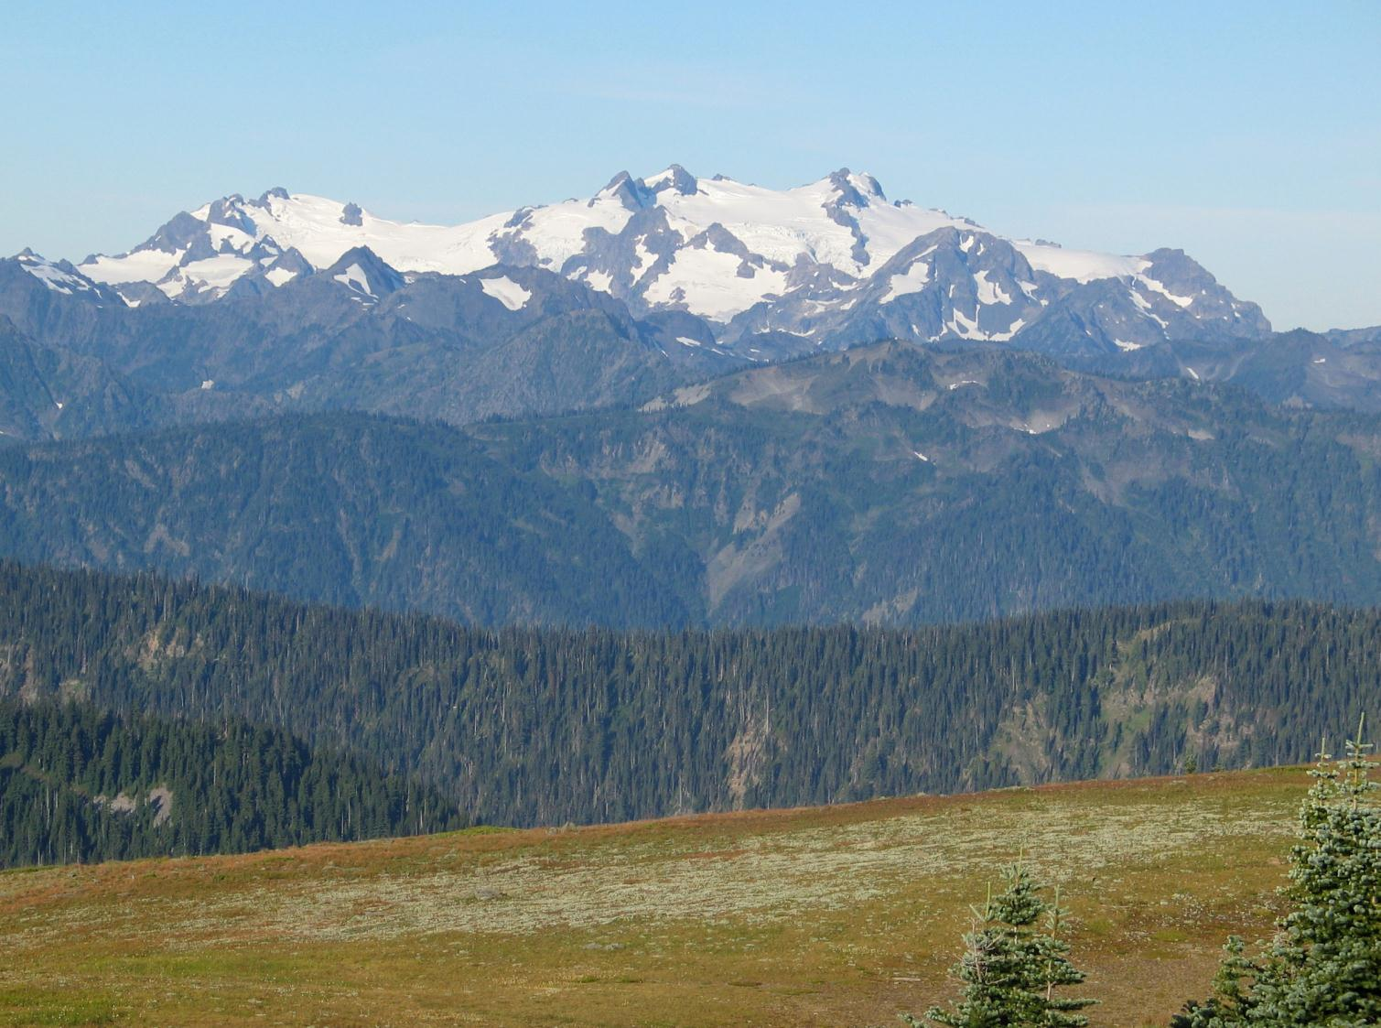
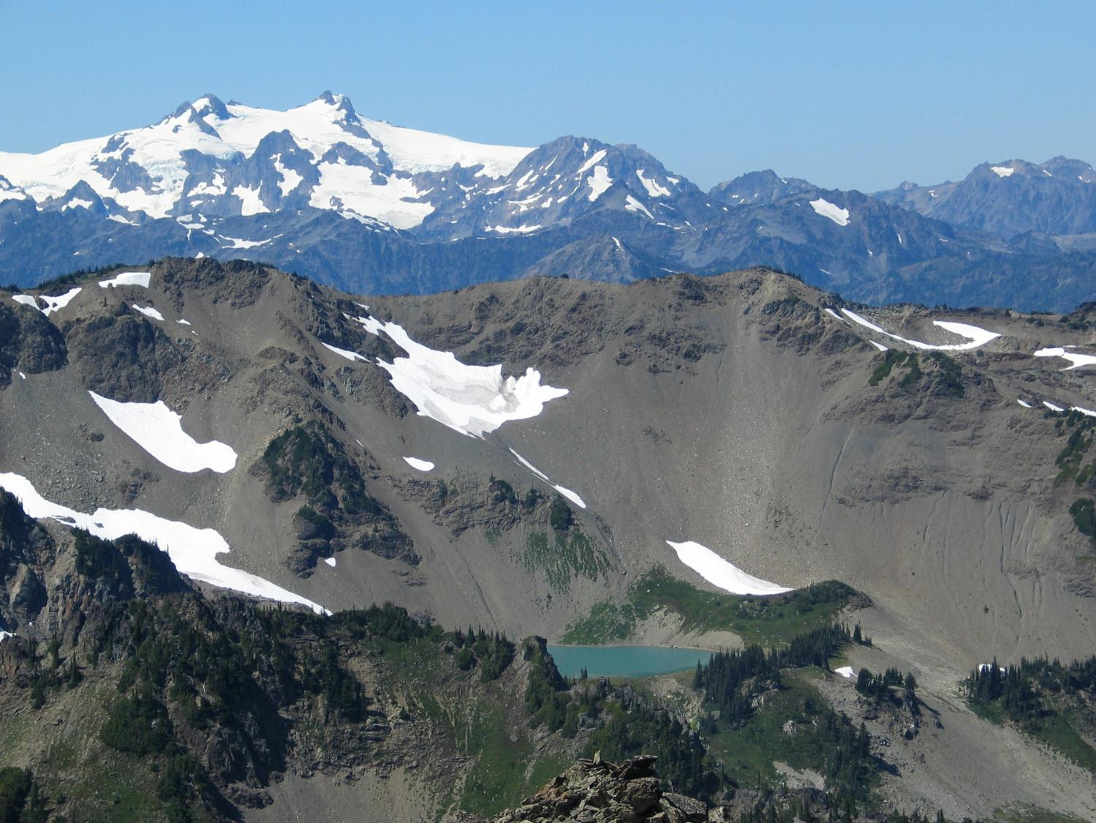
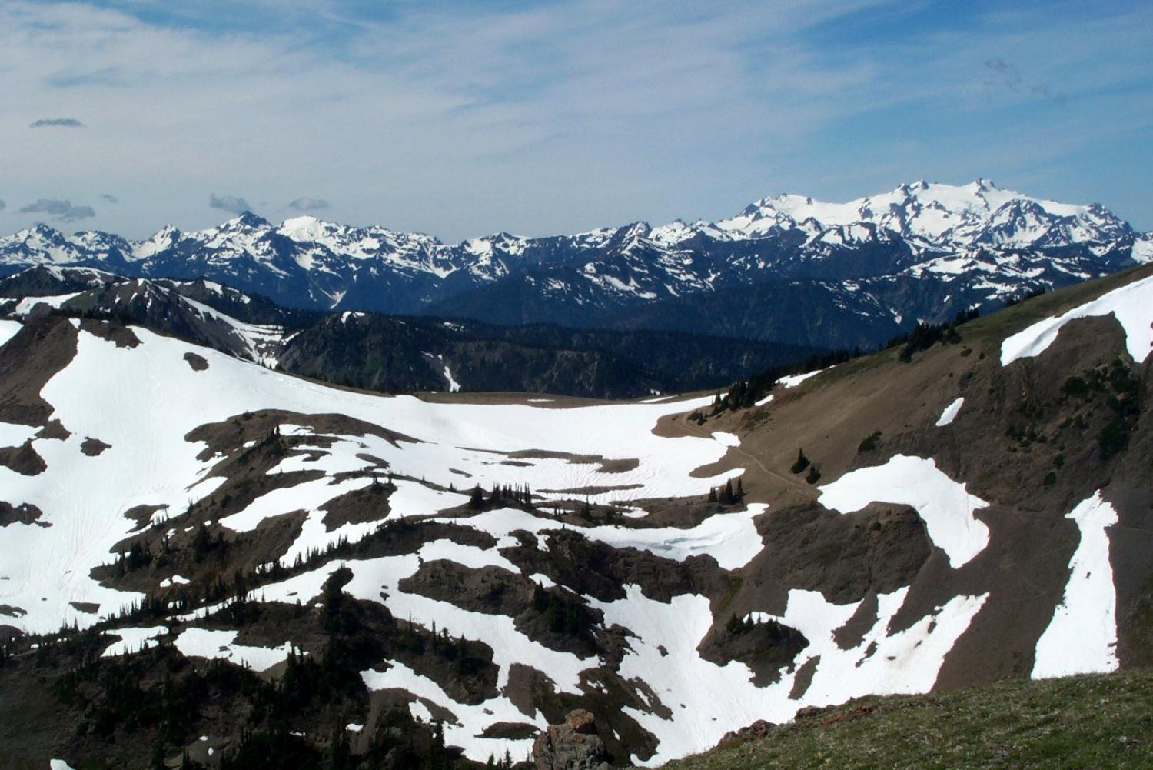
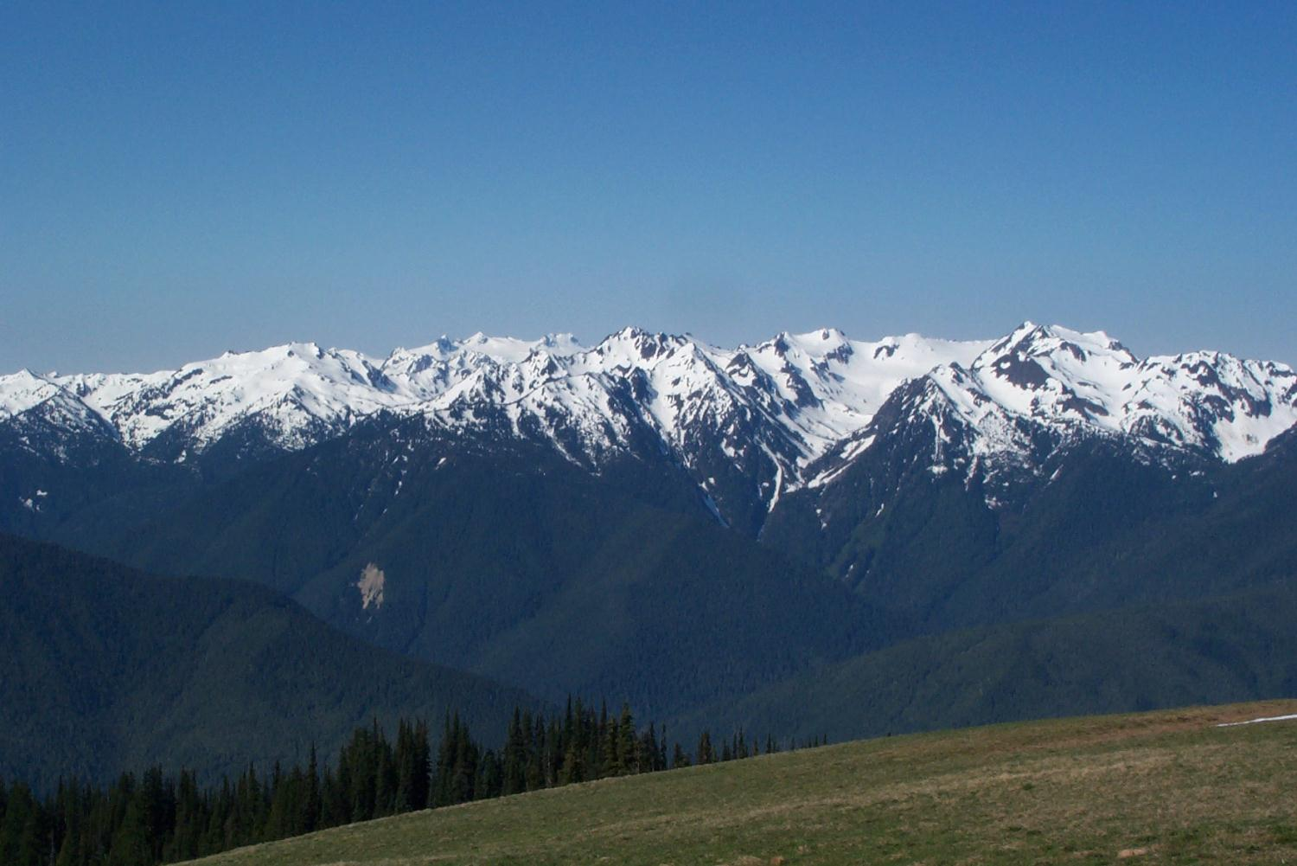
Mid-October
Mid-August
The Summer Snowpack Meltout
Mid-July
Early June
Notes:
With snowpack reaching its maximum around March, the winter snowpack will begin to melt out with increasingly warmer temperatures and longer days of sun around April. Rain falling instead of snow will speed up the process. However, due to the depth of the snowpack, by mid-June there still remains thick blankets of snow in the subalpine forest and alpine meadows. While patches of bare ground open up, many high elevation trails are still mostly impassable.
Second Image: By mid-July, most alpine meadow areas have melted out and the wildflowers start making an appearance, particular on south-facing slopes. However, deep snow packs remain in the higher elevations and in sheltered north-facing basins.
Third Image: By August, almost all of the winter snowpack has melted, but sheltered pockets on north-faces remain. Some high elevation ridges still have significant patches of snow.
Fourth Image: By October, the long summer drought is coming to an end and the temperatures are dropping back toward freezing. Virtually all of winter snow pack is gone, except for the glaciers. But, the first snowfall of the next season is just about to begin. Sometimes there are sheltered places where previous year’s snow pack has not fully melted out before the next season’s snow begins.

Slide 11
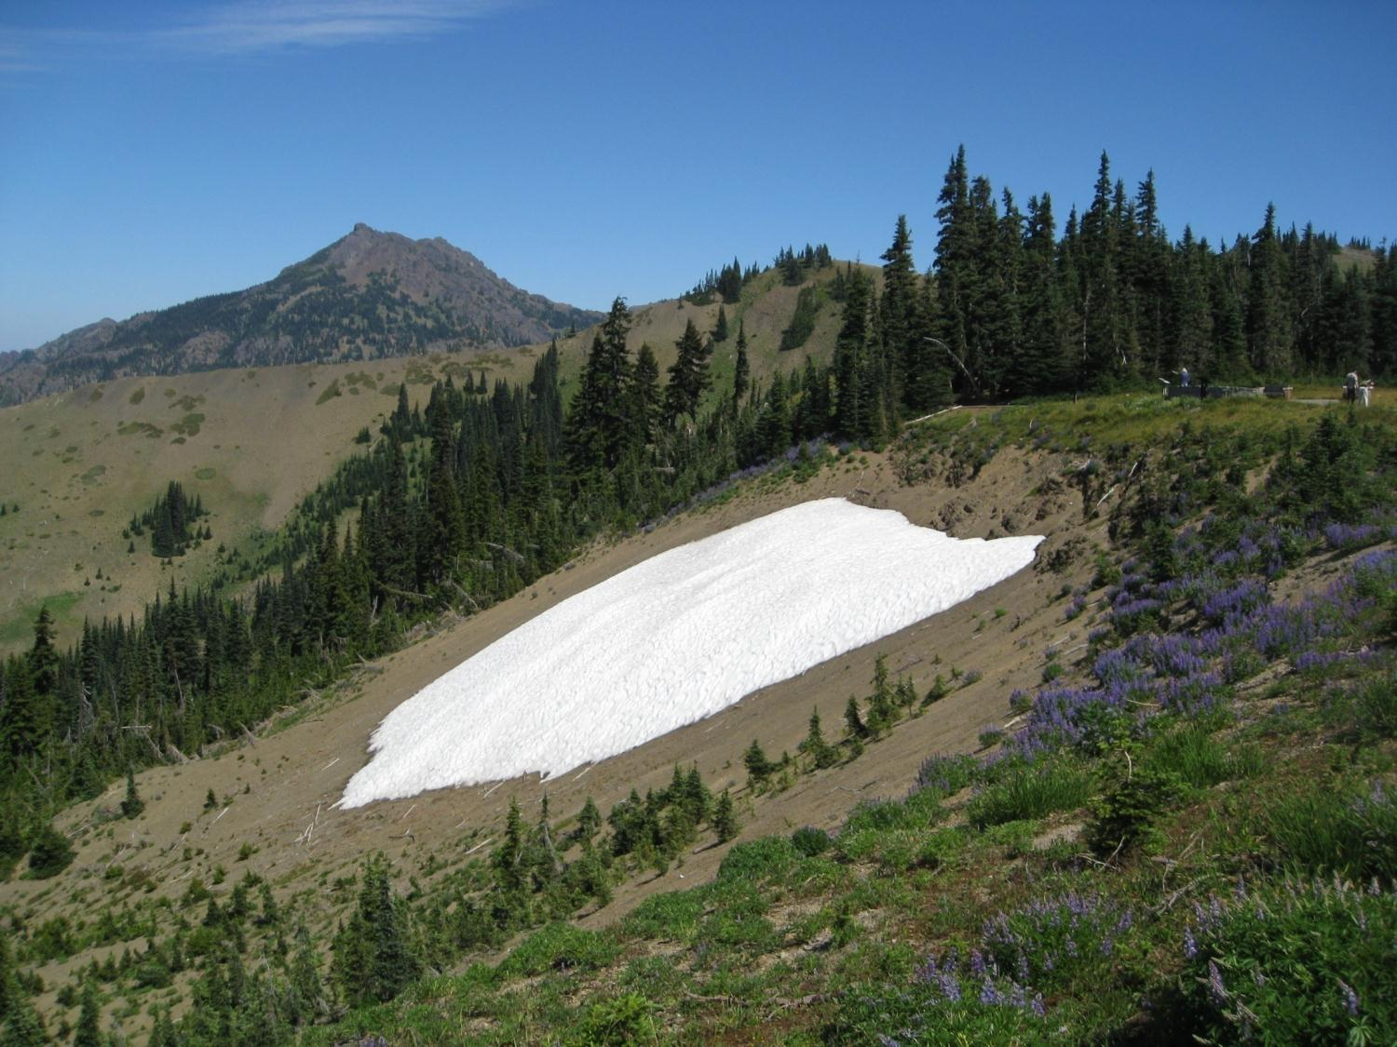
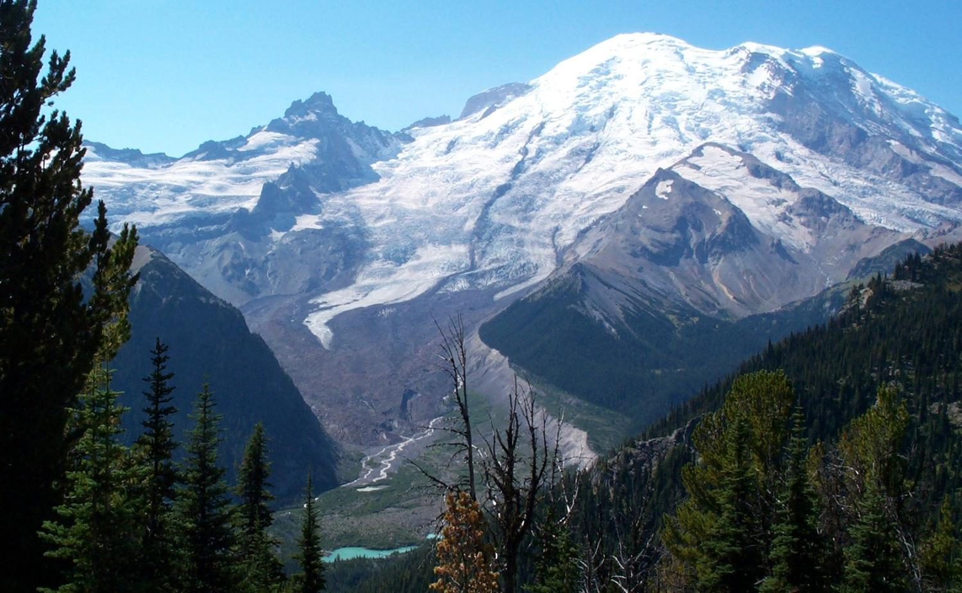
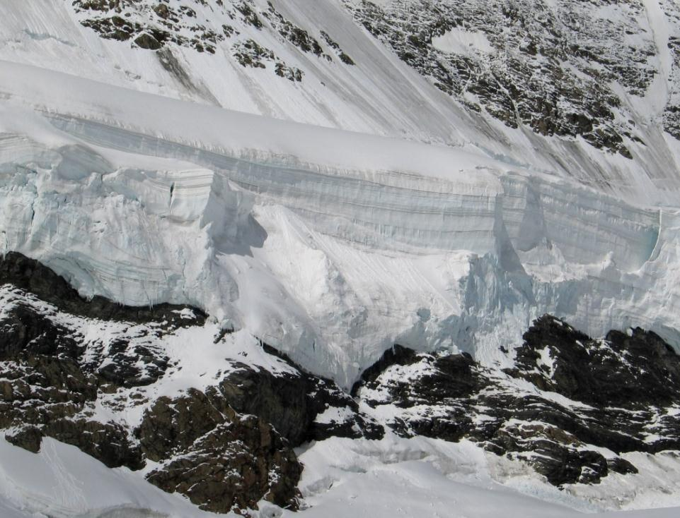
Permanent Snow and Glaciers
Some snow fields will not melt completely in summer.
Notes:
In some places, deep snow drifts blown by the wind and north-aspect providing shade results in snow fields that will not melt off in the summer and are then reburied under the next seasons snow fall. These developing snow fields can remain year after year. This snow field at Hurricane Ridge can remain virtually all summer.
When these snow fields build up year after year, the weight of the snow above compacts the layers of snow into ice. Each year’s snow forms layers that can be seen. The thickness and density of each layer tells a story of the depth and average temperatures of that year’s snowpack.
When these snow fields last long enough and compact enough to form solid ice, they become glaciers. The pressure of the ice above causes the ice below to behave almost like plastic, and the glacier begins to flow downhill under the weight of the ice above. As they flow downhill, their “tongues” reach lower elevations where the temperature is warm enough to begin melting the ice. This melt water becomes the source of many rivers in the Pacific Northwest.
Glaciers will continue to grow and flow downhill as long as more snow accumulates on top of the glacier than melts at the tongue. Glaciers recede when either temperatures rise high enough for the tongue to recede upslope, or accumulations decrease above, such that the glacier no longer have the weight to flow as far downhill.
This image shows glaciers on Mount Rainier. The tongue is located at the yellow line. The dark colors in the lower part of the glacier are the accumulation of dirt and rocks on the surface of the glacier due to landslides and erosion of the rocks the glacier is carving into. Glaciers are very important for sustain water supplies for urban communities down stream in the dry summer season.

Slide 12
The Movement of a Glacier
Crevasses
Terminal Moraine
Notes:
As snow falls and accumulates on the top of a glacier, it begins to compact and form into ice. This ice will begin moving down slope, under the enormous pressure of the accumulating ice above. As the ice pushes down on the rocky slopes of the mountain, it will pluck pieces of rock off the mountain and imbed those rocks in the ice. The glacier then transports those rocks down the slope. Where the glacier reaches elevations of warmer temperatures, it melts faster and the ice thins out. Without the transport mechanism, the rocks are deposited at the tongue of the glacier in the terminal moraine. A moraine is just a hill of glacial sediments and rocks deposited at the end of sides of a glacier. The pressure and friction of the rocks and the ice often break these pieces into tiny dust-sized pieces called glacial flour or till. Often, rivers originating as melt water from glaciers are a cloudy blue-gray color due to carrying large quantities of this glacial flour.

Slide 13
This project was made possible in part by a grant from
Washington’s National Park Fund.

