Slide 1
The Effects of the Elwha River Dams on Sediment Transport

Slide 2
Historic Conditions of the Elwha River
Notes:
This modern photo located within Olympic National Park is above Lake Mills and is pretty much pristine wilderness with little impact by human activities. This is what the Elwha has been like for thousands of years.

Slide 3
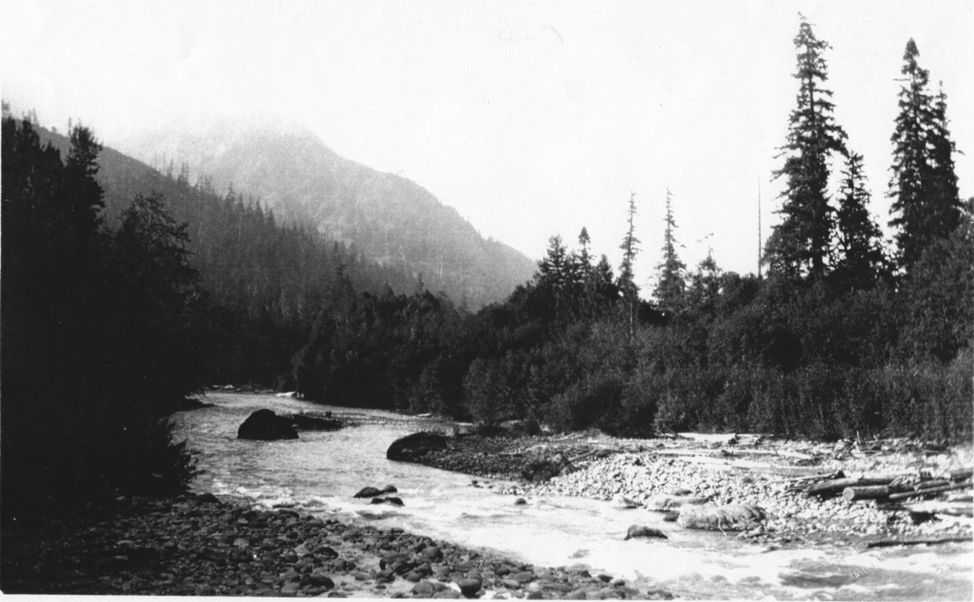
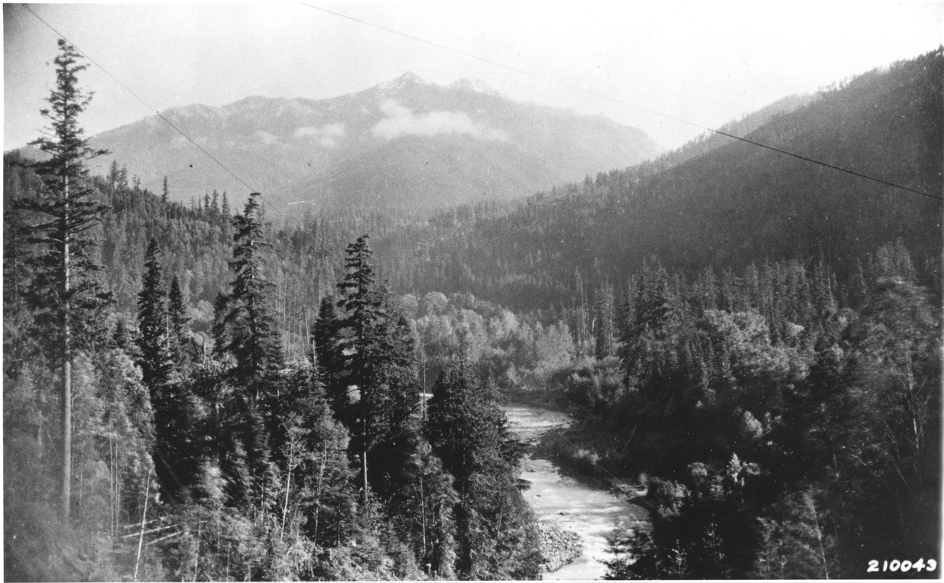
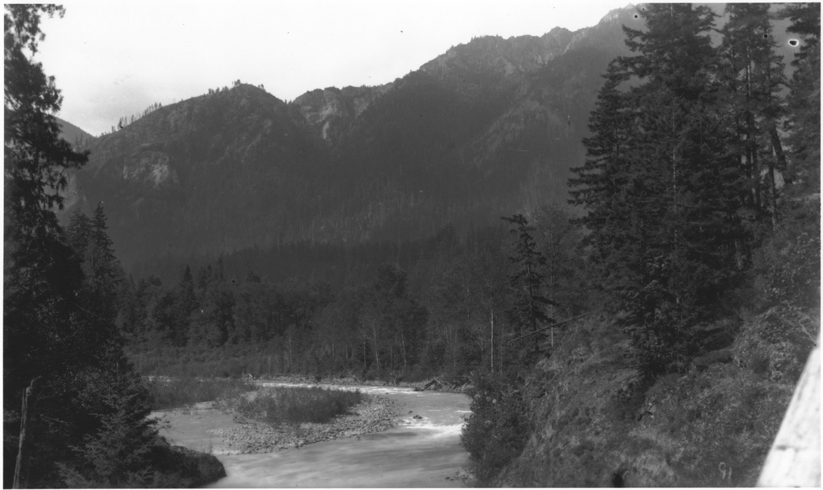
The Area Before the Dams
Notes:
These are all images taken in areas that are now under the Lake Mills and Lake Aldwell reservoirs.

Slide 4
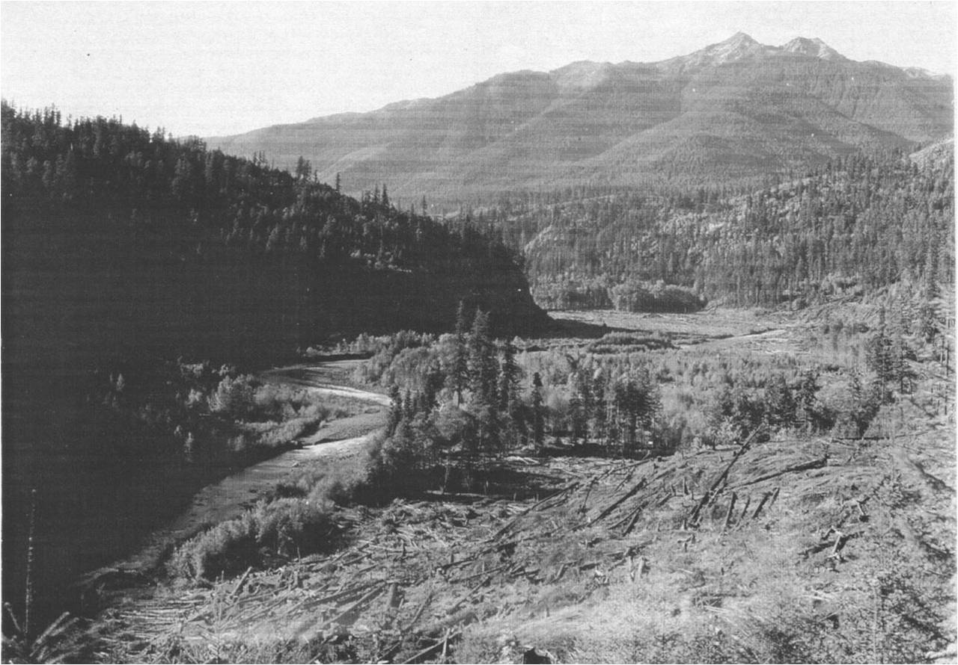
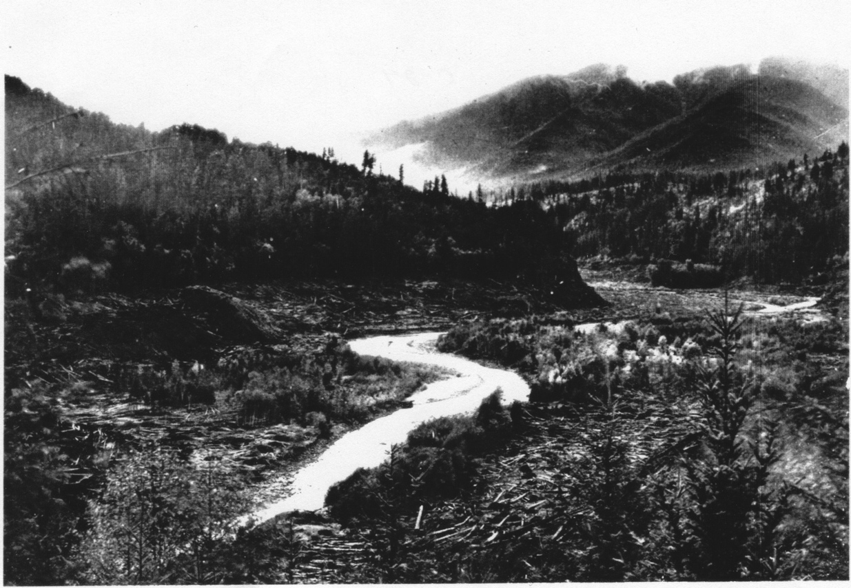
Logging Lake Mills Basin Before Dams
Notes:
Just before the dams were completed, the area that was to be flooded, was clear-cut to take out valuable timber. But, it was quick operation to take just the best trees, so there is a lot of wood at the bottom of the lakes, buried in silt.

Slide 5
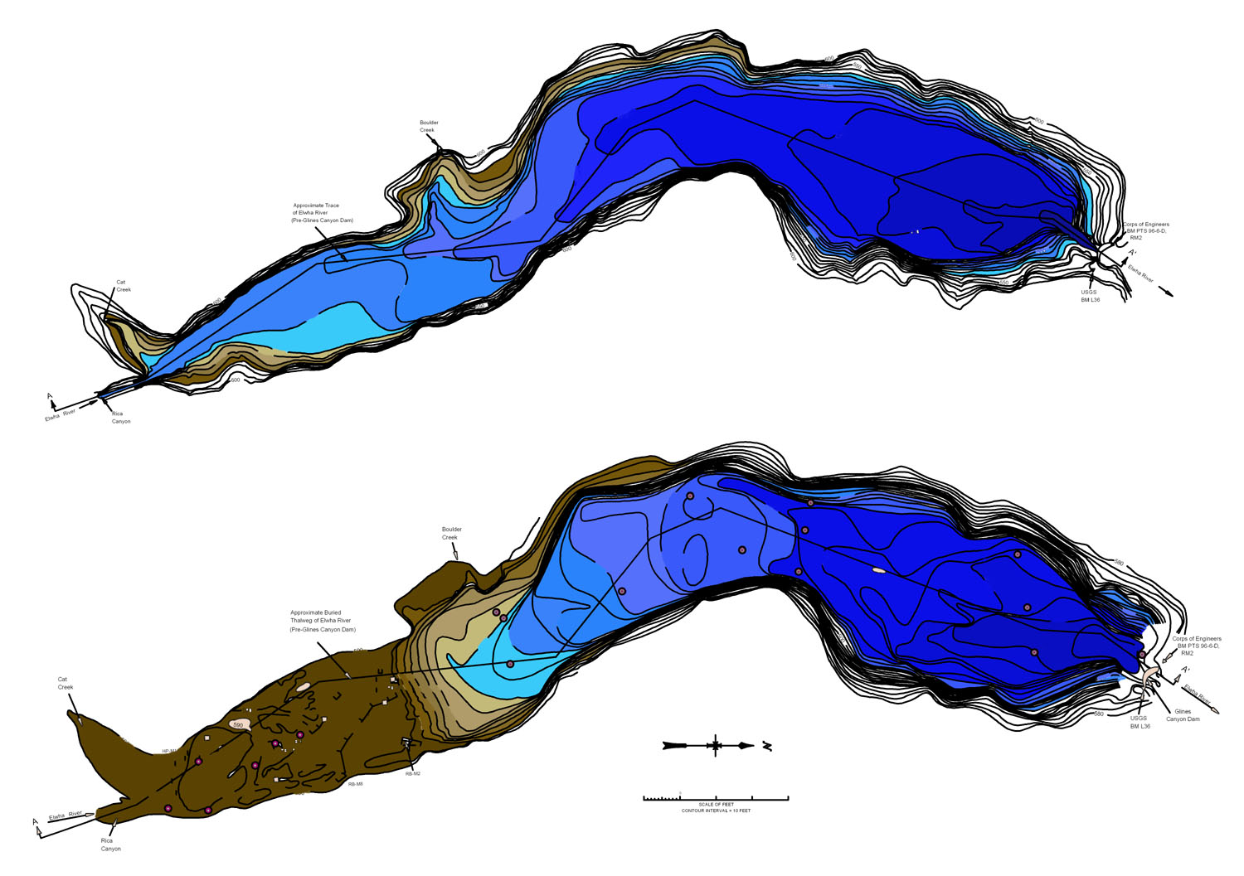
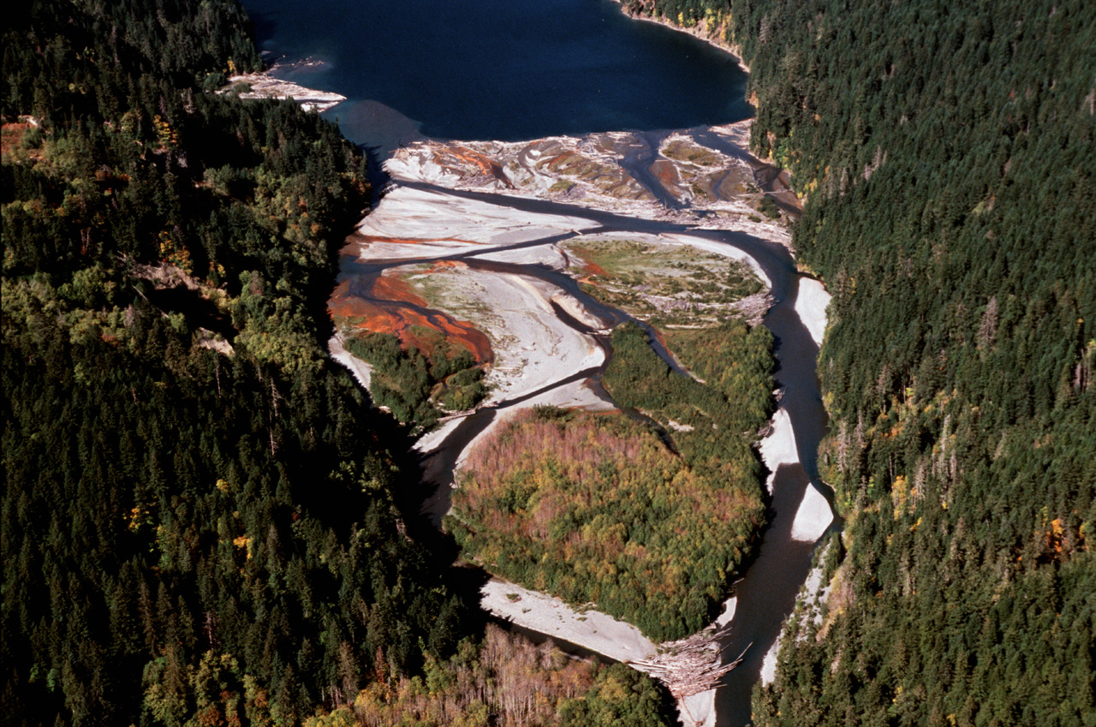
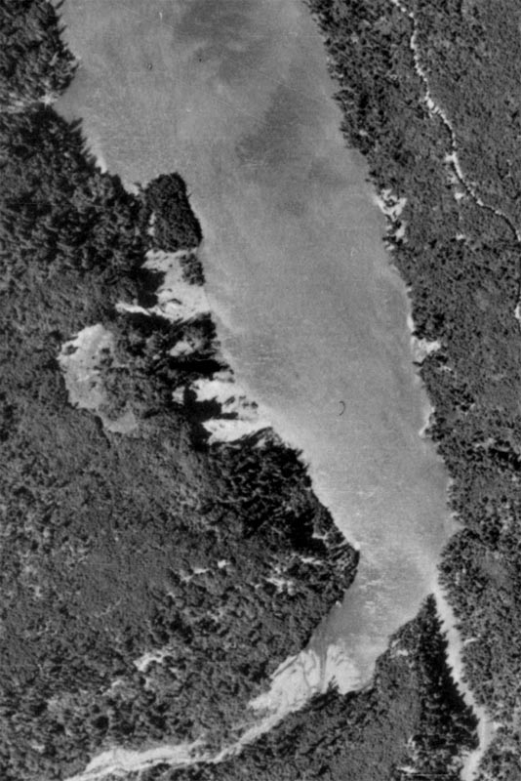
Sediment Loads in the Reservoirs
Upper Lake Mills Delta 1939
Upper Lake Mills Delta 2011
Notes:
The first image shows Lake Mills shortly after it was filled. The second image shows 70+ years of sediment that have accumulated in Lake Mills since. The third image gives a top-down sense for how much of the reservoir has filled with sediment over the year

Slide 6
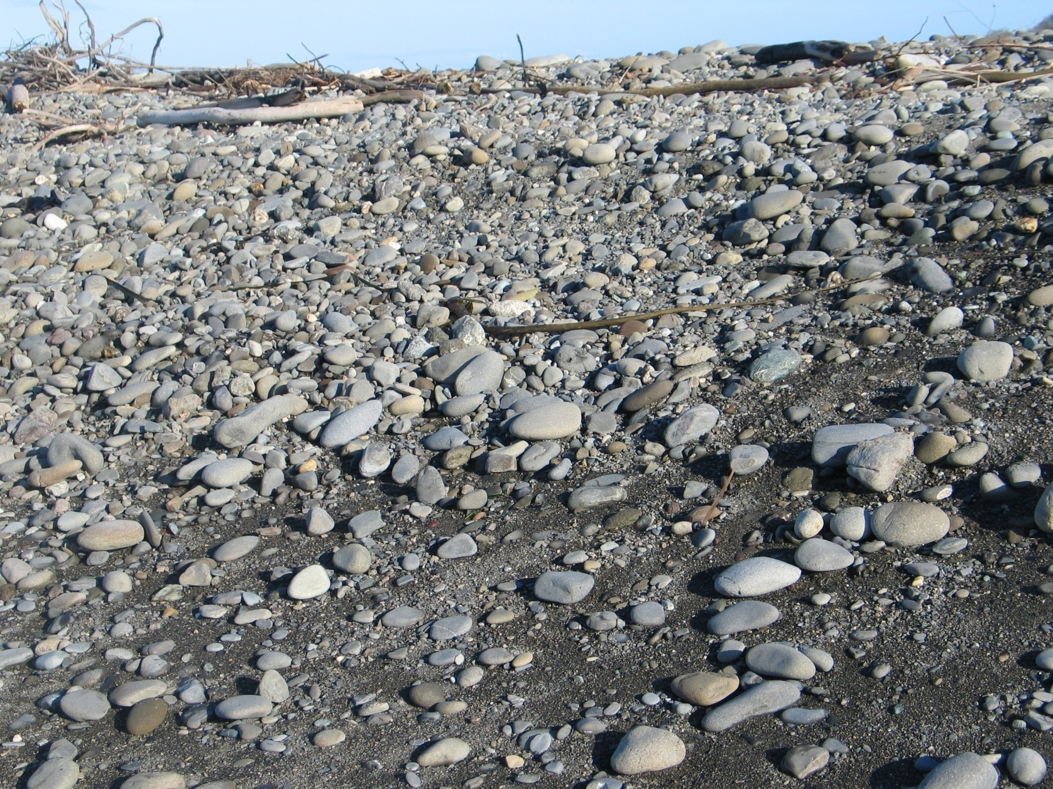
Elwha Delta Plain and the Mouth
Notes:
The Elwha Delta plain is the entire area that has been built up for thousands of years by deposition of Elwha river sediment. However, levees built to protect the Elwha Klallam community have restricted the river to flowing into the western part of the plain. At the mouth, the active delta has eroded badly due to a lack of sediment from the dams.
Image three shows the beaches at the mouth of the Elwha river today What were once sandy beachrs are now gravel beds and wave action is eroding the delta back.

Slide 7
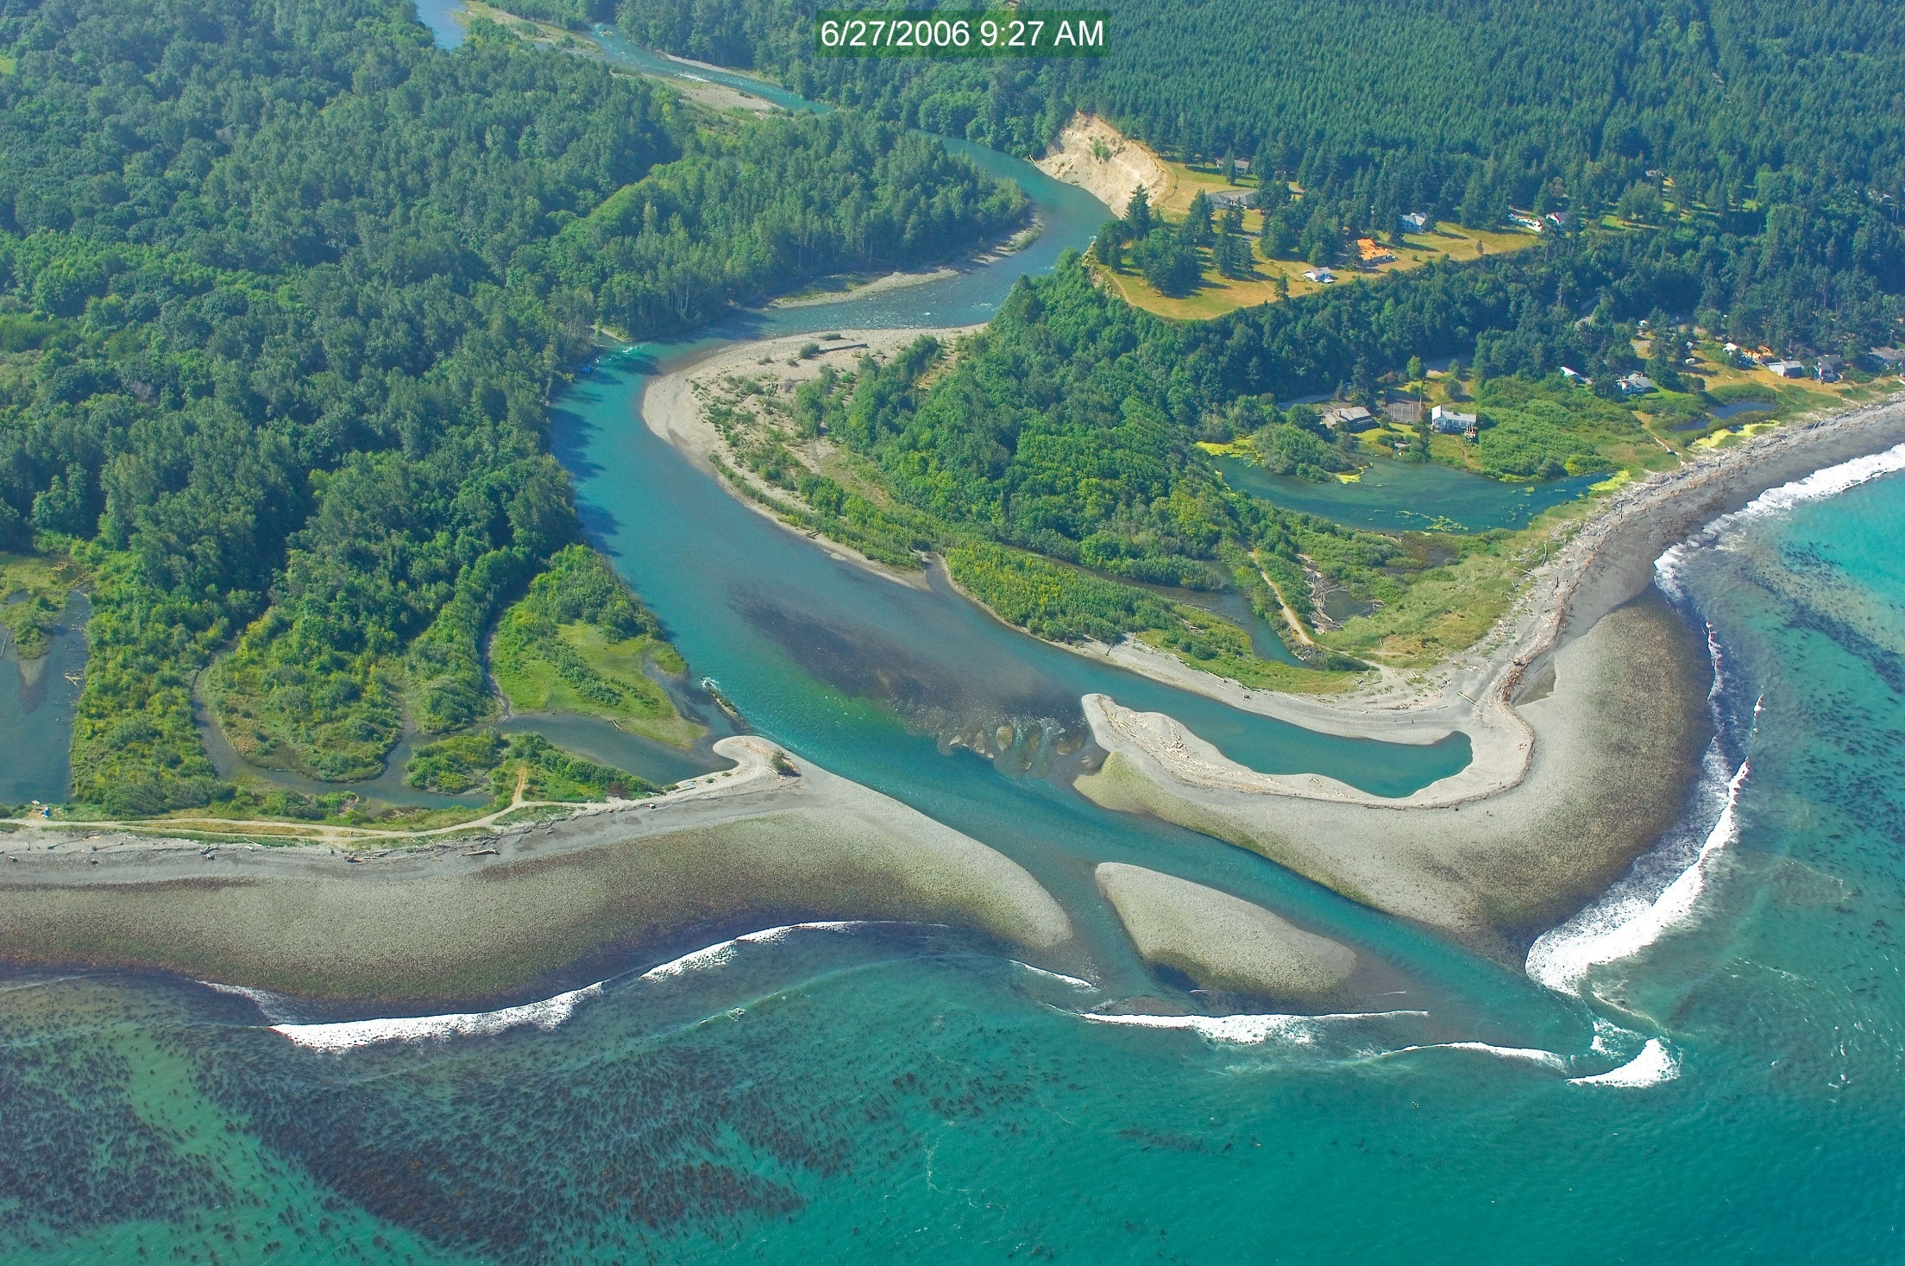
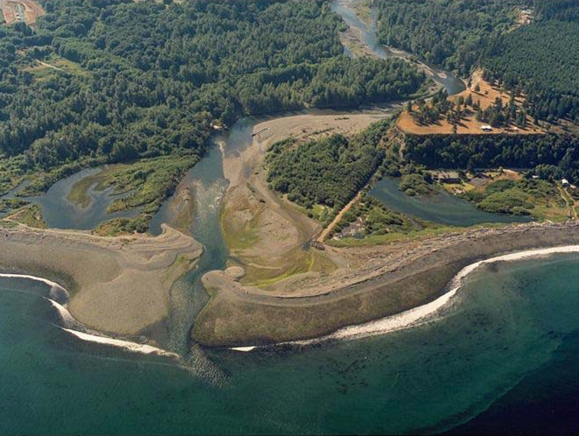
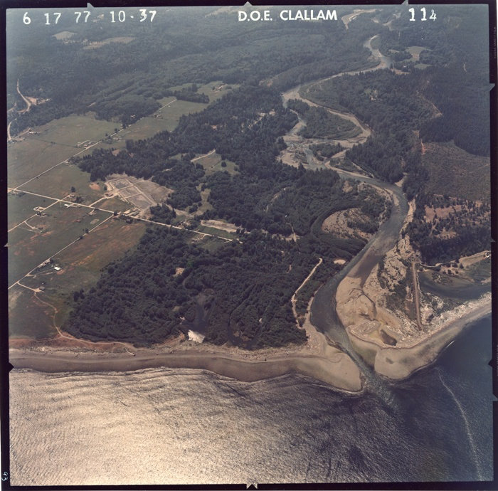
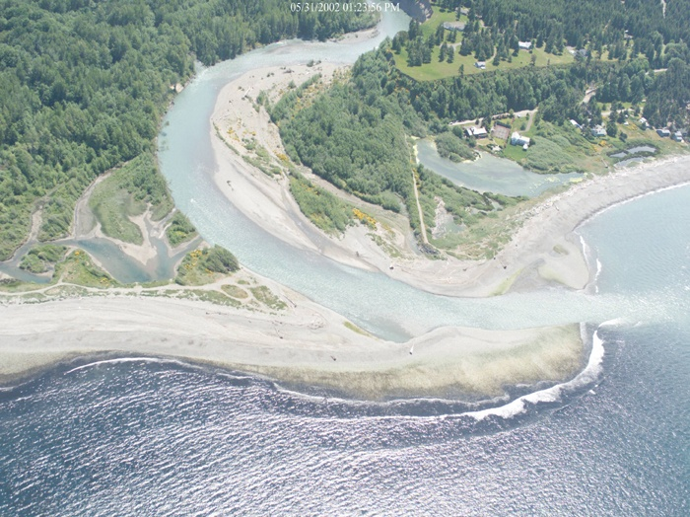
Mouth of the Elwha River Over the Years
1992
Notes:
These are a series of images showing how the Elwha river delta has changed over the years. The delta has turned from mostly sandy beaches to gravel beds. The once abundance shellfish have all but disappeared. This image is at low tide, nearly the entire delta and beach would be underwater during high tide.

Slide 8
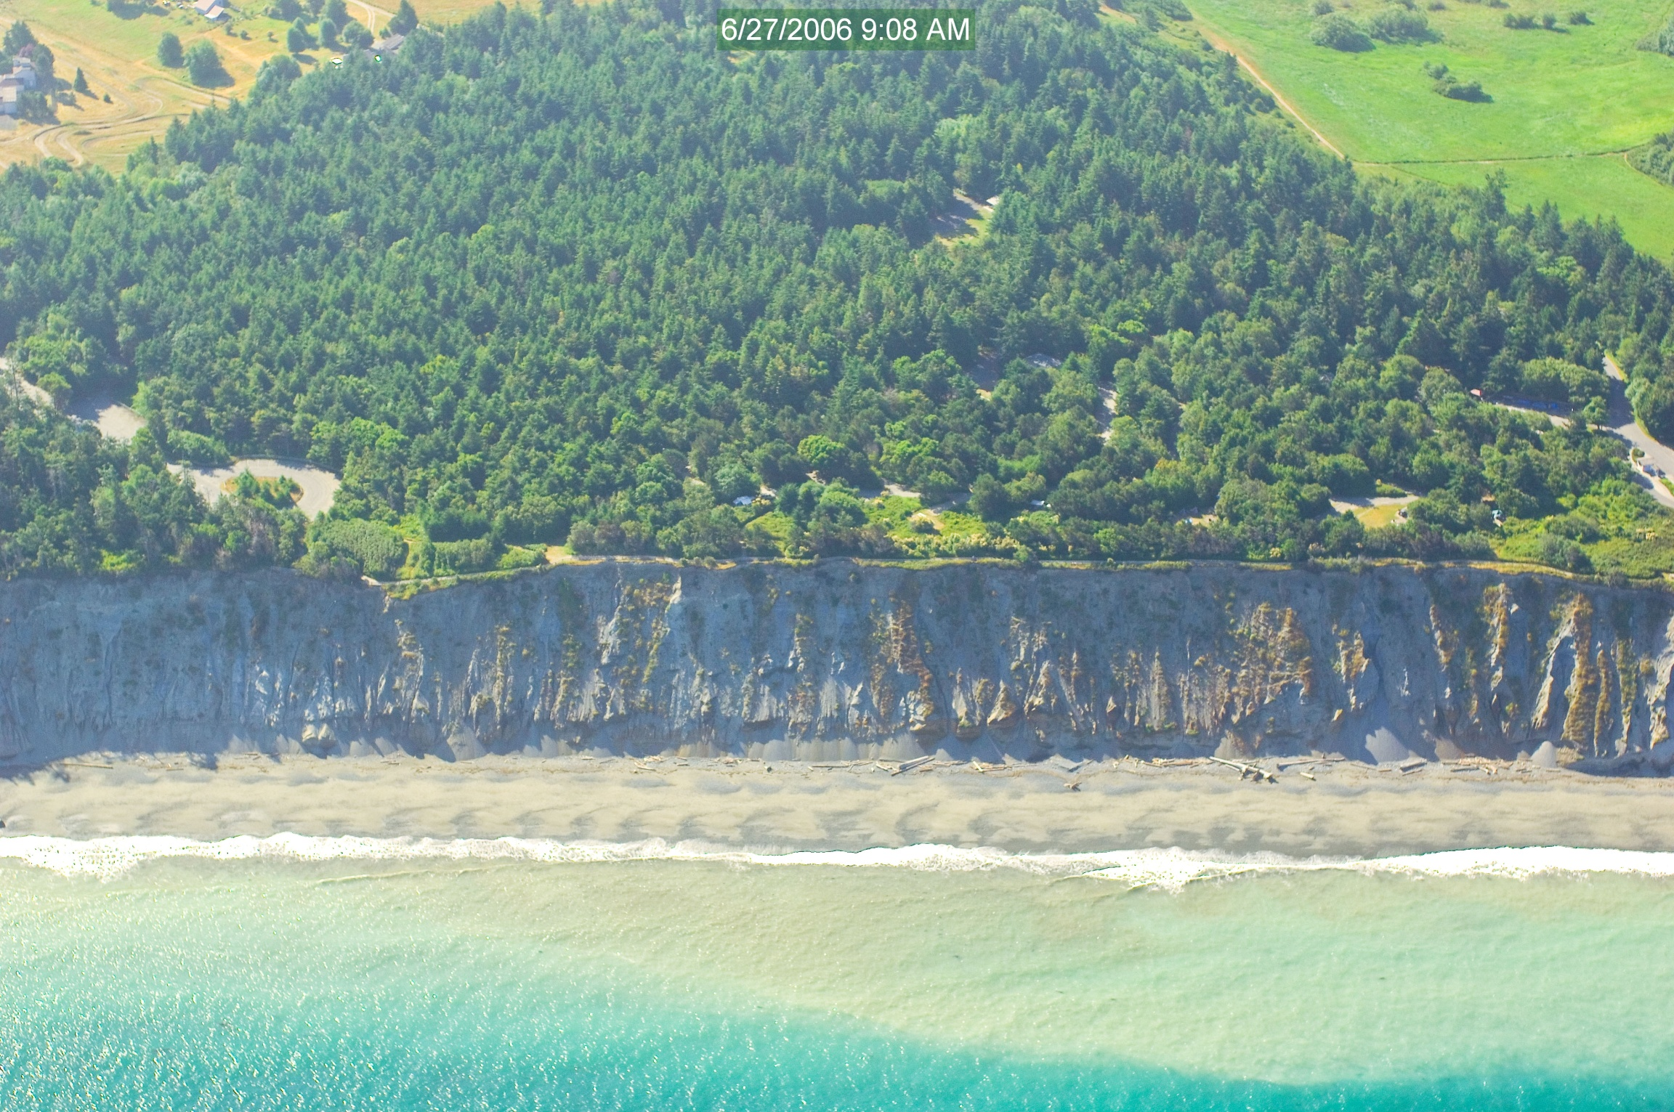
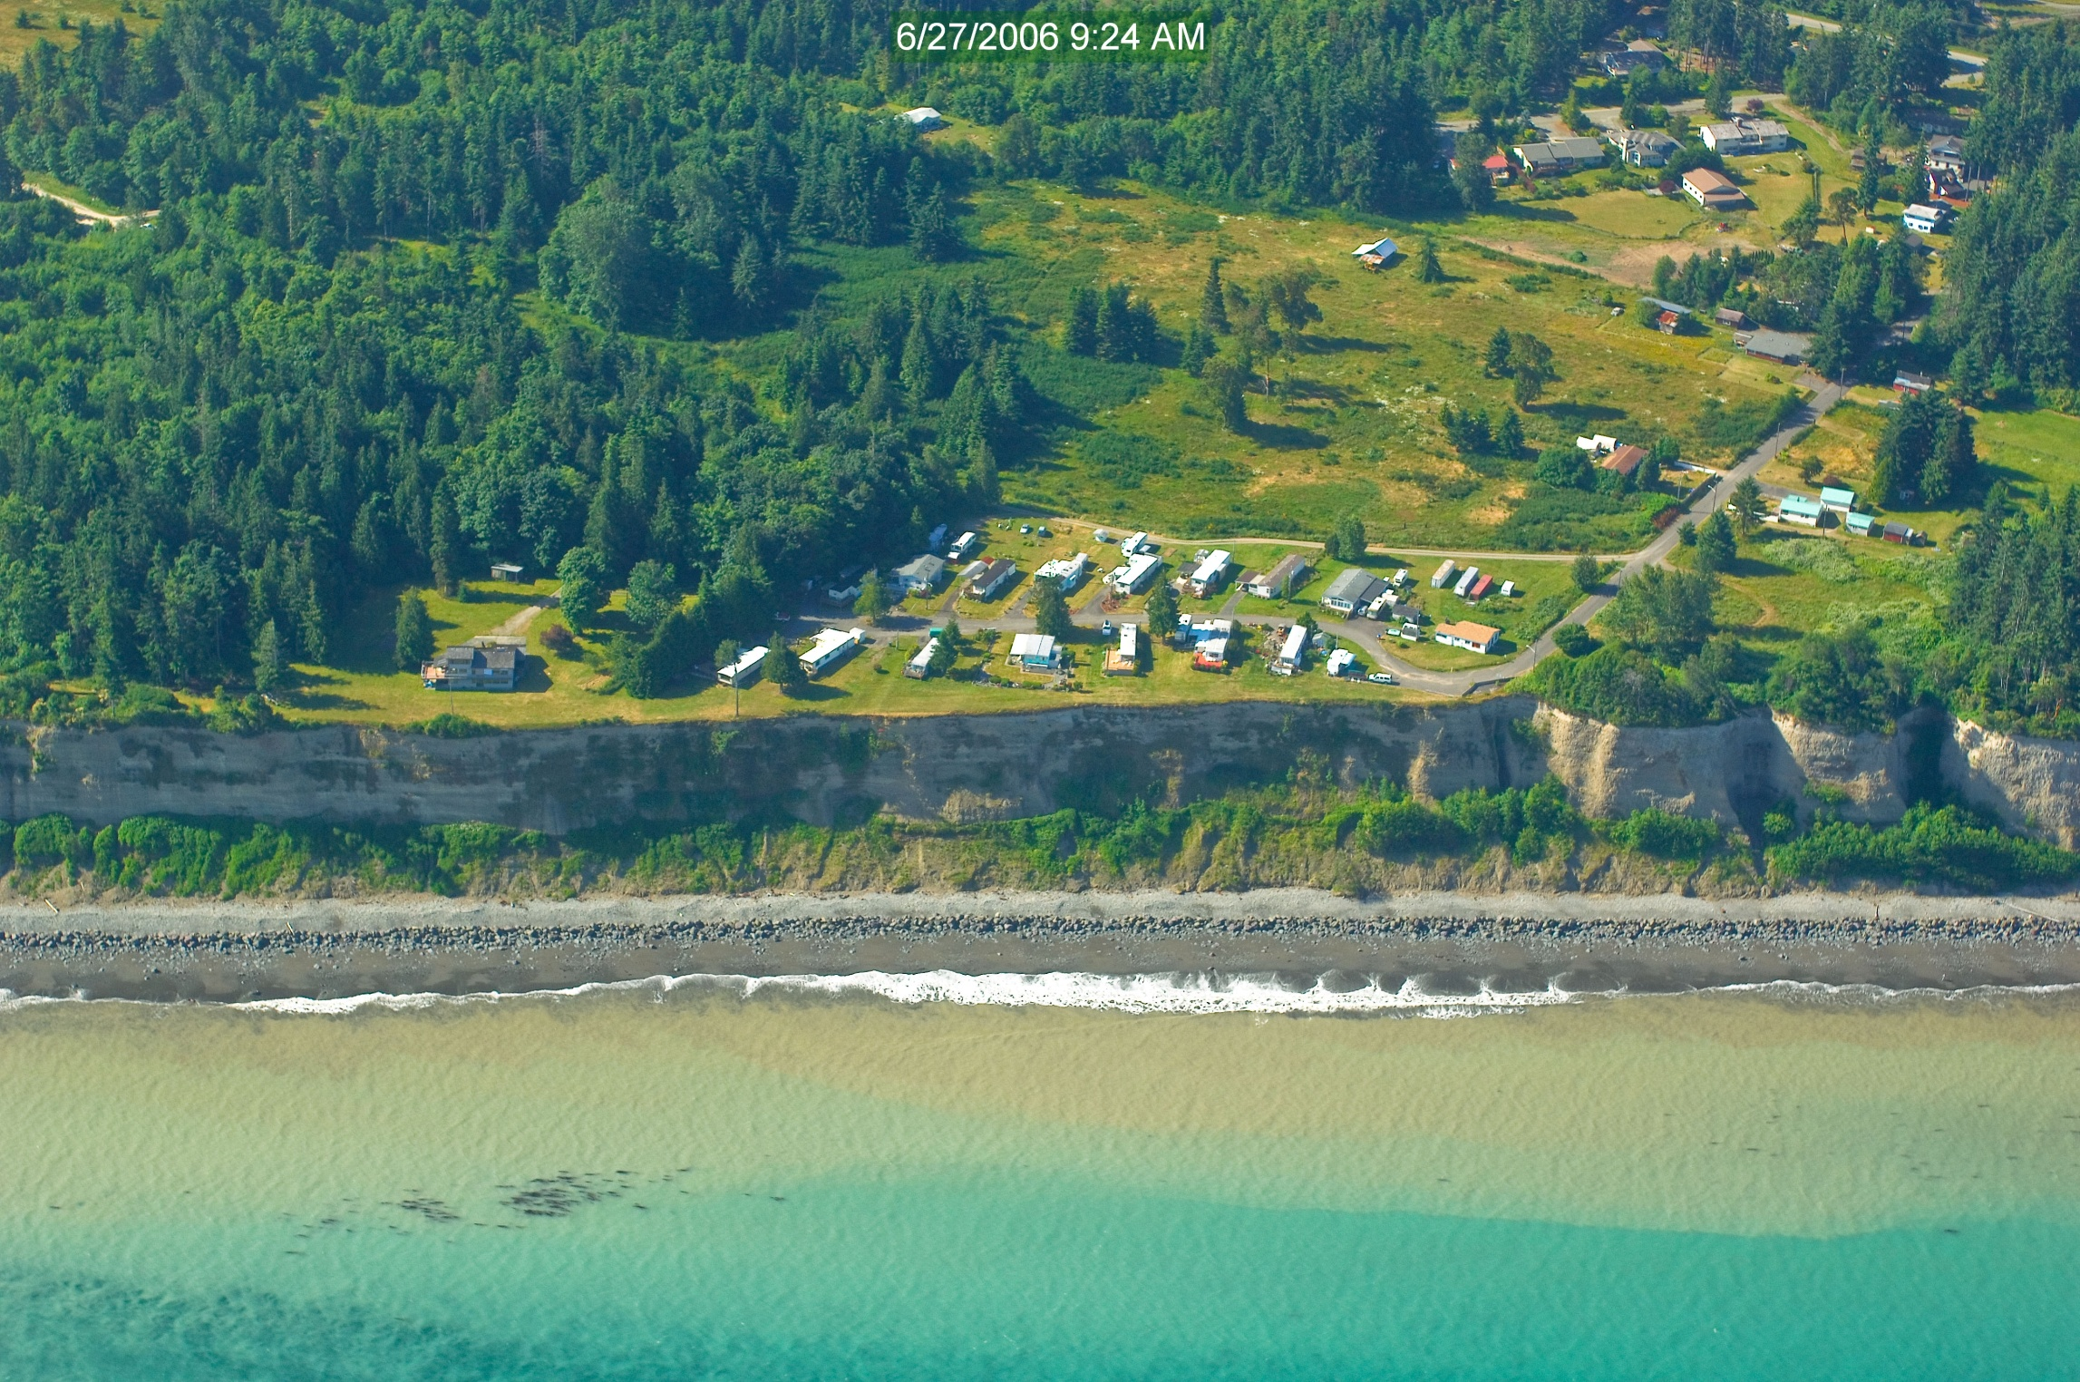
Other Local Impacts on Sediment
Notes:
In addition to the sediment that is trapped in Lake Mills, there was another even larger impact on the sediment transport in the Strait of Juan de Fuca. That is the armoring of the coastal bluffs in west Port Angeles. This rip-rap prevents waves from eating into the bluffs and secures sediment on the shoreline. This has vastly reduced the sediment available to accumulate on Ediz Hook. Notice the collapsed sections of the bluffs are consistent in shape and thickness across the entire base and have vegetation growing on them? That indicates they are stable and not being eroded by the wave action. Otherwise the bluffs would drop directly down to the beach and the collapsed bluff sections would be sporadically spaced and would only last until the next storm washes them out to sea.
The contrast can be seen on the next image of bluffs at the Dungeness NWR, where the non-armored bluffs have eroded to the base. In addition, the increased sediment load results in wider beaches.

Slide 9
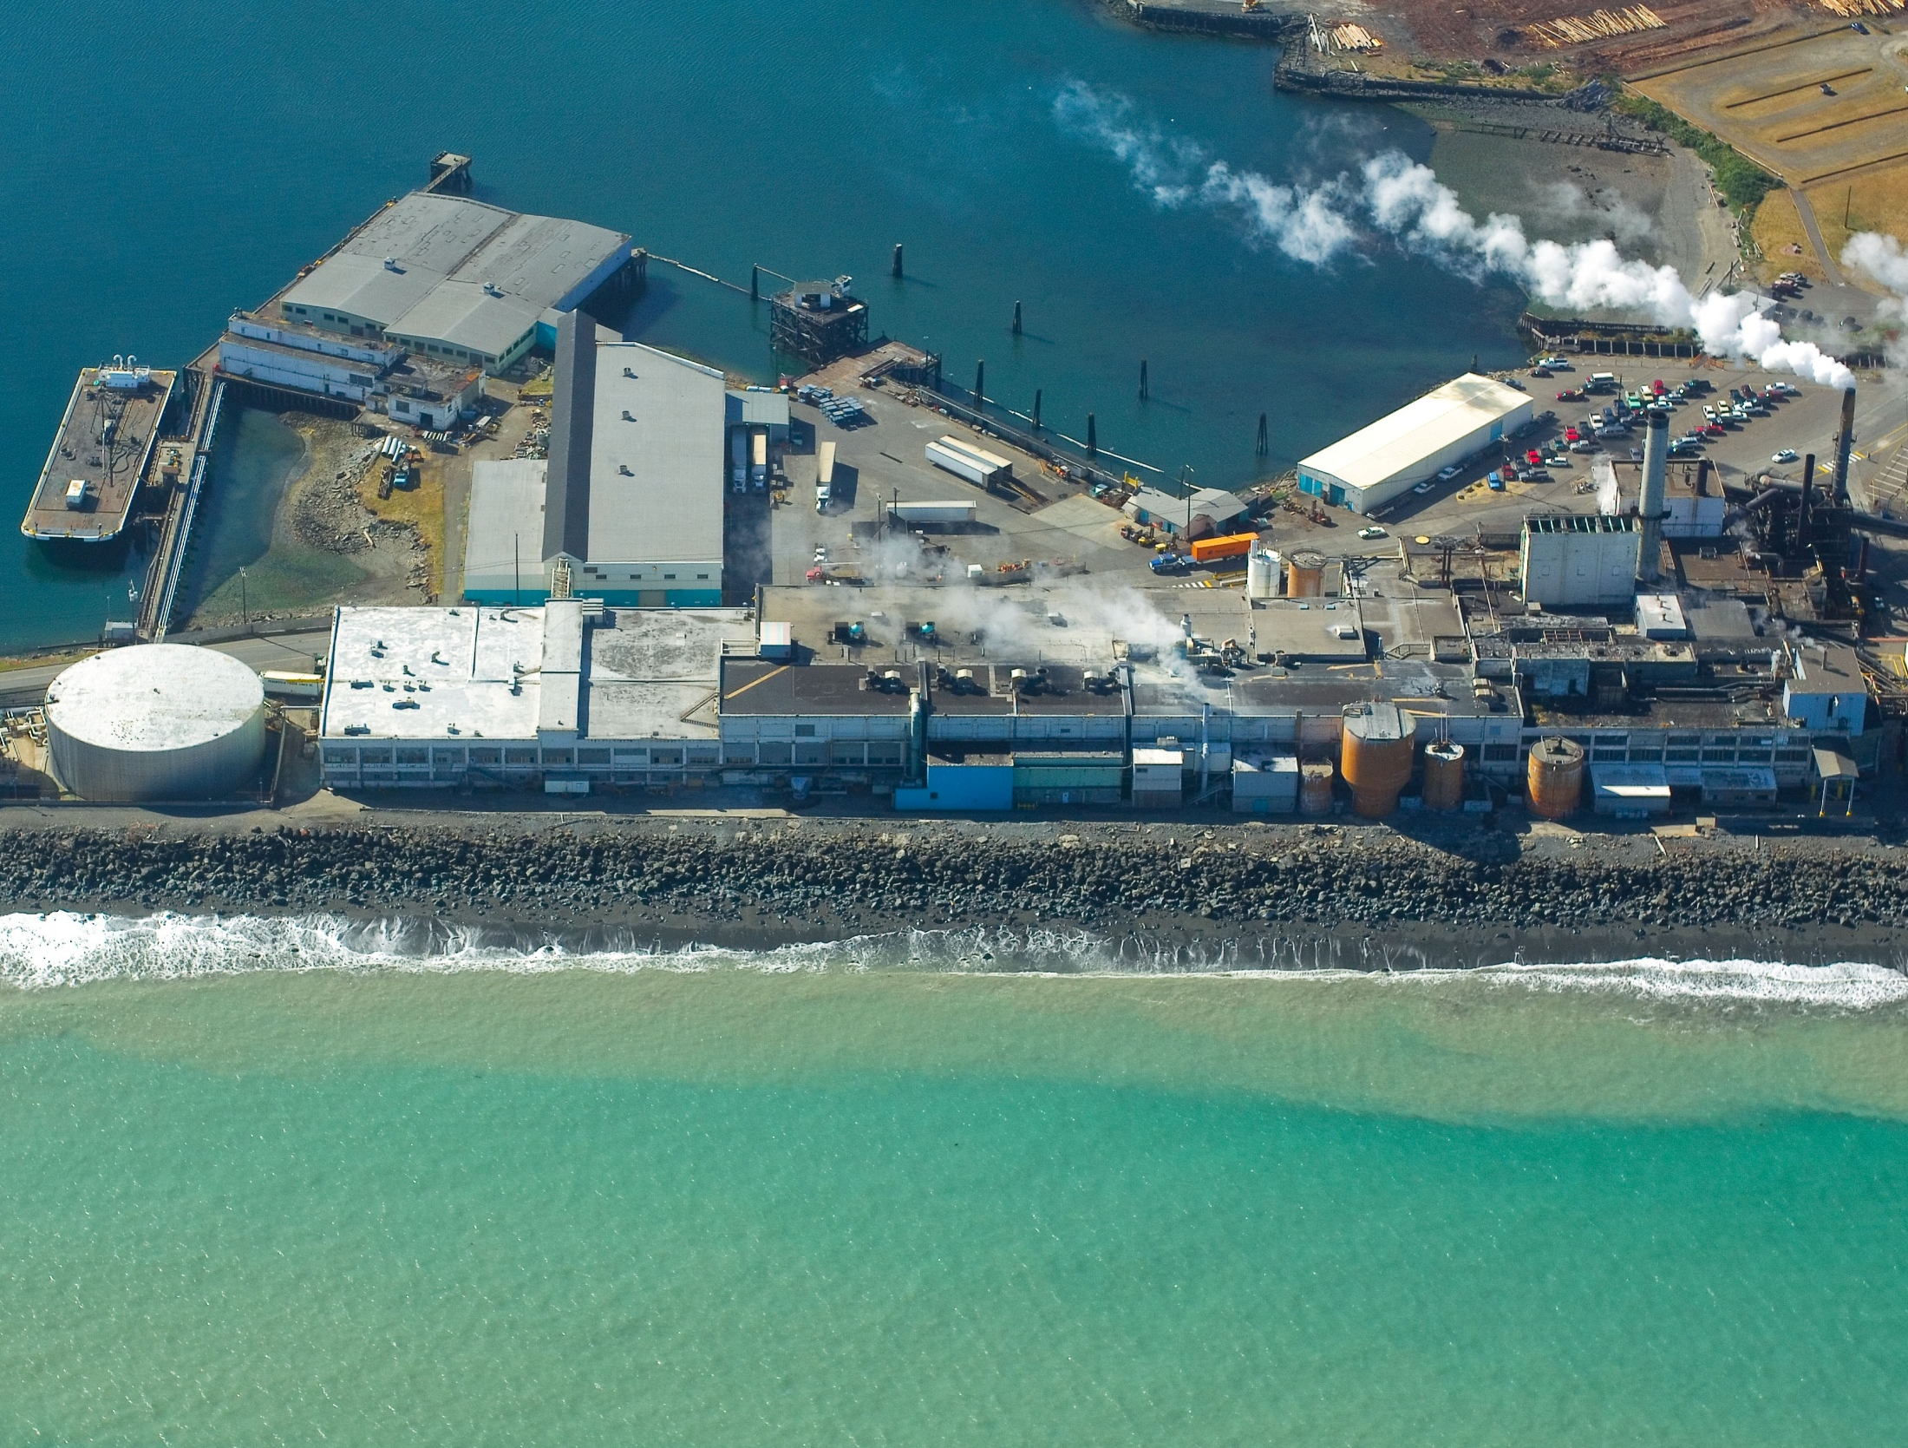
Impacts of Reduced Sediment on Ediz Hook
Notes:
The lack of sediment from the Elwha River (20%) and the armoring of the nearby bluffs (80%) have caused Ediz Hook to erode badly. In order to prevent it from being completely washed away, they have armored its shores with rip-rap. Ediz Hook is very important, as it protects Port Angeles Harbor from high waves, erosion of the harbor shores, and sedimentation of the shipping channels.
Notice the silt moving offshore. It has difficulty accumulating on the beaches because the rip-rap deflects it and it continues downcurrent and out into deeper water.
The second image shows the end of Ediz Hook. It is no longer growing, but deflected sediment continues to move out into deeper water where it is deposited on the sea floor.

Slide 10
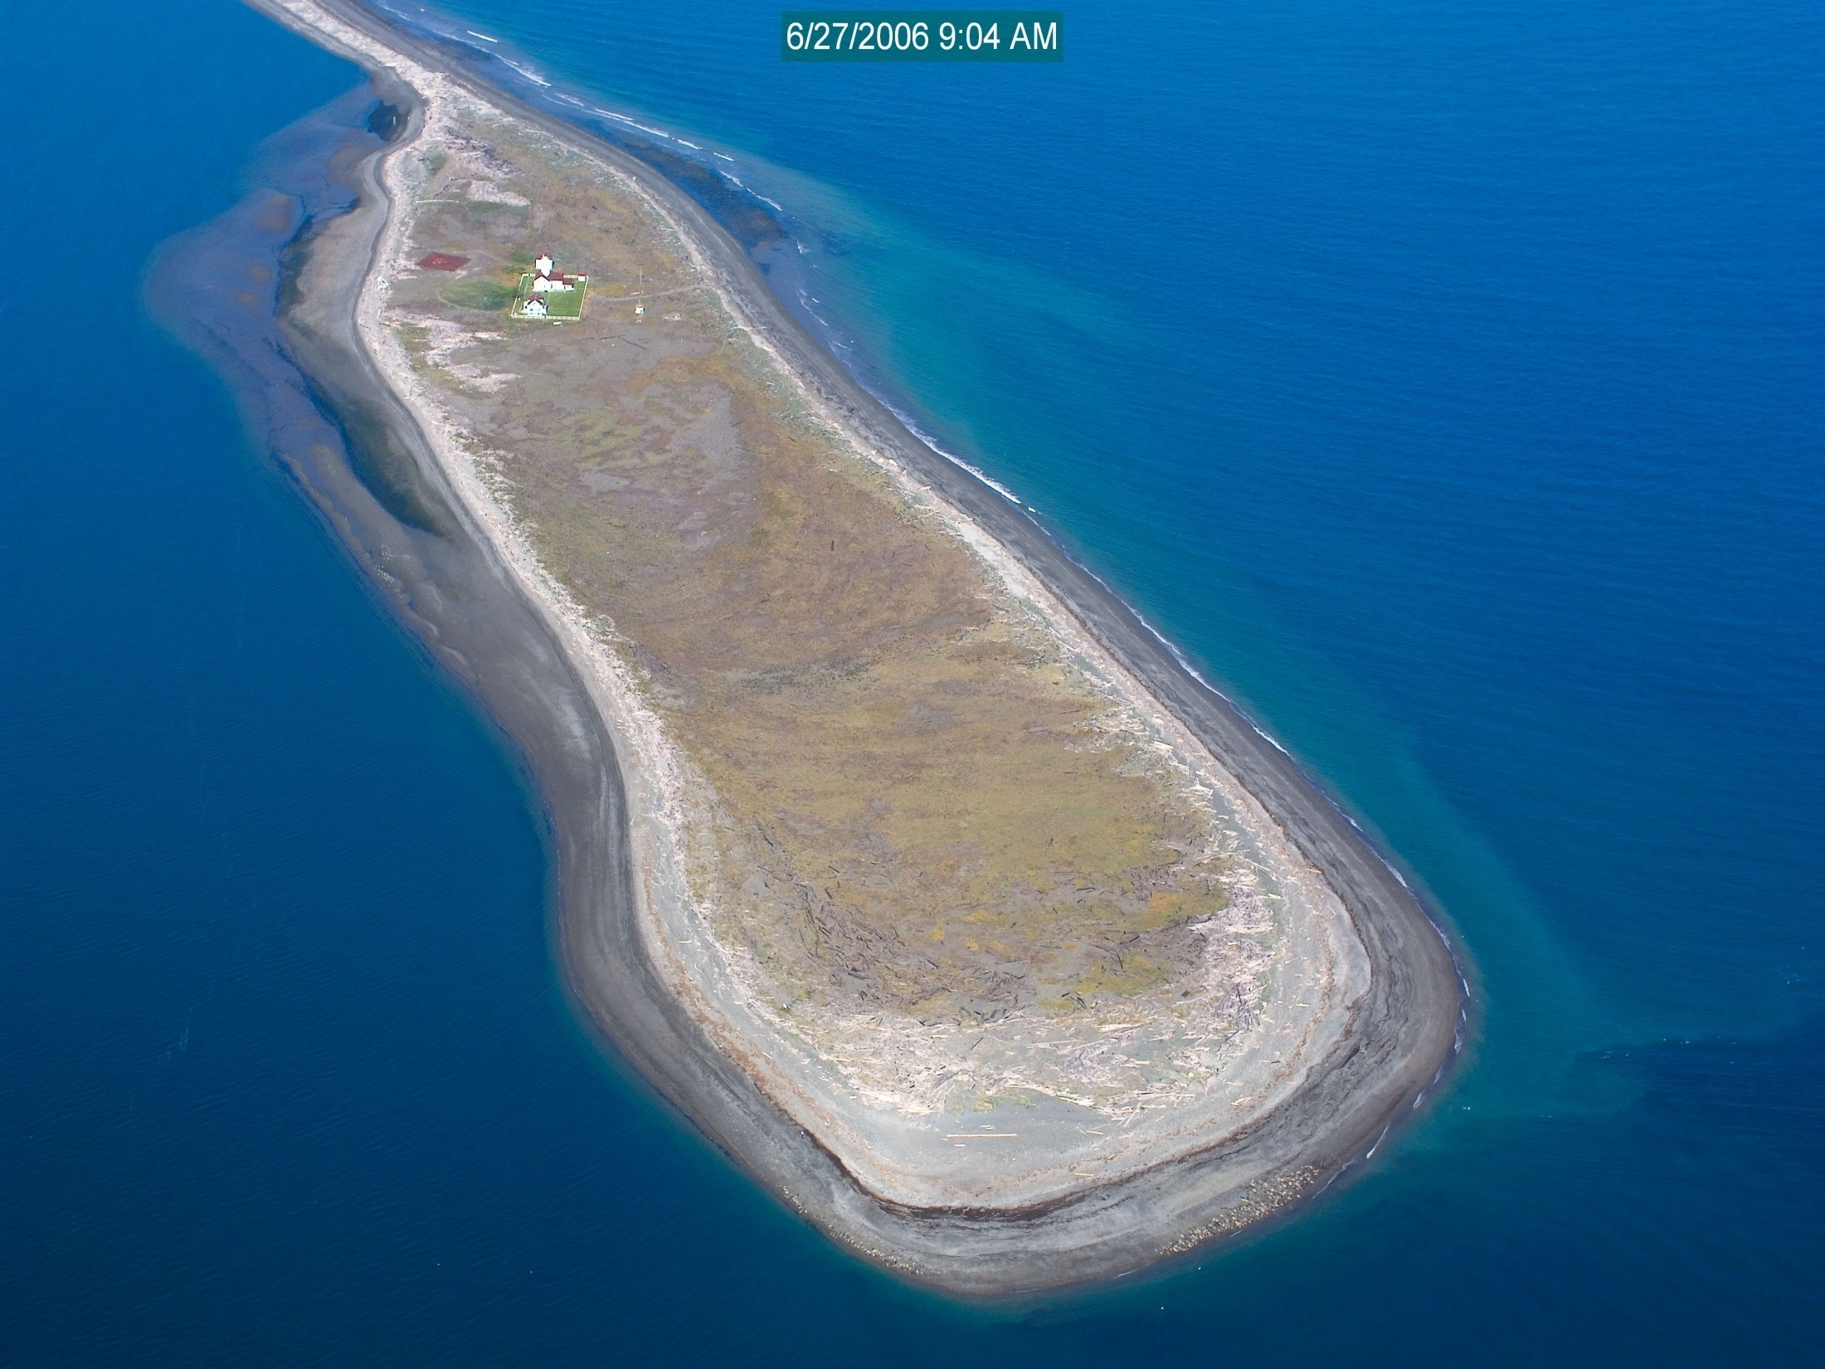
Dungeness Spit Keeps Growing!
Growth Since 1857
Notes:
When the lighthouse on the Dungeness Spit was built in 1857, it was built near the end of the spit to alert ships to the risk of beaching themselves. By 2008, however, the lighthouse is now nearly 3000 feet away from the end of the spit. That is because the spit keeps growing some 15-30 feet per year. This is what happens when sediment is free to move. In this case, it is fed by erosion of the nearby unarmored bluffs and from Dungeness River sediments.

Slide 11
This project was made possible in part by a grant from
Washington’s National Park Fund.

