Slide 1
Effects of the Elwha River Dams

Slide 2
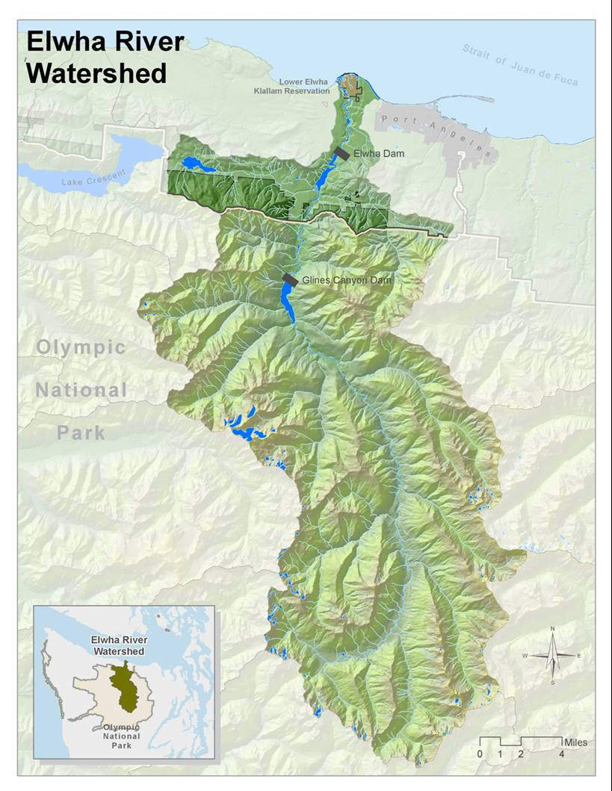
Largest Watershed
in the Park
Covers almost 20% of
Olympic National Park
Notes:
The Elwha River watershed is the largest on the Olympic Peninsula, containing over 70 miles of pristine river habitat for salmon. It once had runs estimated at approximately 400,000 adult salmon returning to the river.

Slide 3
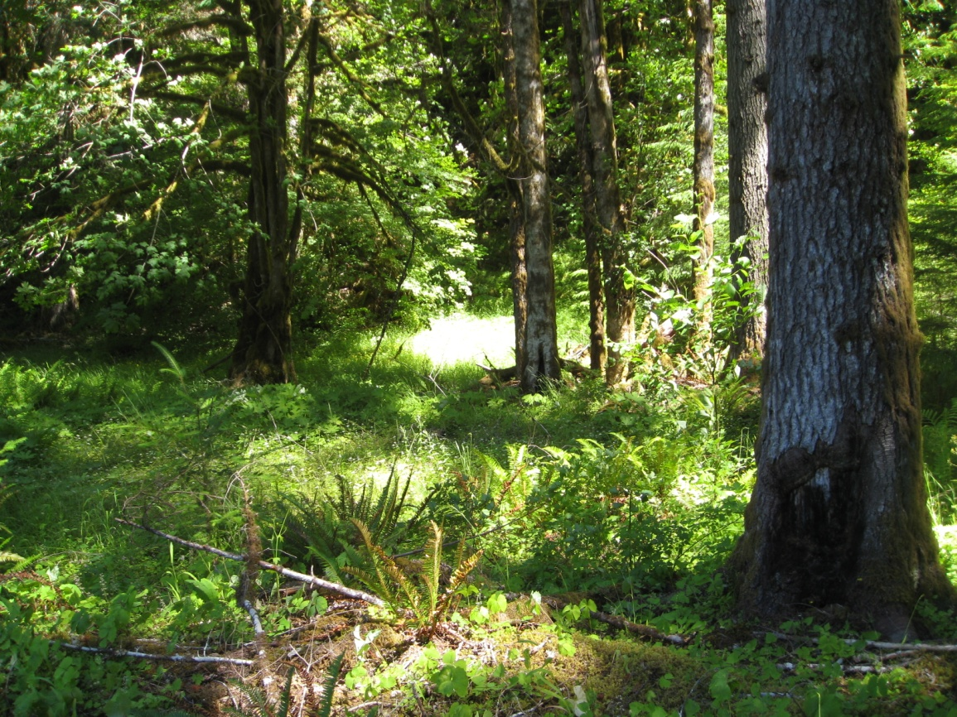
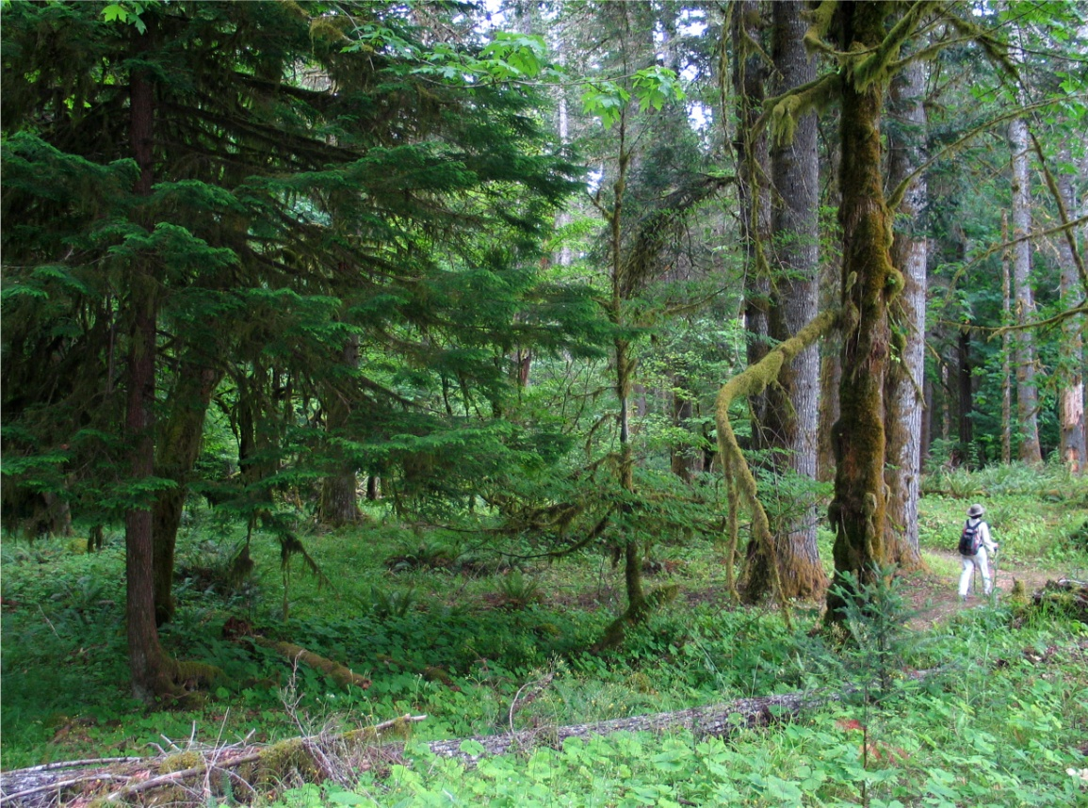
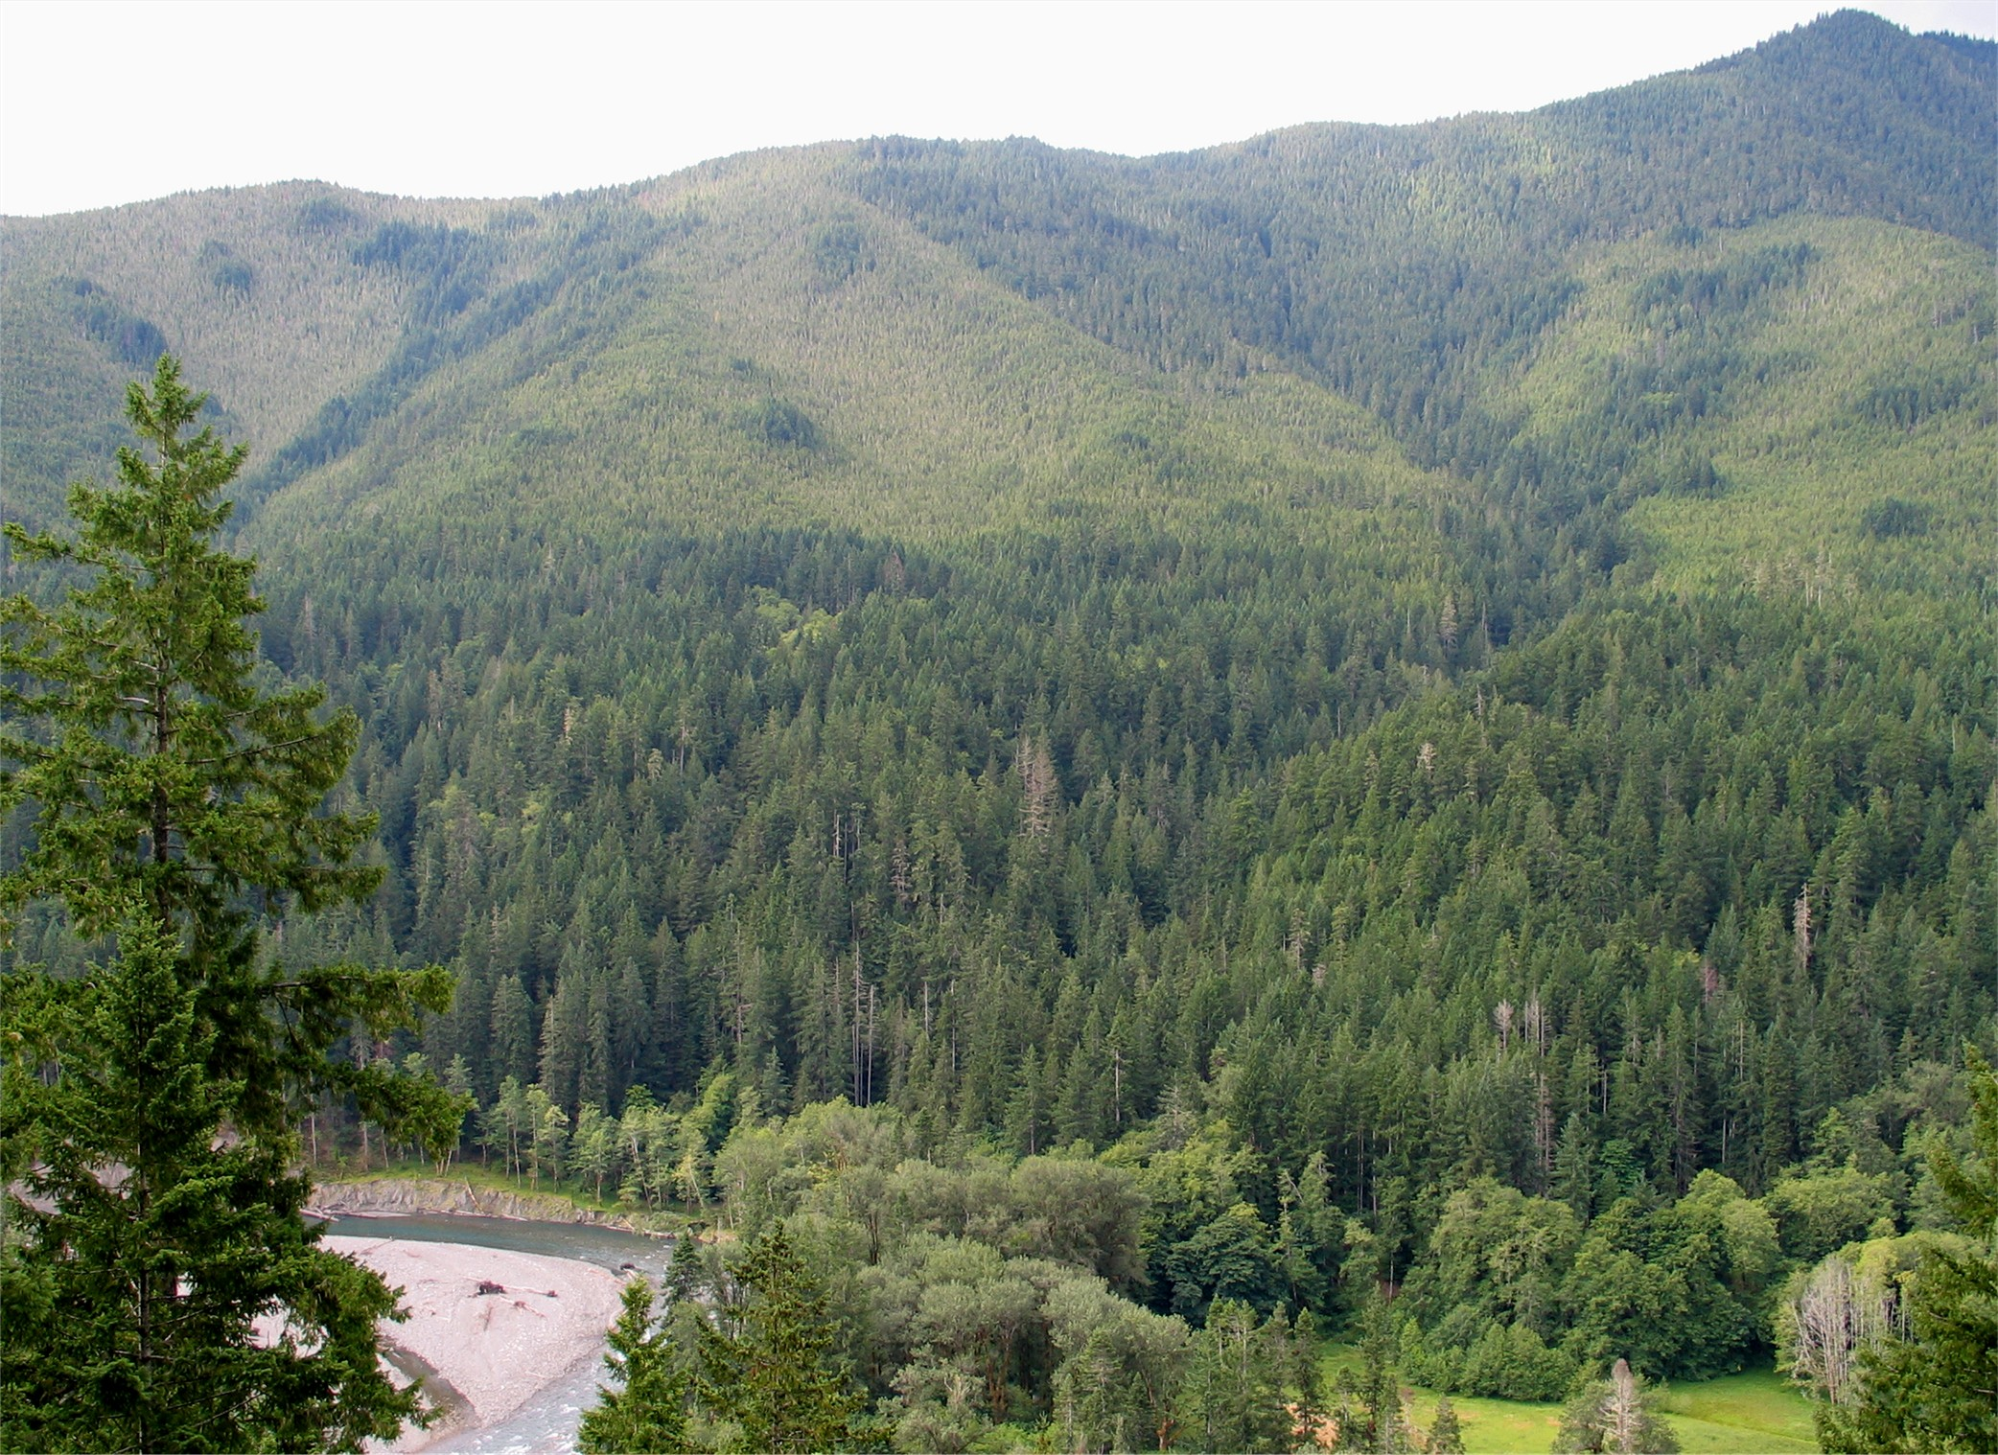
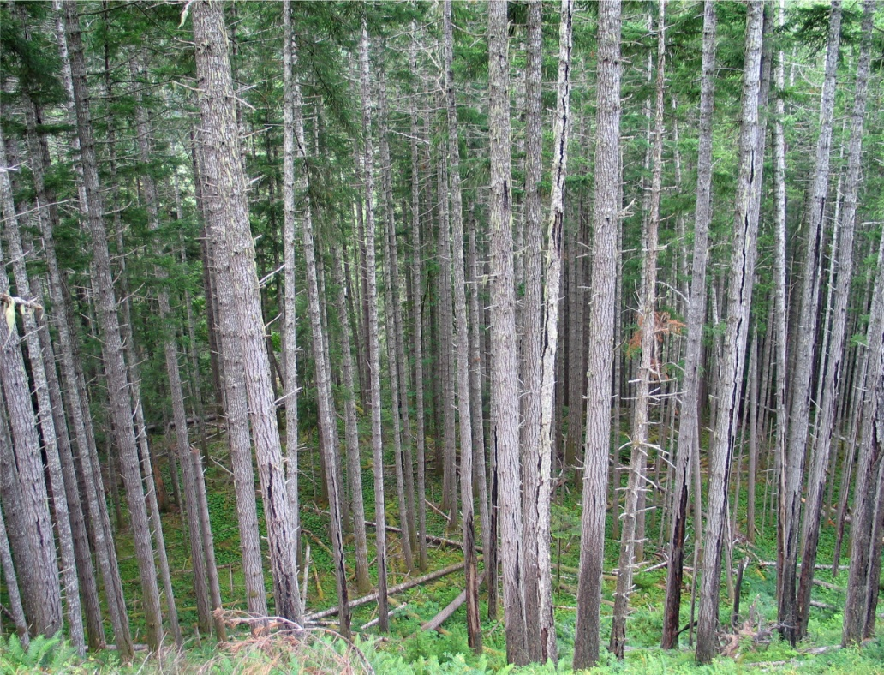
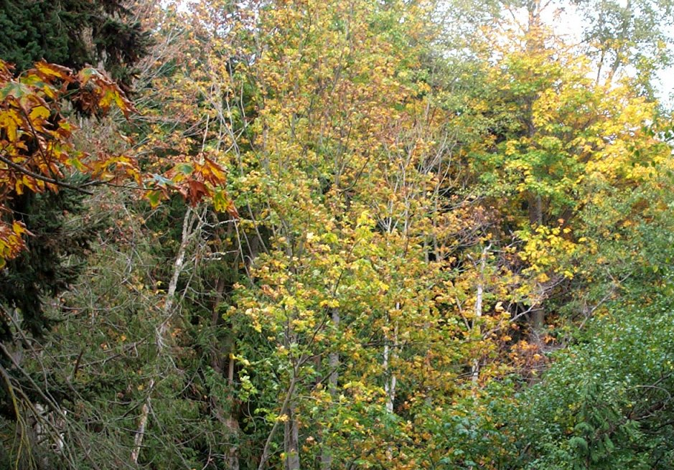
Notes:
The Elwha Valley contains a wide variety of terrestrial ecosystems. The forests consist of a matrix of old-growth over 400 years old (dark green sections), and younger forest stands that are about 100 years old that burned in the late 1800’s. In addition, the riparian forests at the valley bottom consist of a variety of deciduous trees. This mixture of forest types provides habitat for hundreds of plant and animal species.
The forests are primarily Douglas fir, grand fir, and western red cedar at low elevation. Silver fir become more common on the ridgetops. The riparian forests are primarily big-leaf maple, red alder, and black cottonwood. Willow thickets are common right along the water’s edge.

Slide 4
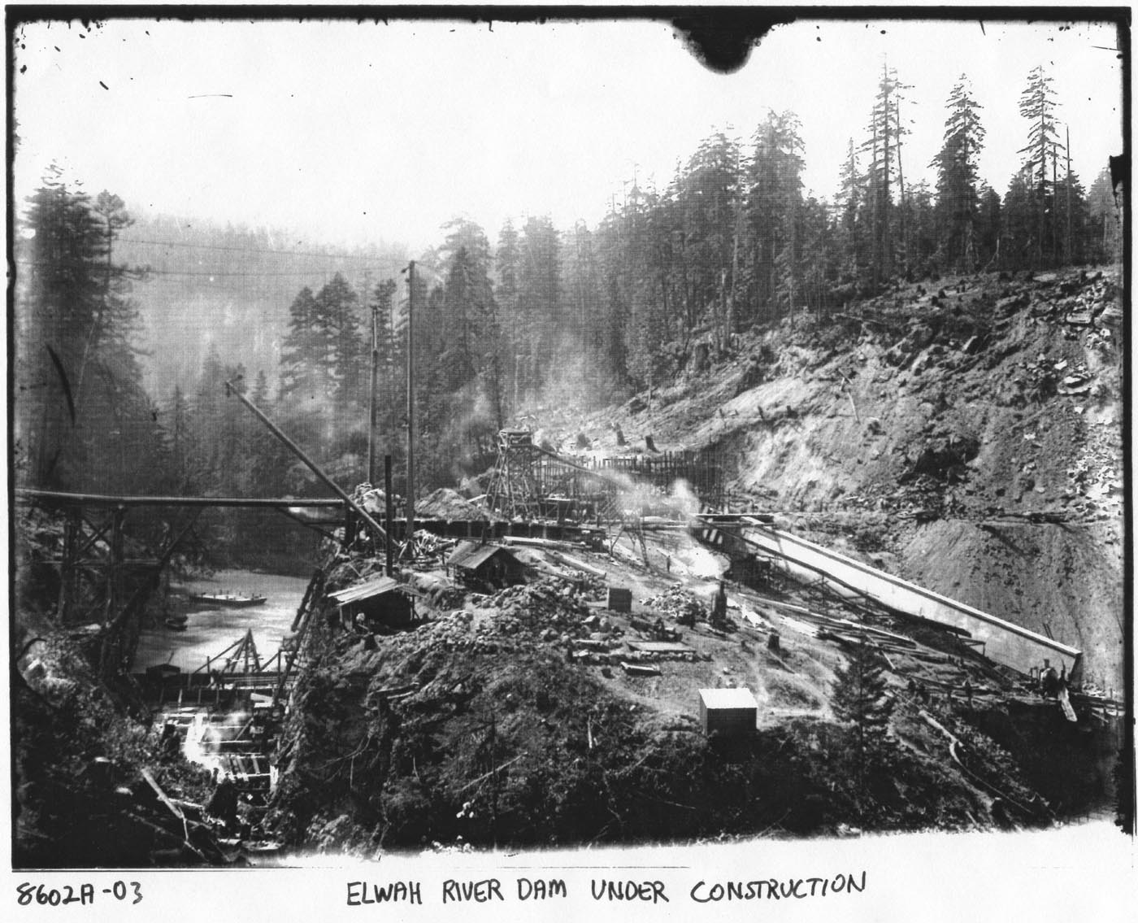
Thomas Aldwell
1910
Notes:
In the 1890’s a man named Thomas Aldwell moved to Port Angeles with an ambitious vision; to harness the power of the Elwha River to generate electricity for the Olympic Peninsula. He began buying up property along the river and in 1910 he began construction of the Elwha River dam, 5 miles from the mouth of the river.
Aldwell cut corners in construction of the dam and did not secure it to the bedrock. Knowing about the importance of the salmon runs on this river, the Washington State Fish Commissioner requested that Aldwell build fish passages on the dam. It was a request he ignored.

Slide 5
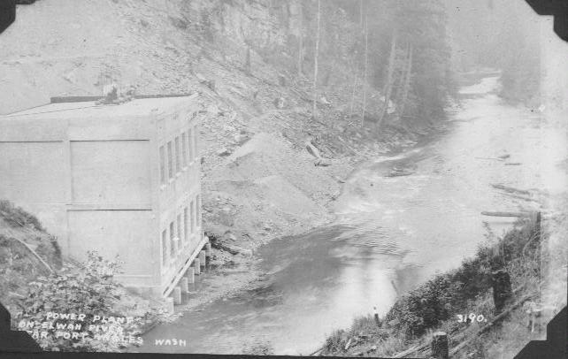
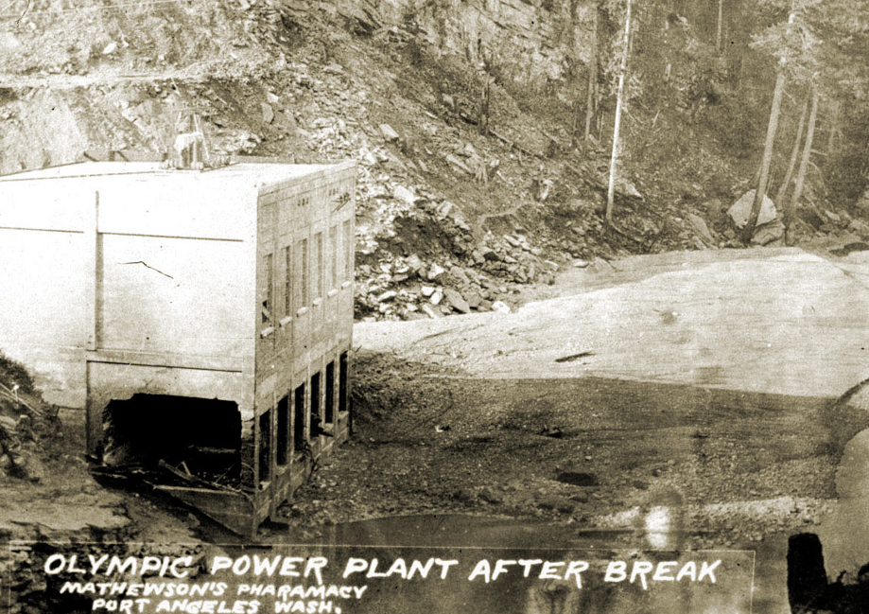
Cutting Corners; The First Dam Blows
Aldwell did not secure the foundation into the bedrock.
Aldwell did not get a federal license for the dam!!!
In October 1912, the foundation blew out and the torrent of water took out the lower bridge.
Notes:
In 1912, with construction nearing completion and the reservoir filling behind the dam, the pressure of the building water caused the dam to blowout at its base. A torrent of water came rushing down the river. This disaster did not kill anyone, but it did cause a lot of damage downstream.

Slide 6
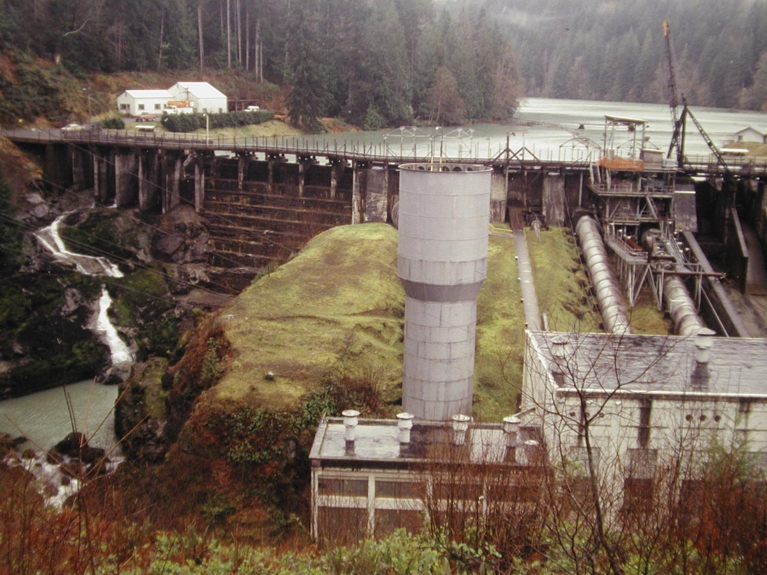
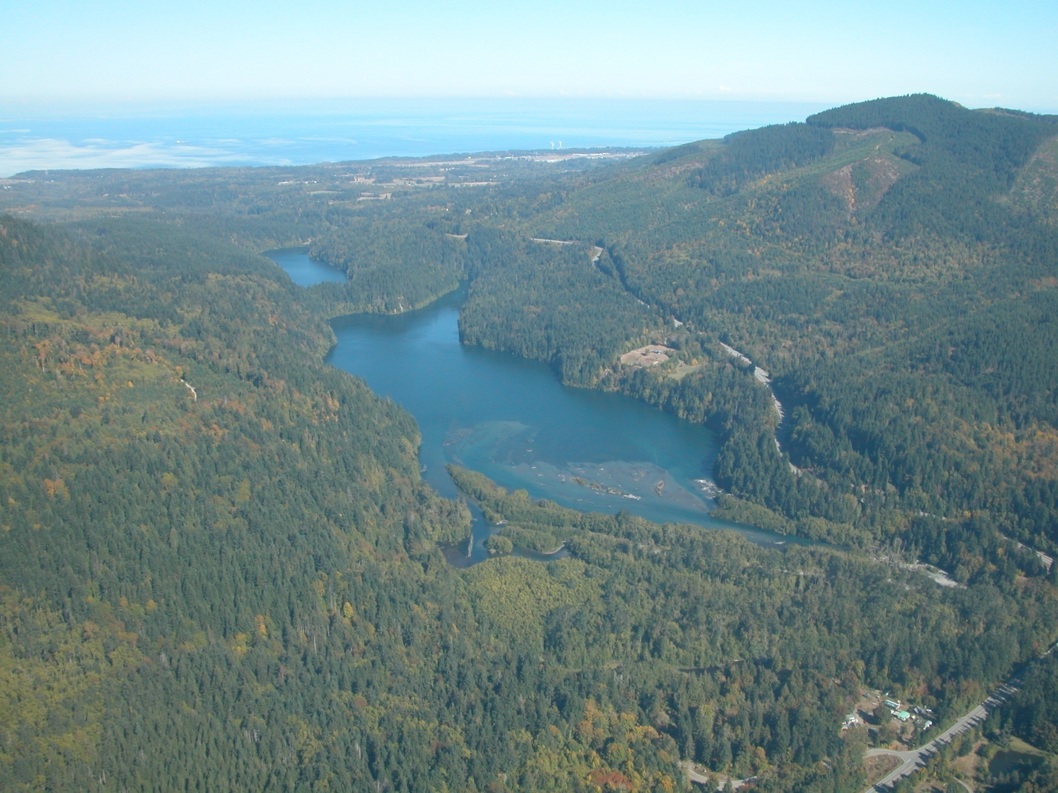
The Second Try
Lake Aldwell in 2010
Elwha Dam
Nippon Paper Mill
Amazingly, Aldwell was able to get funding to rebuilt the dam!
Repairs were completed in 1913 and the dam began operation.
Before their turbines were deactivated in June 2011, the Elwha and Glines Canyon dams produced ONLY 38% of the power for one paper mill!!!
Lower Elwha Dam
Notes:
Amazingly, Thomas Aldwell was able to get the financing to rebuild the dam and it was completed in 1913. Today, it holds the reservoir named Lake Aldwell. The electricity from the dam was used for many years to operate the pulp mill in Port Angeles, today named the Nippon Mill. Since the dam did not contain any fish passages, it immediately blocked access to 70 miles of available fish habitat and destroyed the anadromous salmon runs of the Elwha River.

Slide 7
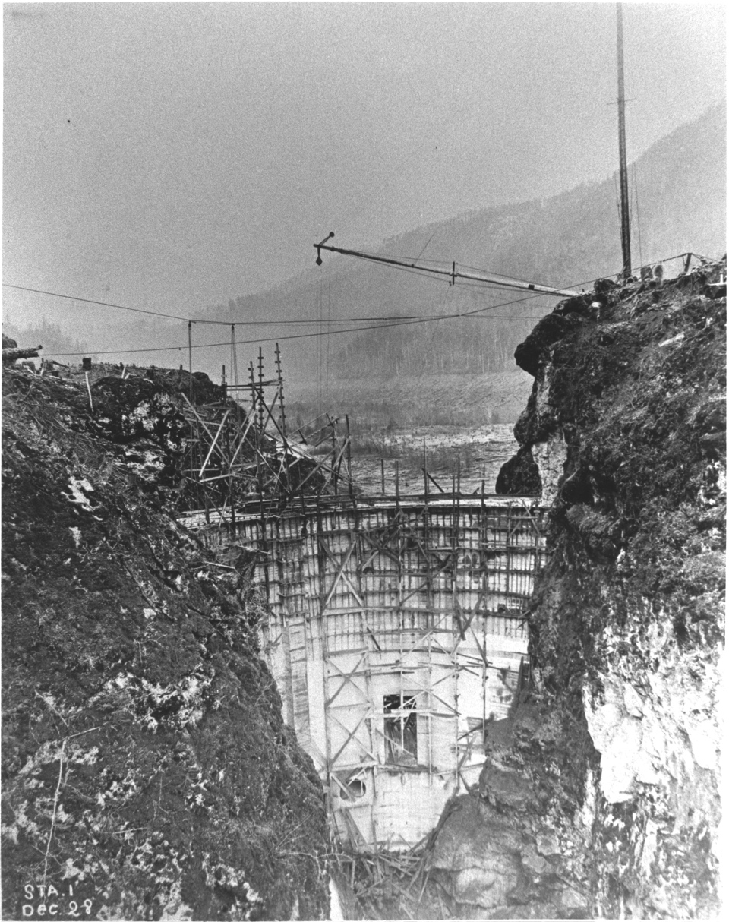
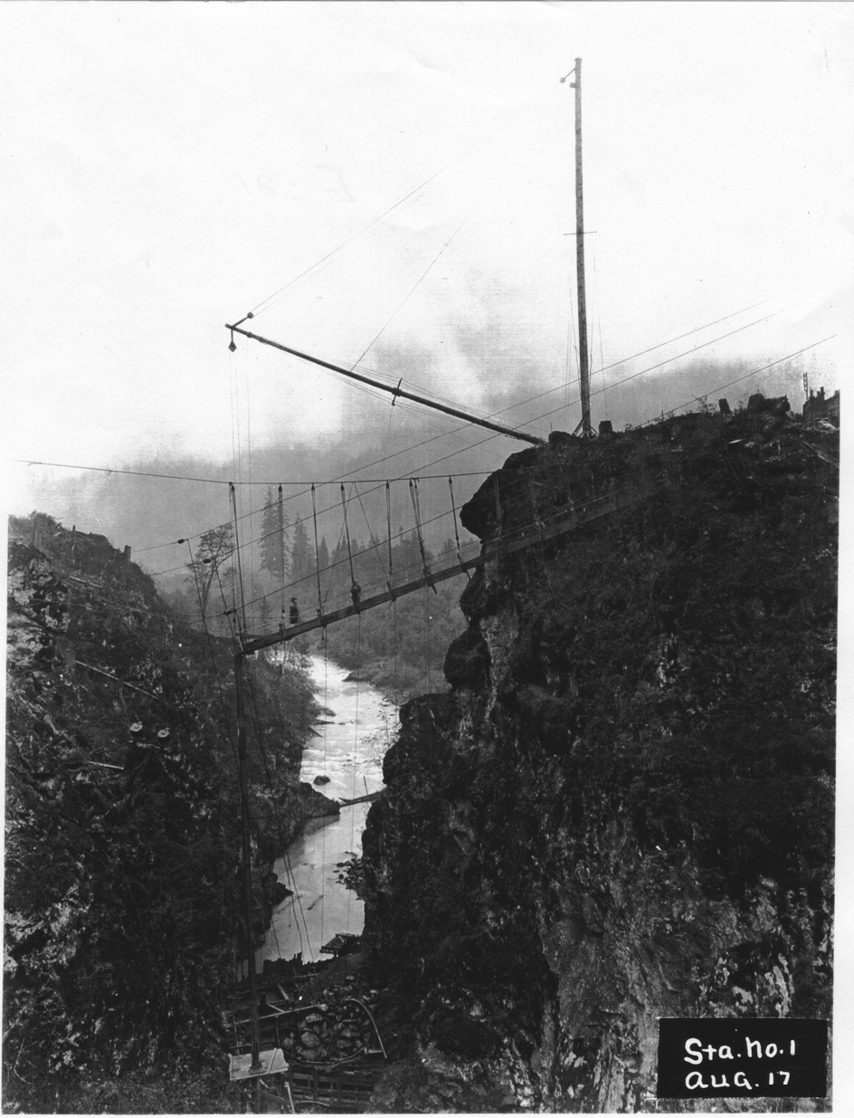
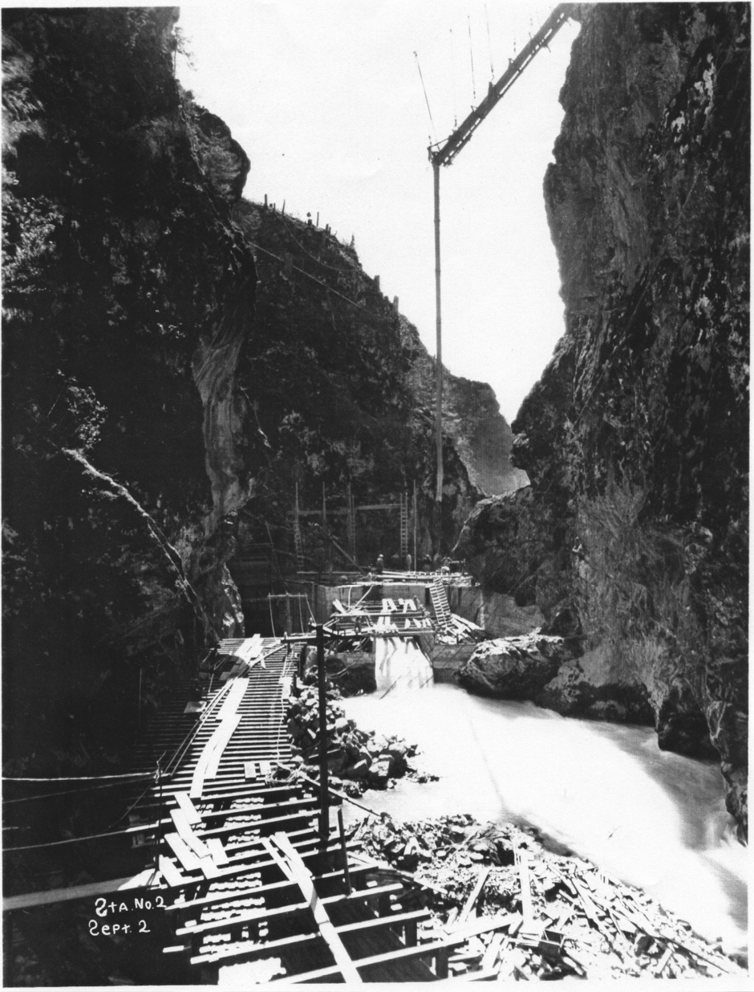
Glines Canyon Dam
Glines Canyon dam was completed in 1927, 7 miles upstream from the Elwha dam.
The dam and reservoir were included in the boundaries of Olympic National Park in 1938.
Notes:
In 1926, Thomas Aldwell and George Glines built the Glines Canyon dam about 7 miles upstream from the Elwha Dam. It is 210 feet high and also does not have any fish passage facilities.

Slide 8
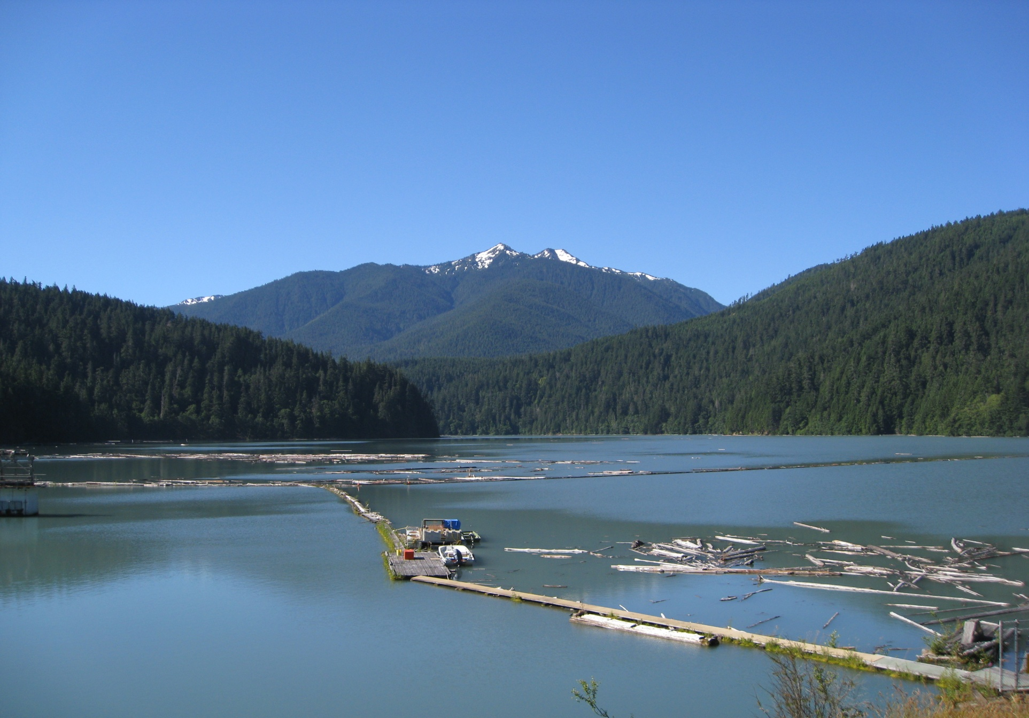
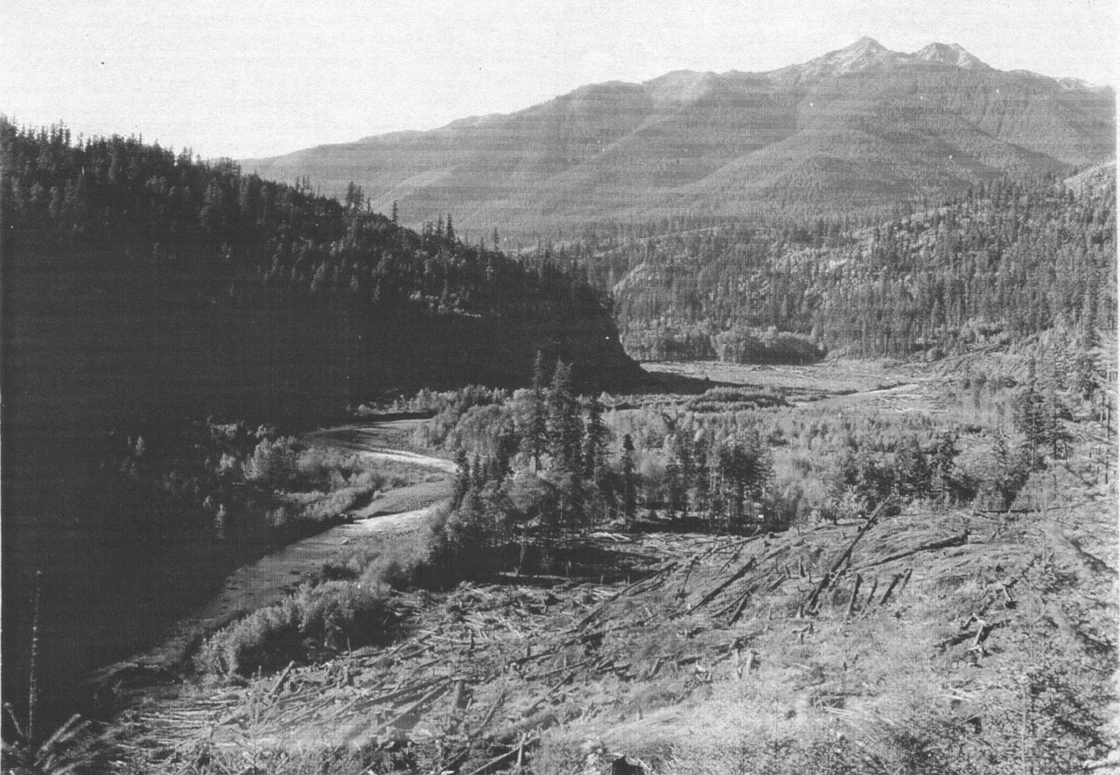
Lake Mills Reservoir
Notes:
The area just above Lake Mills was a flat-bottom riparian zone containing an old-growth coniferous forest, wide riparian zones, and perhaps some grassy meadows and alder glades. However, it was clear-cut just before dam completion as seen in this first photo. The second photo shows Lake Mills today.

Slide 9
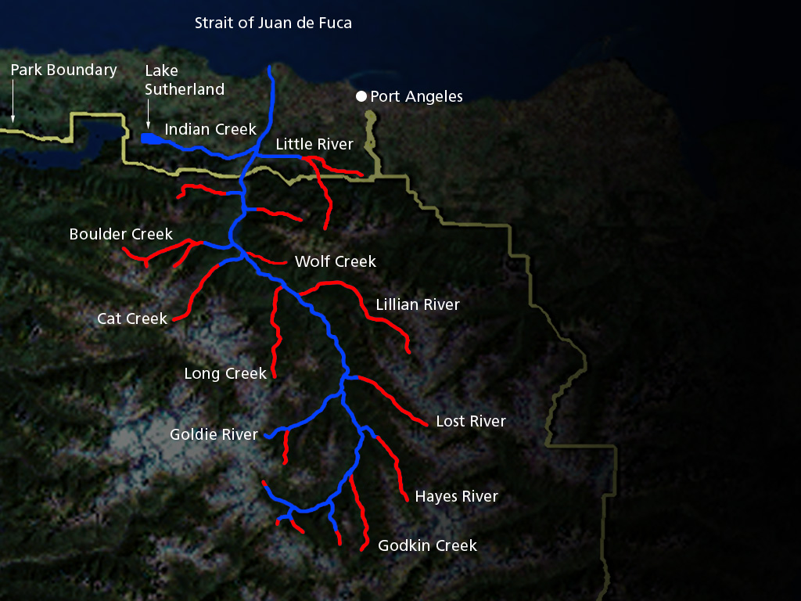
Anadromous Fish
Pre-Dam
~400,000 returns
70+ miles habitat
What Effects Did the Dams Have on Salmon?
Notes:
Map: Elwha watershed pre dam construction
400,000 adult returns and over 70 miles of available habitat.
Script: Prior to dam construction anadromous fish could reach far into the upper watershed and tributaries.

Slide 10
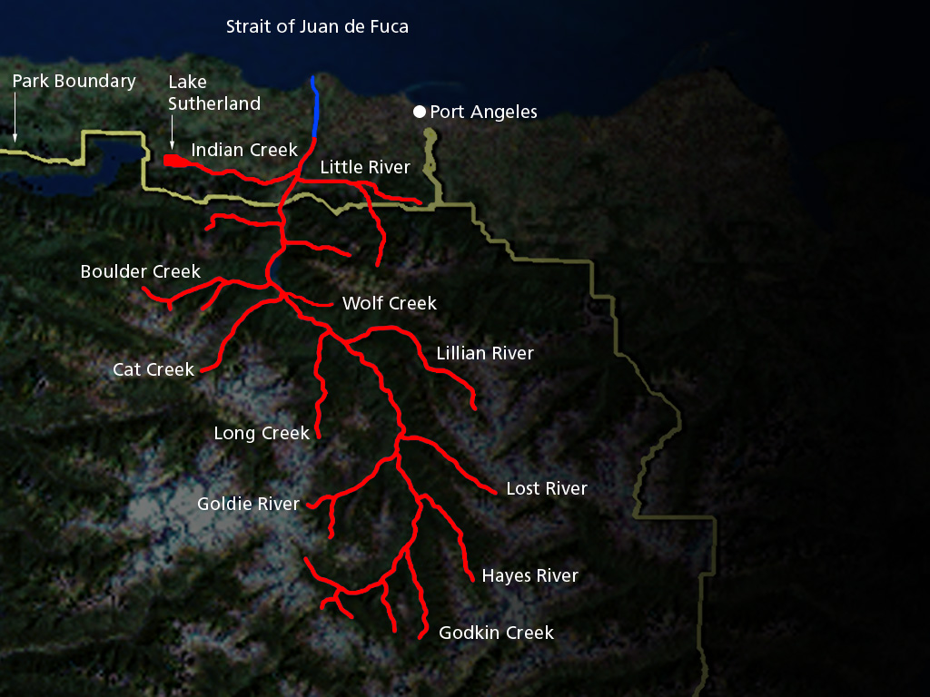
Anadromous Fish
Post-Dam
< 4,000 returns
4.9 miles habitat
Notes:
Map: Elwha River and tributaries post dam construction
Less than 4,000 adult salmon return to the river each year, with half of them being Chinook. The rest of the salmon species have fewer than a few hundred adult returns left.

Slide 11
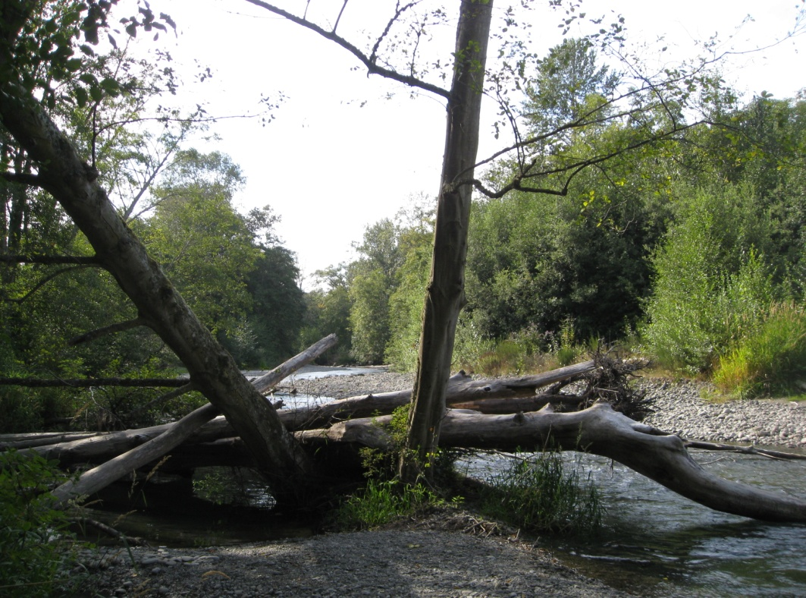
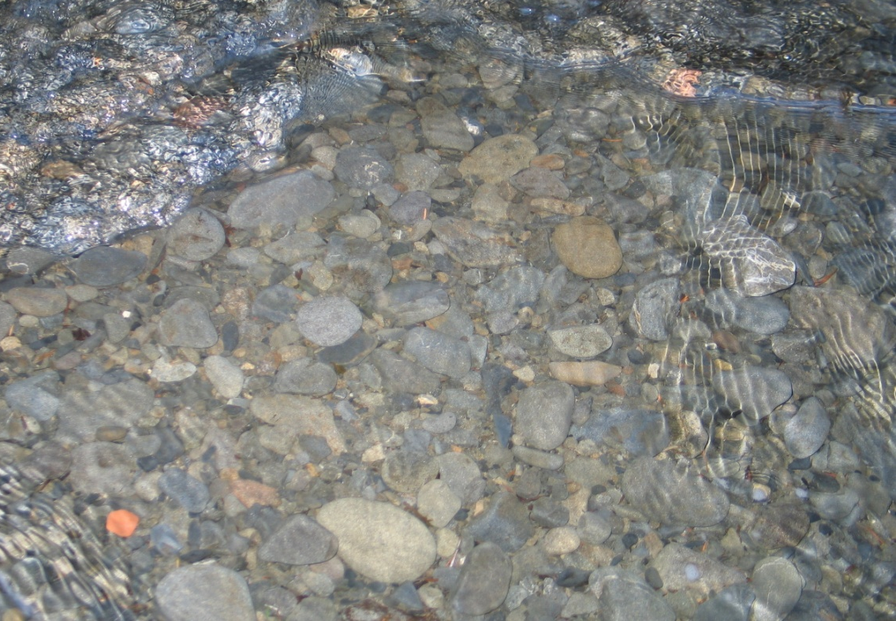
The Loss of Downstream Spawning Grounds
The 5 miles of remaining available salmon habitat became severely degraded over time.
The loss of sediment below the dams resulted in river channels that lacked the gravel salmon need for spawning.
Historic practices, such as logging and agriculture also damaged the river.
Notes:
The 5 miles of remaining available salmon habitat became severely degraded over time.
The loss of sediment behind the dams resulted in river channels that lacked the gravel salmon need for spawning.
Historic practices, such as logging and agriculture have also damaged the river.

Slide 12
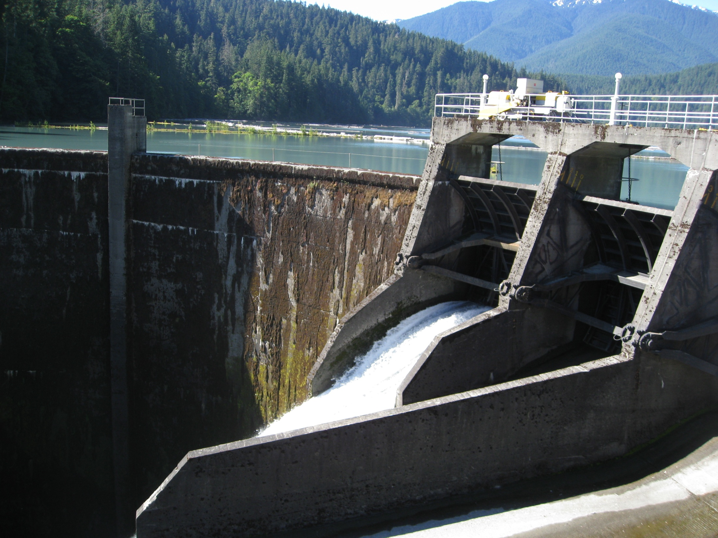
The Problems Mounted…
Water-treatment facilities were built downstream.
Dam removal began in September 2011.
Notes:
The dams generate very little electricity. Combined, they only produce less than 40% needed to power one pulp mill.
The dams prevent the sediment from making it to the Strait of Juan de Fuca, causing erosion at the mouth of the river and the loss of salmon spawning grounds.
The dams eliminated the once enormous salmon runs.
Their age and construction makes them very susceptible to earthquake damage and perhaps another catastrophic failure that threatens downstream communities.
Thus, after a long political process, the decision was made to remove the dams.
After several delays due to funding and research needs, the process has begun.
Two water treatment facilities were built. These facilities will filter out the silt that will move downstream when the river starts to erode into the delta that has formed in Lake Mills.
Since the Elwha river is the source of the water the city of Port Angeles, it is important to secure their water supply before removing the dams.
In September 2011, the removal of the dams began. Both dams are to be removed simultaneously and the process will take 2½-3 years.

Slide 13
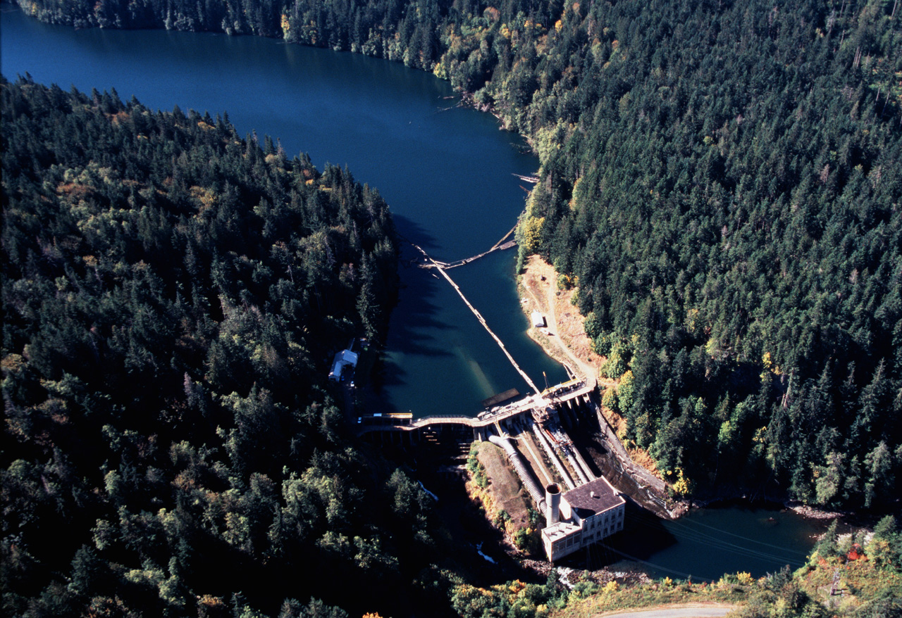
Elwha Dam Removal
Click image to view animation
Notes:
Both dams will be removed simultaneously. The process will be drawn out over a 2.5-3 year period, because of built in “fish windows”. These are important periods when salmon are in the river to spawn or juvenile fish are heading to sea from the hatcheries, where increased silt in the water may harm them.
Removal of the Elwha dam is much simpler than the Glines Canyon, because the river can be diverted through the floodgates while the original channel is restored.

Slide 14
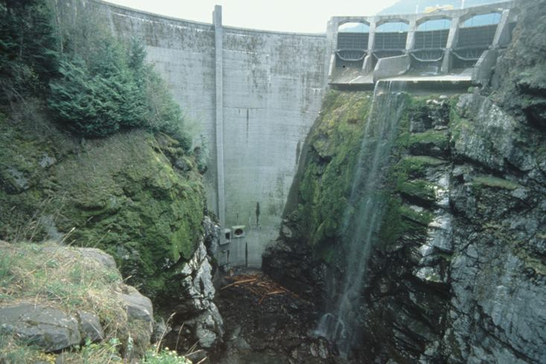
Glines Canyon Dam Removal
Click image to view animation

Slide 15
Dam Removal Webcams
The dams are inaccessible to the public during deconstruction. 6 webcams were installed along the Elwha River for the public to observe the removal process.
They can be viewed at http://video-monitoring.com/construction/olympic/js.htm

Slide 16

This project was made possible in part by a grant from
Washington’s National Park Fund.

