Slide 1
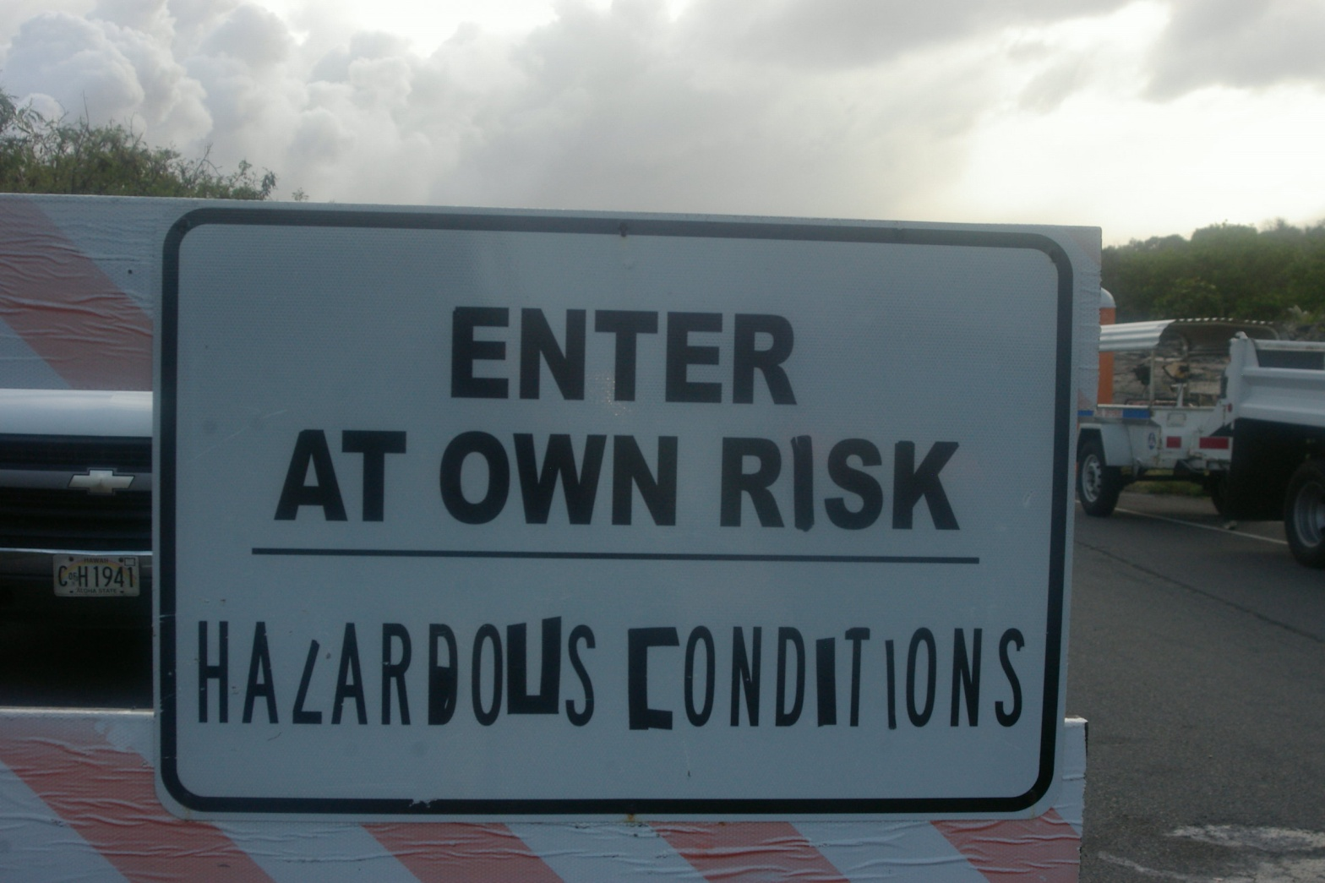
Volcanic Hazards

Slide 2
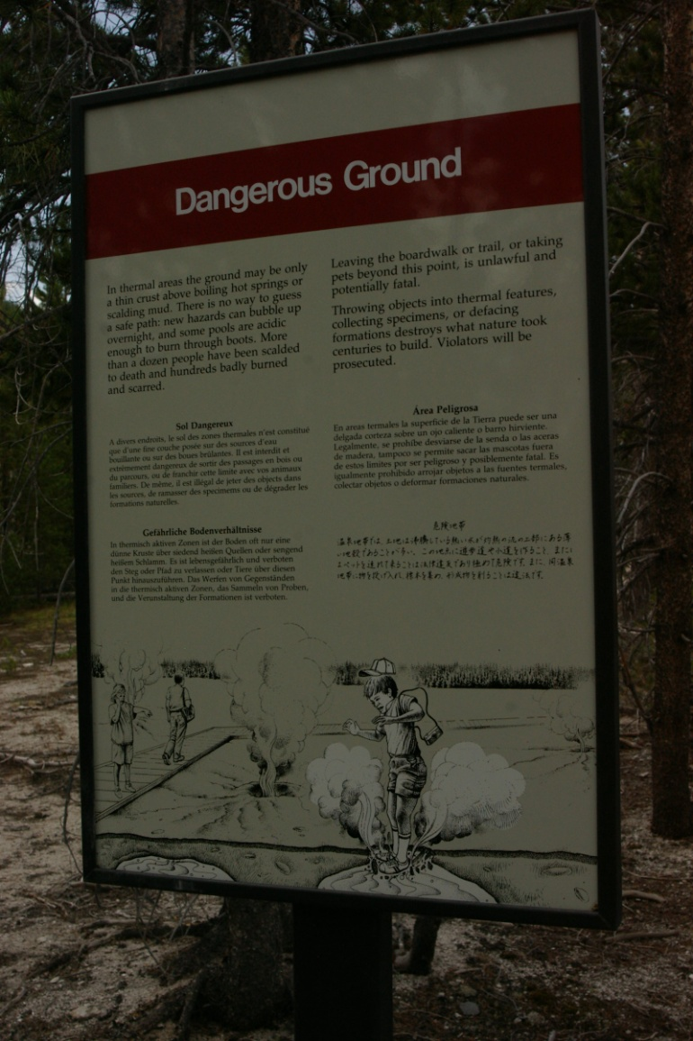
Limiting Danger from Hazards
Warning
Know when event is happening
Education
Know what to do when an event happens
Research
Know what will happen in an event

Slide 3
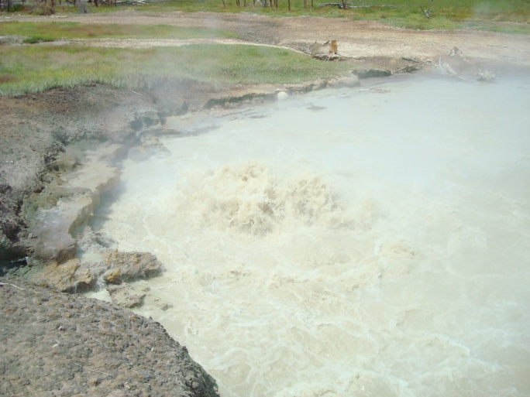
‘Water’ Volcanoes
Water that can be hazardous that are due to magma or Lava
Geysers
Hot Springs
Fumaroles
Mud Pots

Slide 4
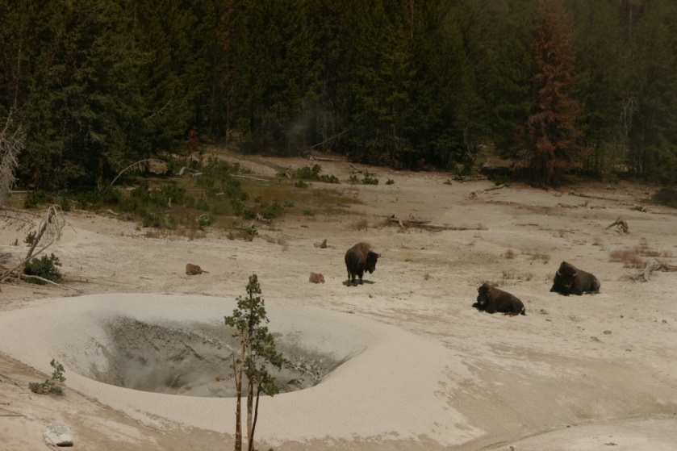
Gases
Release from within magma as pressure and temperature changes
Can cause explosive eruptions
Can poison plants and animals at surface
H₂O, SO₂, CO₂, H₂, HCl, H₂S, Fl

Slide 5
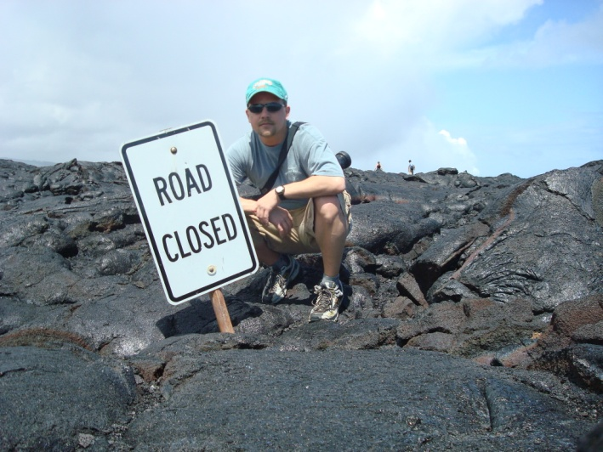
Lava Flows
Streams of molten rock
Some flow smoother and faster than others
Depends on
Temperature
Chemical make-up
Everything in the path of the lava is in danger
Knocked over
Surrounded
Buried
Burned
Melted

Slide 6
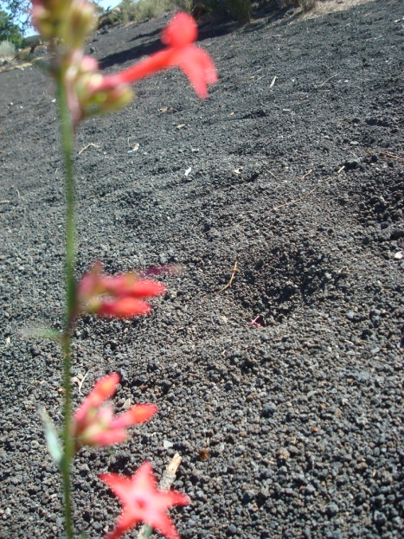
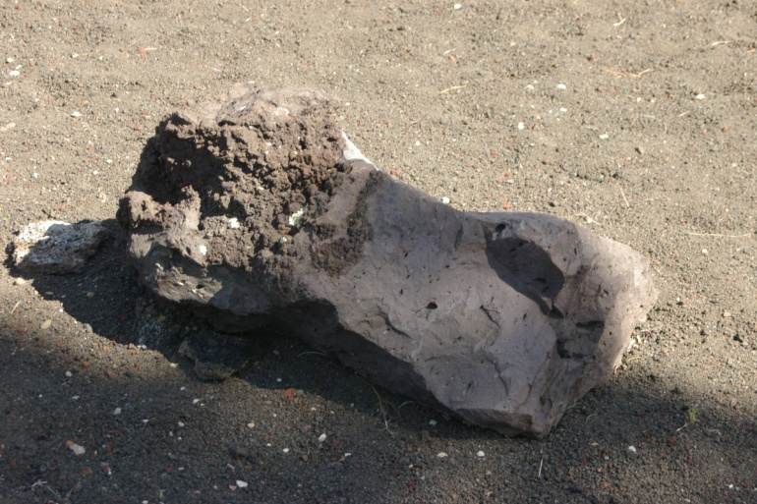
Explosions and “Stuff” that is Ejected During Eruptions
‘Ash Fall’
Tephra- lava and solid material, blasted into the air, during an eruption
Volcanic Ash/Dust- Small and very small material ejected during an eruption
Volcanic Bombs- Pebble sized to massive boulders of ejected material
Cinders- Small volcanic bombs the size of golf balls

Slide 7
Pyroclastic Flows
Fast moving flow of hot rock and gases
‘Ash Flow’
Could include molten rock as well
Rock includes small ash and large boulders
Can move at 80 km/h
Reach temperatures of 700º C

Slide 8
Landslides
Flow of rock and debris
Can be caused because weaker layers of rock give way and collapse
Landslide may allow for other hazards; explosion, lava flow, or lahars

Slide 9
Lahars
Mixture of water and rock fragments flowing down a volcano’s slopes
‘Mud Flows’
Water often comes from suddenly melted glaciers
May pick up more debris while moving down slope
Water can be very hot

Slide 10
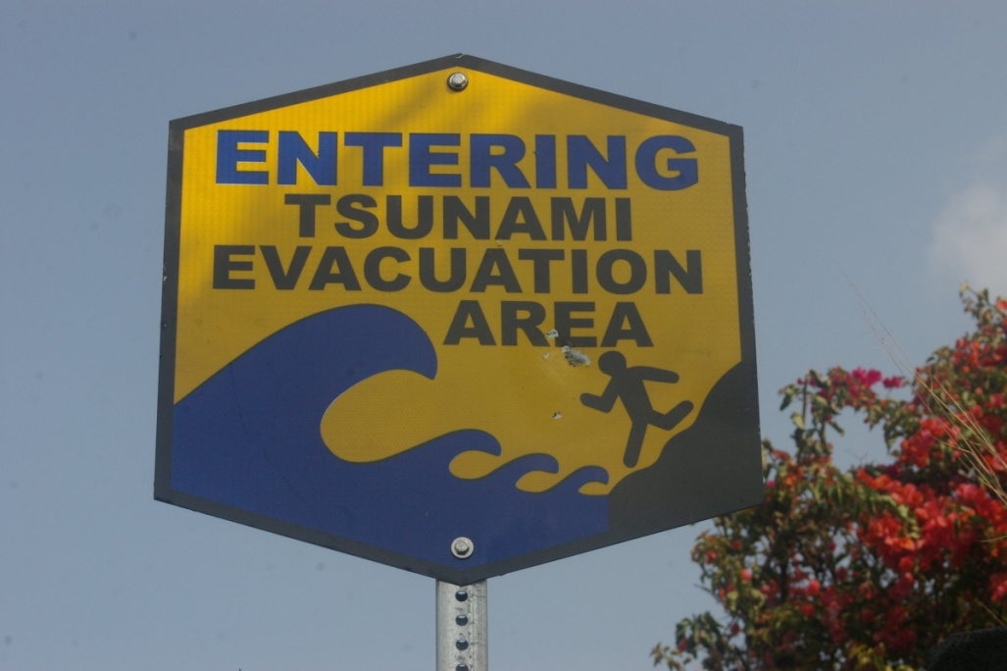
Tsunamis
Eruptions can create huge waves in large bodies of water located near a volcano

