Slide 1
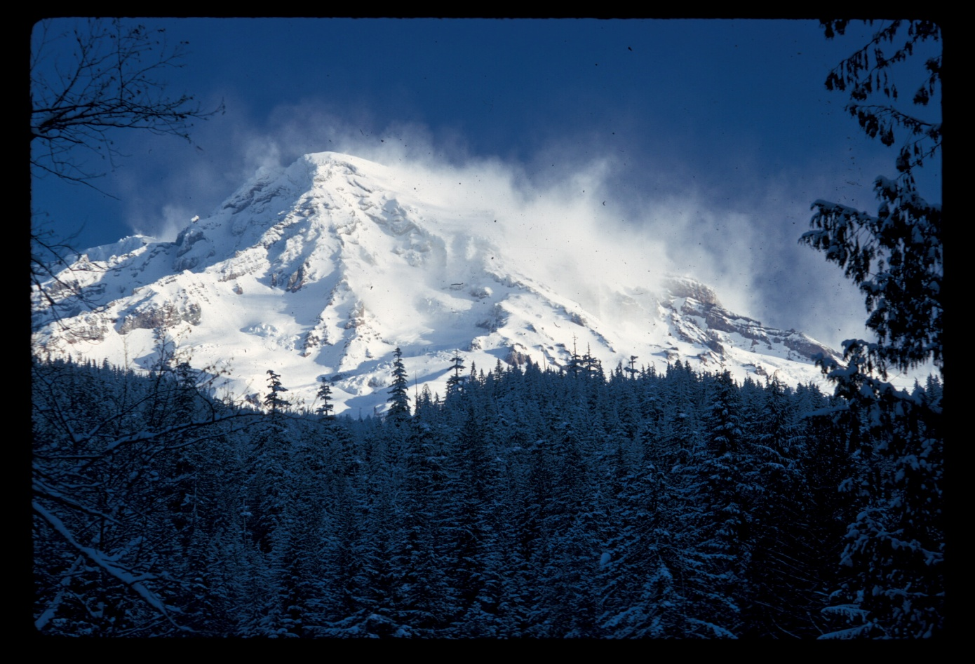
King of the Mountain
Mount Rainier’s Life Zone

Slide 2
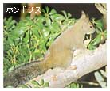
Ecosystem

Slide 3
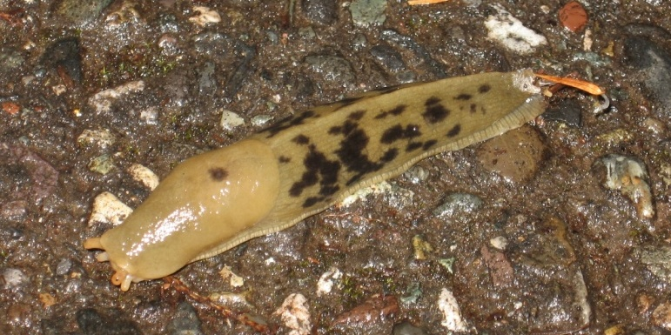
Low-Elevation Forest (518-762 meters)
Banana Slug
(Ariolimax columbianus)

Slide 4
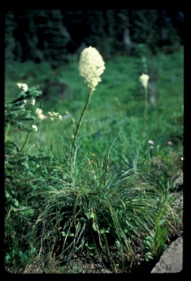
Mid-Elevation Forest (762-1,220 meters)
Bear Grass
(Xerophyllum tenax)

Slide 5
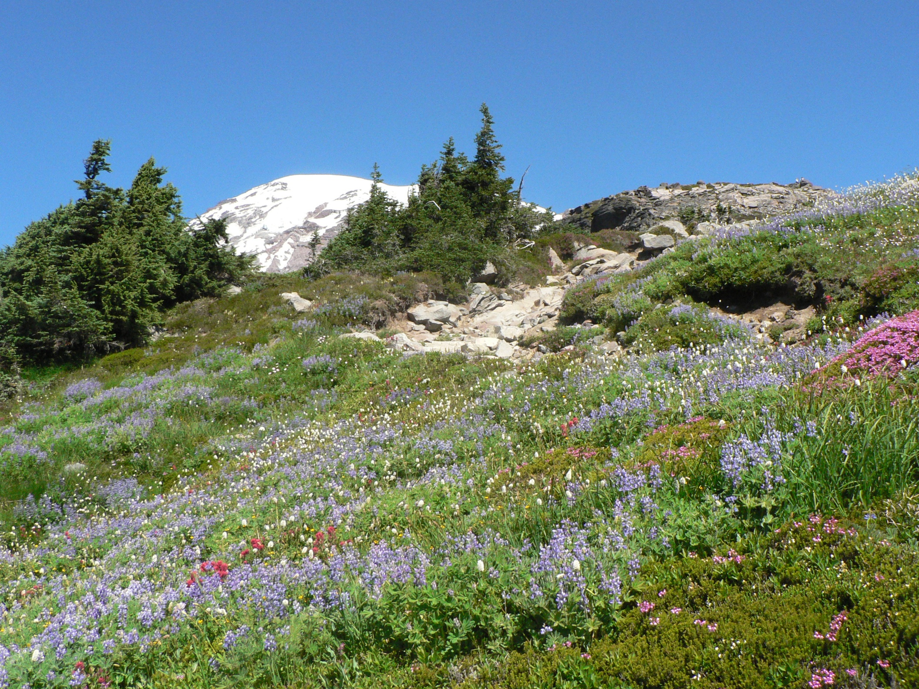
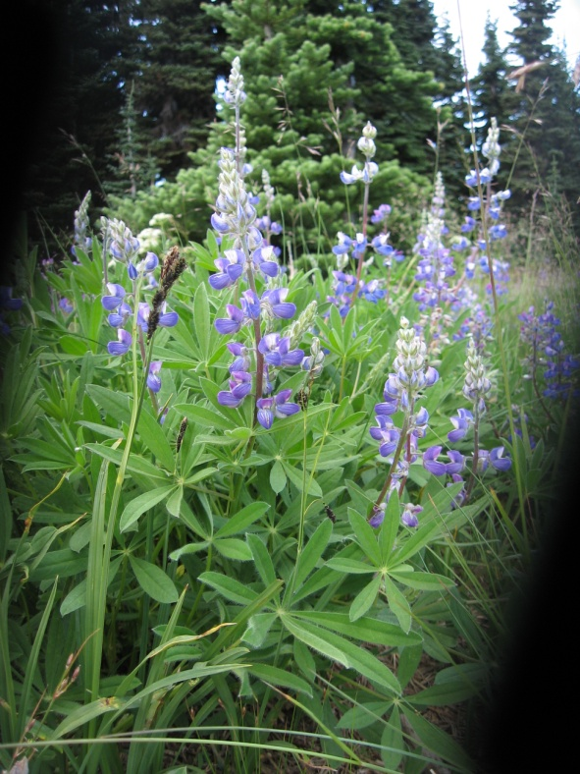
Subalpine Forest and Meadow (1,220-1,981 meters)
Lupine
(Lupinus latifolius)

Slide 6
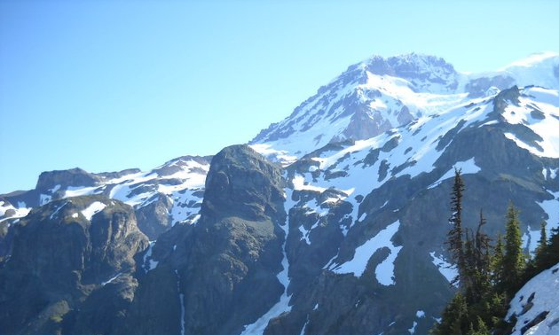
Alpine (1,981-4,392 meters)
White-tailed Ptarmigan (Lagopus leucurus)

Slide 7
Example of what a student might pick…
Low-Elevation Forest
Devil’s Club (Oplopanax horridus)

Slide 8
Adaptation Cards
This plant has large broad leaves to catch any sunlight filtering through the tall Douglas firs, and the sharp thorns give it its name.
この植物は大きく広がる葉を持っており背の高いDouglas Firs(米松)があっても充分太陽の明かりを受け取ることができる。鋭くとがったとげからこの名前がつけられている

Slide 9
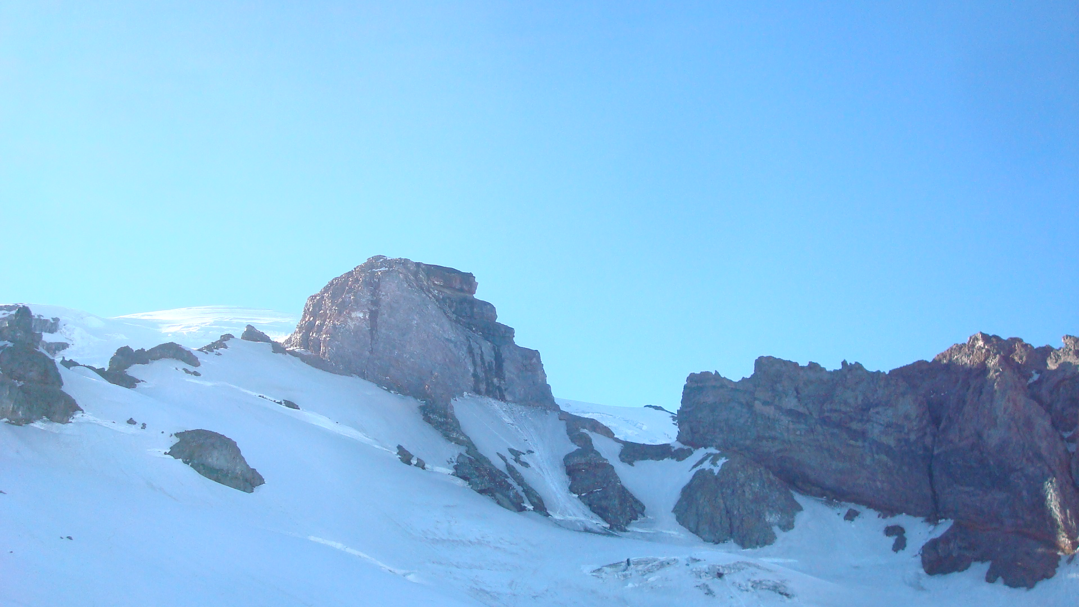
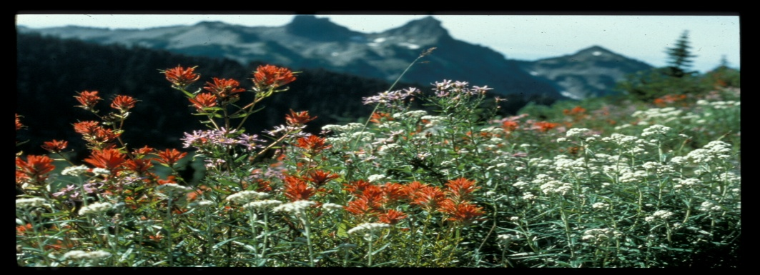
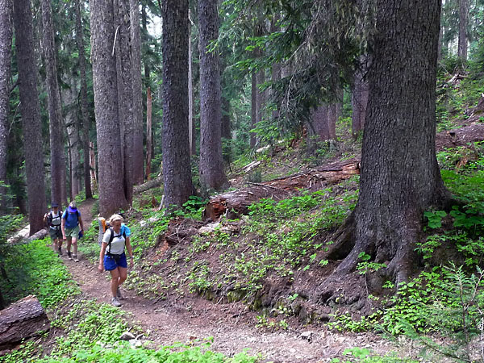
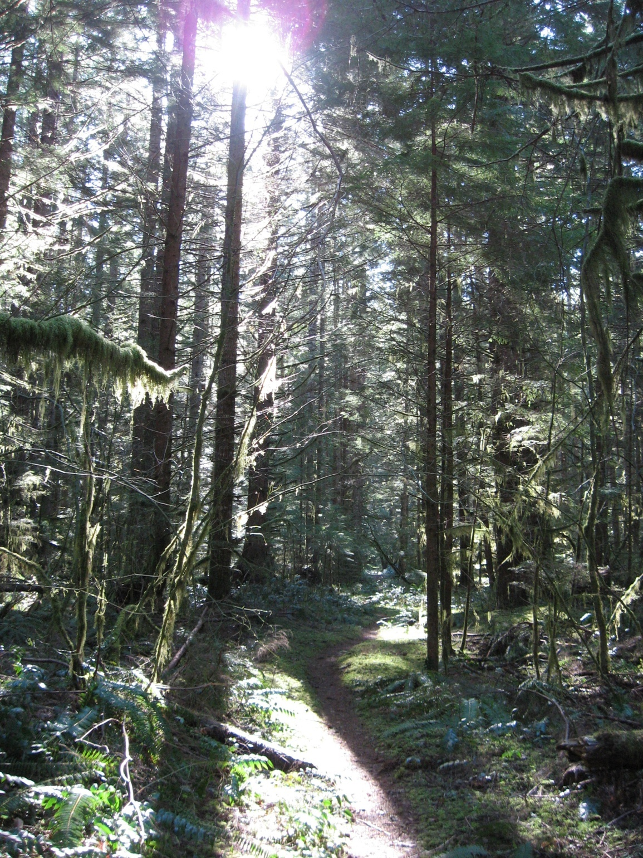
Mount Rainier Play Dough Key
Alpine
Subalpine Forest and Meadow
Scale: 1 cm= 200 m
Mid-Elevation
Forest
Low-Elevation
Forest

