Slide 1
Sub-Alpine Forest
Approximately 23% of Mount Rainier National Park is considered sub-alpine parkland. The parkland is a mix of meadows and forests between the elevations of 5,000 and 7,000 feet. Tree cover in the parkland is controlled by the depth and timing of snow cover. The sub-alpine parkland is some of the most visited, cherished and photographed areas of Mount Rainier National Park.

Slide 2
Warmer summer temperatures increase the population of bark beetles such as the White Pine Beetle, the Douglas Fir Beetle and the Fir Engraver Beetle by speeding up the beetle life cycle so that there are more beetles breeding at one time.

Slide 3
Trees are stressed by warmer temperatures, drier soil conditions, and earlier spring peak runoff (due to a shorter snow season) and produce less of the resin that repels bark beetles. When a bark beetle finds a stressed tree, it uses its pheromones to ‘call’ its friends, who then attack and kill the tree by boring underneath the tree’s bark and limiting the tree’s ability to transport nutrients from its roots to its needles. Bark beetles further impact living trees by infecting them with a fungal infection called “Blue Stain” that can also weaken a tree’s defenses. Trees infected with bark beetles and fungal infections eventually die.

Slide 4
The combination of warmer temperatures, less water, dead trees due to bark beetle infestation and longer frost-free seasons result in a longer and more robust wildfire season. Fire impacted areas are more prone to erosion, leading to an increase of sediment in the rivers, thus affecting fish species.
Fire destroys the habitats of many small mammals and birds. In contrast, ash provides nutrients to soil, making burned areas very fertile for plant species.
Non-native species are often more adapted to cope with the warmer temperatures and drought conditions may that caused the fire danger in the first place and displace the native species.

Slide 5
Mountain wildflower meadows exist in a delicate climatic balance because heavy winter snow cover and a short summer growing season limit the survival of woody plant seedlings. When the frost-free season lengthens, tree seedlings are better able to survive and slowly crowd out and shade the meadow grasses and wildflowers.
Subalpine fir is already invading the Paradise meadows by taking advantage of mild years to establish. Then the Firs are able to form ‘islands’ of trees that buffer individual trees against cold and snow.

Slide 6
Small mammals, such as pika and marmots, are dependent upon alpine meadow grasses and low-lying berries for food.
As meadow grasses disappear, the populations of these already endangered animals will likely further decrease.
Many of these plants remain an important part of Native American culture and have been collected in the park for at least 3,400 years.

Slide 7
A longer frost-free period causes alpine habitats to move higher in elevation and encroachment of subalpine trees into formerly alpine communities. Some of the heather communities have persisted on Mount Rainier for 10,000 years.
Visitors to Mount Rainier often come to view the blooming wild flowers and the snow-covered alpine spaces and hike in the spindly subalpine forests. Dislocation, destruction or retreat of these features further up in elevation, may negatively impact the visitor experience.

Slide 8
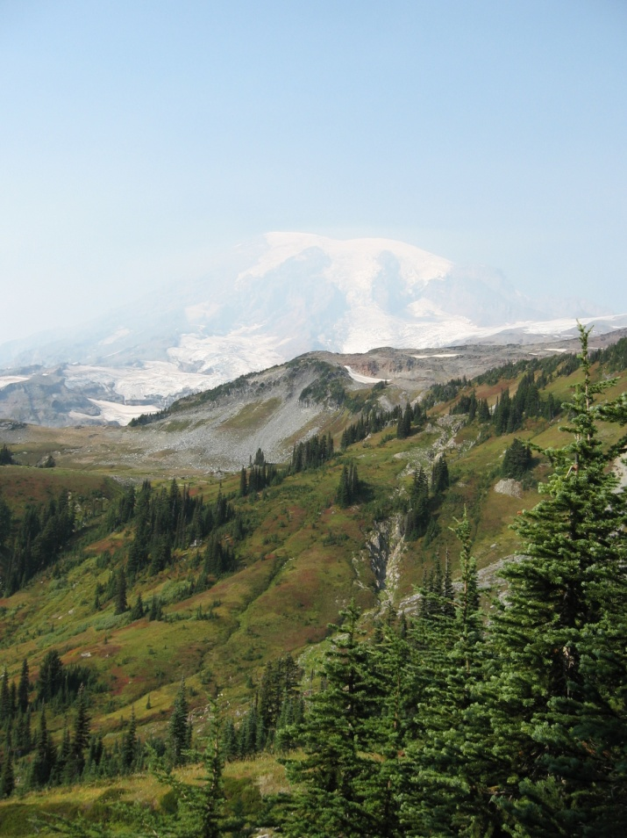
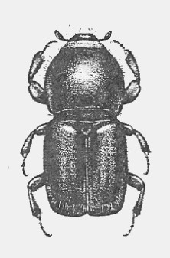
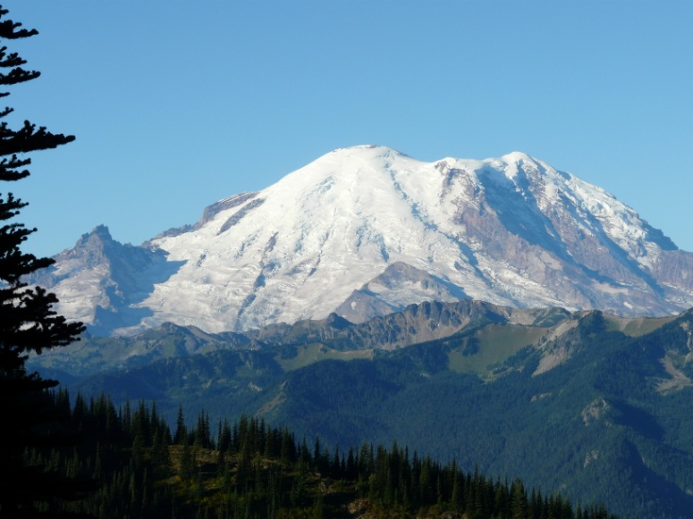

Slide 9
