Slide 1
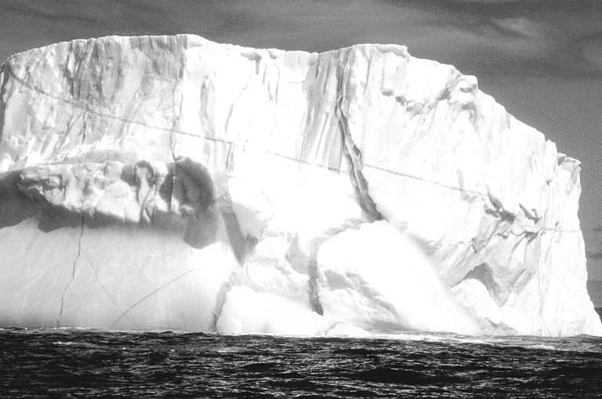
Fire and Ice
Mount Rainier and Mount Fuji
Geologic Overview

Slide 2
Born of Fire. Shaped by Ice.
Mount Rainier is born of fire and shaped by ice.
It is a geologically young volcano but has been worn down by the erosive power of glaciers since its birth.
Mount Fuji is born of fire.
It is also a geologically young volcano but keeps is conical shape due to the lack of erosion by glaciers

Slide 3
Basic Information
Mount Rainier
Mount Fuji
Location: Washington, USA
  1 of 13 active volcanoes in the Cascade Range
Height: 14,410 ft (4,395 m)
Age: 500,000 to 1,000,000 YO
Type: Strato/composite
Rock type: andesite and dacite
Status: active with a high risk due to hydrothermally altered rock
Erosion: primarily glaciers
Location: Japan (SE main island)
  1 of 108 active volcanoes in Japan
Height: 12,385 ft (3,776 m)
Age: 200,000 YO
Type: Strato/composite
Rock type: basalt
Status: active with low risk of eruption
Erosion: primarily wind/water

Slide 4
Tectonic Setting
Mount Rainier
Mount Fuji
Subduction zone with 2 plates involved:
  Eastern edge of Juan de Fuca Plate is subducting beneath the North American Plate.
  Western edge of the Juan de Fuca Plate is part of a divergent boundary with the Pacific Plate which creating new plate material that continues to feed subduction on the eastern edge.
Triple junction with 4 plates involved:
  Pacific Plate is subducting beneath the North American and Philippine Plates.
  The Philippine Plate is also subducting beneath the Eurasian Plate.
  The Philippine Plate is rifting due to the subducting of the Pacific Plate on its eastern edge and its western edge subducting beneath the Eurasian Plate.

Slide 5
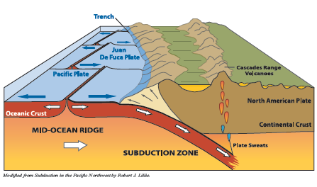
Subduction Zone
Explorer Plate
Gorda Plate
The eastern edges of the Explorer Plate, Juan de Fuca Plate, and Gorda Plate are being subducted beneath the North American Plate.
The western edges of these three plates are at a divergent boundaries with the Pacific Plate.

Slide 6
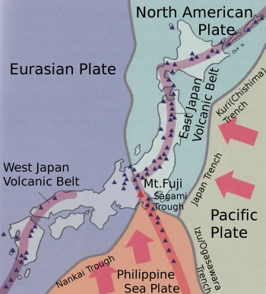
Triple Junction
Pacific Plate is subducting beneath the North American and Philippine Plates.
The Philippine Plate is also subducting beneath the Eurasian Plate.
The Philippine Plate is rifting due to the subductiing of the Pacific Plate on its eastern edge and , its western edge subducting beneath the Eurasian Plate.

Slide 7
Eruption History
Mount Rainier
Mount Fuji
  1-2 MYA
    Ancestral Rainier
    Adesite and dacite lava flows
  500 to 400 KYA
    Growth of modern cone and massive andesite lava flows
  400 to 280 KYA
    Little to no activity
  280 to 90 KYA
    Far traveling flows with ice contact features, pyroclastic flows
    40 to 20 KYA
    Frequency and volume increase but only on summit
  20 KYA to present
    40 ash and tehra flows
    50+ lahars. Large Mudflows
4 phases of volcanic activity:
  Sen (ancient)Komitake
    200,000 YA
    Ancient andesite core
  Komitake
    200,000 to 100,000 YA
    Built up by basalt and pyroclastic layers
  Ko (old) Fuji
    100,000 to 11,000 YA
    Erupted over Komitake
  Shin (new) Fuji
    11,000 YA to present
    Overtook nearby volcano Ashitaka

Slide 8
Notable Events and Eruptions
MOUNT RAINIER
MOUNT FUJI
  5,600 YA- Osceola Mudflow
    Collapse of hydrothermally altered rock on the east flank
    Initiated Osceola Mudflow which flowed down the White River and extended Puget Sound by 212 miles
    Some of mudflow sloshed down the Nisqually River
    Largest lahar ever in park
  1502- Electron Mudflow
    Collapse of hydrothermally altered rock on the west flank
    Initiated Electron Mudflow which flowed down the Puyallup River
    Average of 15 ft thick
1707- Hoei Eruption
  Last and most recent
  Known as the Hoei eruption
  Opened up Hoei crater
  One of most violent eruptions
  Large amounts of pyroclastics
    Pumice fall
    Scoria fall
    Volcanic bombs
  Large amount of lava flows

Slide 9
Eruption Style & Hazards
Mount Rainier
Mount Fuji
Eruption Style:
  Plinian
    Thin andesite lava flows at summit, thicker below due to glaciers
    Pyroclastic flows
    Several thick tephra layers
    Many thin tephra layers
Hazards
  Lahar
  Debris flows
  Pyroclastic flows
  Flooding
  Earthquakes
  Gas emissions
Eruption Style:
  Plinian
    Thick basalt lava flows
    Pyroclastic flows
    Thin tephra layers
Hazards
  Pyroclastic flows
  Debris flows
  Flooding
  Earthquakes

Slide 10
Why Sister Mountains?
Both are located on the Pacific Ring of Fire.
This is a global zone of frequent earthquake and volcanic activity due to the movement of tectonic plates.
Both are viewed as sacred mountains and cultural icons not only because of the culture in which they reside, but by the people who revere them and work to preserve and protect them.
In 1935, a rock from the summit of Mount Rainier was given to the Consul of Japan. In 1936, a rock from the summit of Mount Fuji was presented to the Superintendent of Mount Rainier National Park. This exchange marked the start of the Sister Mountain relationship.

Slide 11
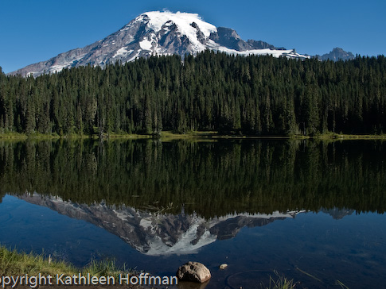
Mount Rainier

Slide 12
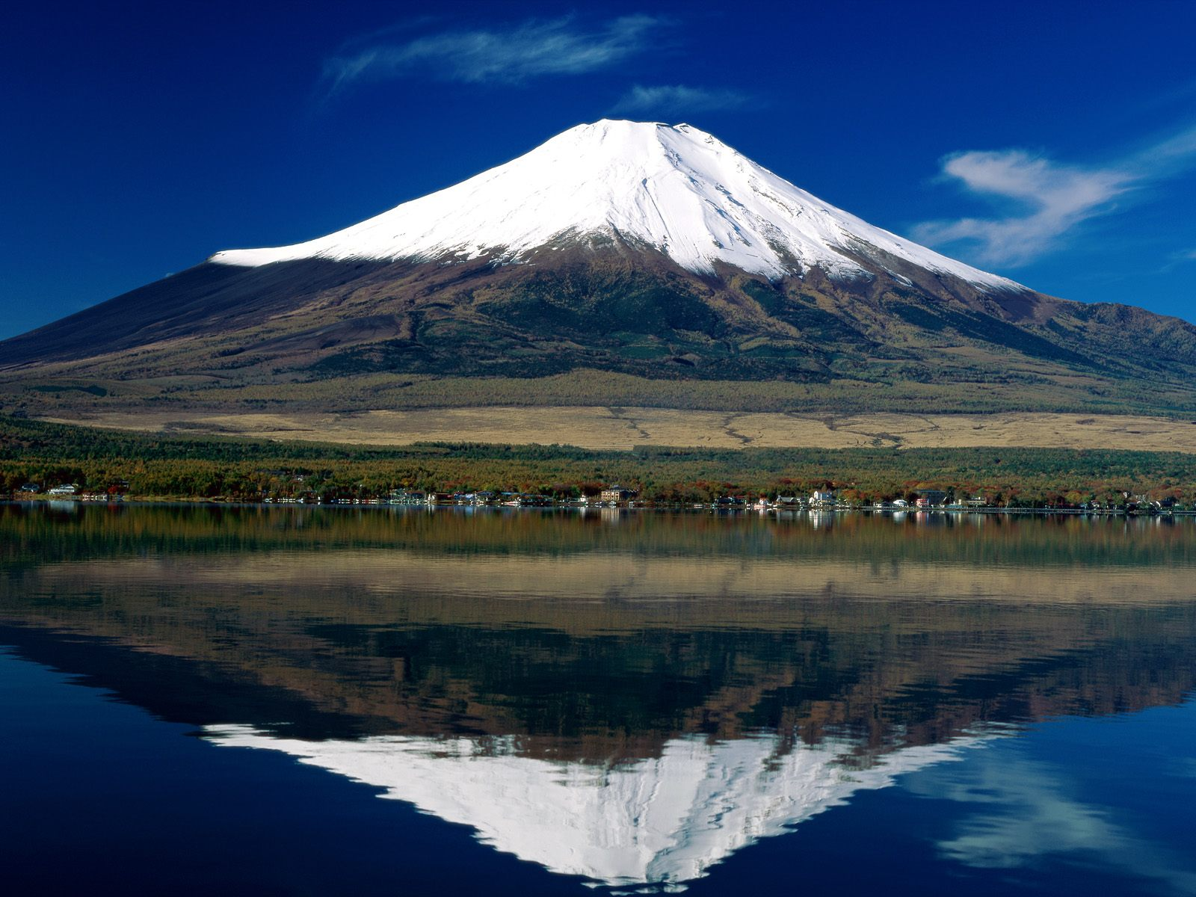
Mount Fuji

Slide 13
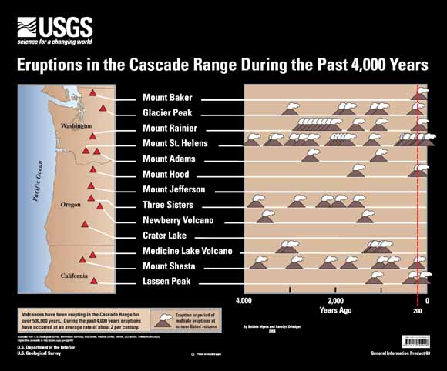

Slide 14
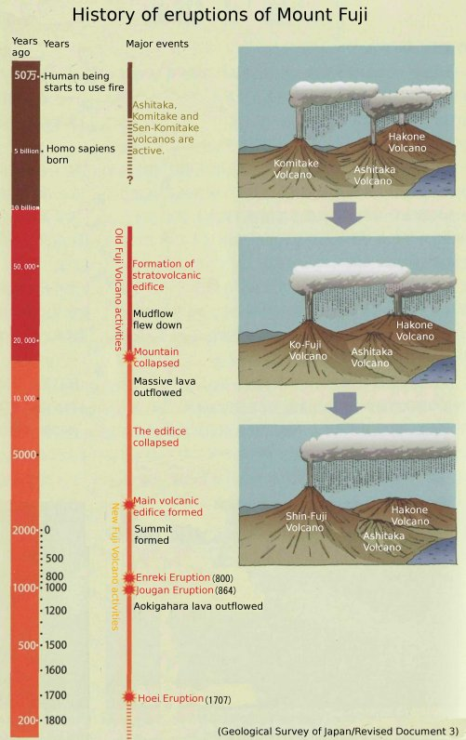

Slide 15
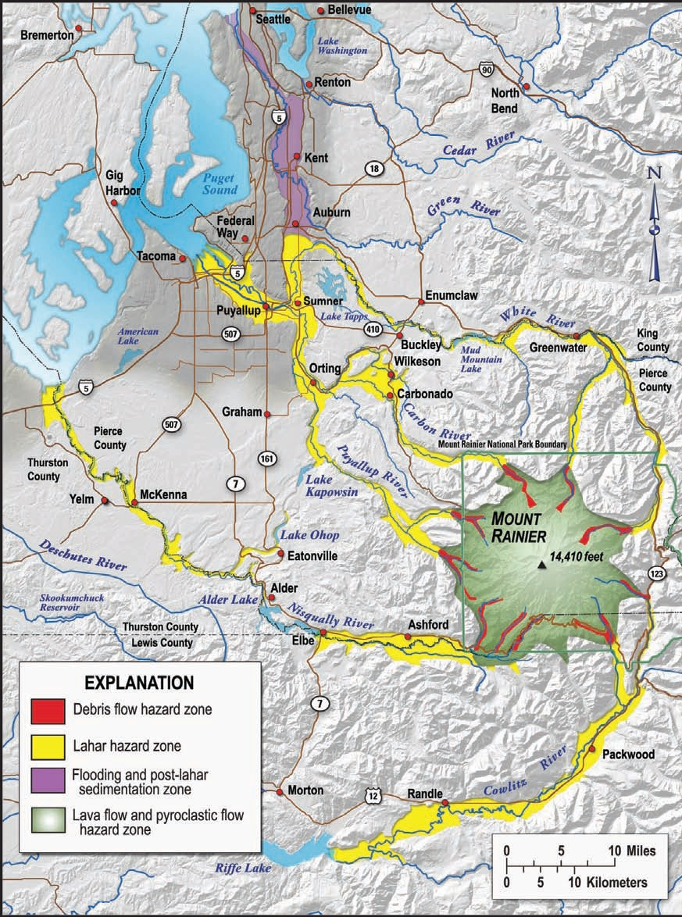

Slide 16
