Slide 1
Notice
The following presentation contains copyrighted materials used under the Multimedia Guidelines and Fair Use exemptions of U.S. Copyright law. Further use is prohibited.

Slide 2
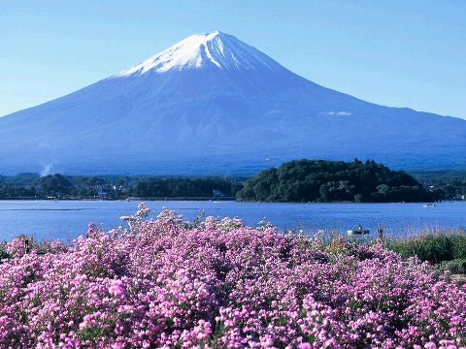
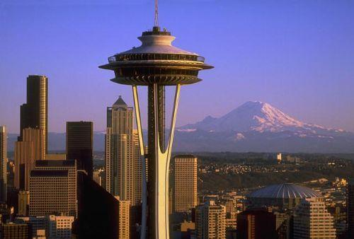
The Sisterhood of Two Mountains
By a student
Notes:
The Sisterhood of Two Mountains, Mt Fuji and Mt Rainier.

Slide 3
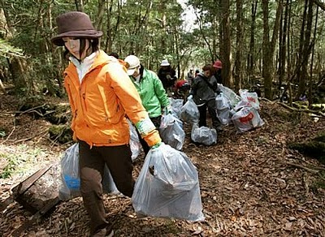
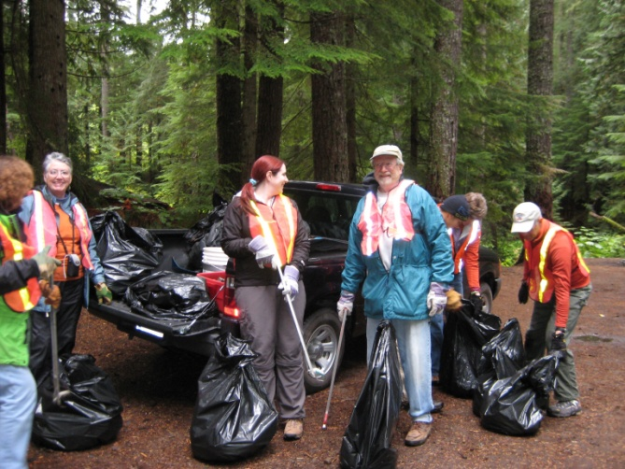
Pollution
Mt Fuji
Human Waste
Pollution
Trash
Mt Rainier
Human Waste
Pollution
Water Quality
People picking up trash at both Mt Rainier and Mt Fuji.
Notes:
Air Pollution levels have been high at Mt Rainier, particularly the ozone level. Air pollution is high at Mt Rainier because it is situated downwind from pollutant producing industries.
Human Waste has also been a problem at Mt Rainier. Due to worsening water quality from acidic snowmelt, people visiting Mt Rainier are asked to use the toilet facilities provided at the major camps.
Due to the large numbers of people coming to Mt Fuji every year, pollution has become a problem. Much of the pollution is due to the increasing number of tourists. As well, Japan built a highway halfway up Mt Fuji in the 1960s, creating an even easier way to the top and sparking tourism. With more tourists comes more waste, including food, wrappers, and human waste. In the past, the human waste system’s of transporting the waste down the mountain was to pour it down the mountain. This system left waste on the mountain, impacting the environment. Then, when Japanese organizers sought protection of the mountain by making it a UNESCO World Heritage Site, they request was denied, as their was too much pollution problems on and around the mountain.

Slide 4
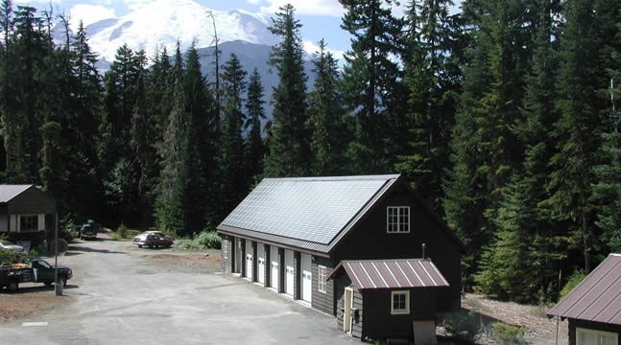
Conservation Efforts
Mt Fuji
Waste Management System
Clean-up Campaigns
Mt Rainier
Waste Management Program
Air Quality
Renewable Energy
Solar Panels on a building at Mt Rainier National Park
Notes:
While Mt Rainier hasn’t been nominated to become a UNESCO World Heritage Site yet, it is on a list of possible nominations from the Nationals Park Service. Yet, the National Park Service is still making efforts to conserve Mt Rainier. It is designated as a Class 1 area, receiving the highest level of air-quality protection. As a result, Mt Rainier has a air quality management program. As well, Mt Rainier is a part of the IMPROVE program, which stands for the Interagency Monitoring of Protected Visual Environments, ensuring that Mt Rainier has good quality of air and that the environment is least affected. In addition, Mt Rainier National Park is working on becoming carbon neutral by 2016, reducing the negative impact on the environment. In doing this, they are planning on building solar sites (sites that collect solar energy) and possibly ways of gaining hydropower at one location. As well, they are going to limit fuel consumption by vehicles at Mt Rainier. In order to do this, they are reducing the size of their transportation fleet and the use of this, through better communication and other techniques, as well as carpooling to and from the mountain. Furthermore, Mt Rainier has implemented
After Mt Fuji was denied status as a UNESCO World Heritage Site, Japanese organizers pushed for conservation and clean-ups of the mountain. Every year many people meet at Mt Fuji to pick up trash. These clean-up campaigns began back in 1998, when Toyohiro Watanabe founded the Fujisan Club. His goal was to reduce the pollution problem that Mt Fuji has, by picking up trash and raising public awareness. In 2006 alone, 80 tons of trash were picked up by volunteers. The Fujisan Club has also complied a map that includes photos of future sites that need cleaning, usually dump sites.

Slide 5
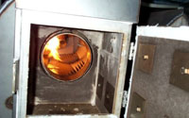
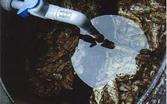
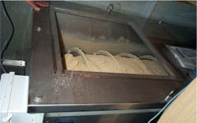
Conservation Efforts (continued)
The three types of eco-friendly toilets on Mt Fuji.
Notes:
While Mt Rainier hasn’t been nominated to become a UNESCO World Heritage Site yet, it is on a list of possible nominations from the Nationals Park Service. Yet, the National Park Service is still making efforts to conserve Mt Rainier. It is designated as a Class 1 area, receiving the highest level of air-quality protection. As a result, Mt Rainier has a air quality management program. As well, Mt Rainier is a part of the IMPROVE program, which stands for the Interagency Monitoring of Protected Visual Environments, ensuring that Mt Rainier has good quality of air and that the environment is least affected. In addition, Mt Rainier National Park is working on becoming carbon neutral by 2016, reducing the negative impact on the environment. In doing this, they are planning on building solar sites (sites that collect solar energy) and possibly ways of gaining hydropower at one location. As well, they are going to limit fuel consumption by vehicles at Mt Rainier. In order to do this, they are reducing the size of their transportation fleet and the use of this, through better communication and other techniques, as well as carpooling to and from the mountain. Furthermore, Mt Rainier has implemented
After Mt Fuji was denied status as a UNESCO World Heritage Site, Japanese organizers pushed for conservation and clean-ups of the mountain. Every year many people meet at Mt Fuji to pick up trash. These clean-up campaigns began back in 1998, when Toyohiro Watanabe founded the Fujisan Club. His goal was to reduce the pollution problem that Mt Fuji has, by picking up trash and raising public awareness. In 2006 alone, 80 tons of trash were picked up by volunteers. The Fujisan Club has also complied a map that includes photos of future sites that need cleaning, usually dump sites.

Slide 6
Effects of Climate Change on the Mountain and Surrounding Area
Mt Rainier
Glacial Reduction Increased Chance of Flooding
Stress on organisms
Mt Fuji
Invasive Species Forest
Devastation
Notes:
Due to Glacial reduction, less freshwater will be available for the community to drink, use for agriculture, and will create a greater chance of flooding.

Slide 7
The End

Slide 8
Images Bibliography
Photograph. Picture Page on Japan. Melissa Smith, 1 May 2008. Web. 23 May 2010. <maps.unomaha.edu/.../Pictures/Japan-2/Japan.htm>.
Photograph. Page 3.14. Science Blogs, 23 Sept. 2009. Web. 23 May 2010. <scienceblogs.com/.../the_buzz_eruptive_media.php>.
Photograph. The Thinking Blog. The Thinking Blog, 18 Jan. 2008. Web. 23 May 2010. <http://www.thethinkingblog.com/2008/01/9-smashing-trivia-bits-on-japans-mount.html>.
Photograph. US Forest Service. US Forest Service, 3 Oct. 2007. Web. 23 May 2010. <http://www.fs.fed.us/gpnf/news/2007/20071003a-post-pup.shtml>.
Photograph. National Park Service. National Park Service, 24 June 2009. Web. 23 May 2010. <http://www.nps.gov/environment/renewableenergy.html>.
Photograph. Designating Mt. Fuji as a World Cultural Heritage Site. Shizuoka-Yamanashi Joint Council Mt. Fuji World Cultural Heritage Registration, 2009. Web. 23 May 2010. <http://www.fujisan-3776.jp/english/protecting/protecting.html>.
Photograph. The Seattle Times. The Seattle Times, 4 Jan. 2010. Web. 23 May 2010. <http://seattletimes.nwsource.com/html/localnews/2010689013_rainiergravel04m.html>.
Photograph. Picture Page on Japan. Melissa Smith, 1 May 2008. Web. 23 May 2010. <maps.unomaha.edu/.../Pictures/Japan-2/Japan.htm>.
Photograph. Page 3.14. Science Blogs, 23 Sept. 2009. Web. 23 May 2010. <scienceblogs.com/.../the_buzz_eruptive_media.php>.

Slide 9
Annotated Bibliography
Baker, Michael V. "The SunBreak | Science." The SunBreak | Home. Michael Van Baker, 2010. Web. 23 May 2010. <http://thesunbreak.com/science>.
This website contained many articles on climate change and how it was effecting the environment. Due to the fact that there were many articles it was hard to find the articles pertaining to Mt Rainier. However, those articles were very useful in my research. All in all, this website was very useful.
Doughton, Sandi. "Local News | Rainier's Rocks Are Filling Riverbeds | Seattle Times Newspaper." The Seattle Times | Seattle Times Newspaper. Seattle Times, 4 Jan. 2010. Web. 23 May 2010. <http://seattletimes.nwsource.com/html/localnews/2010689013_rainiergravel04m.html>.
This article provided information on how climate change is effecting Mt Rainier. It gave information on what steps the National Park Service is taking to combat the climate change and the long term effects of it if it isn't prevented. All in all, this article was very useful.
Freire, Carl. "Nation & World | Mountains of Trash Foul Sacred Mt. Fuji | Seattle Times Newspaper." The Seattle Times | Seattle Times Newspaper. Seattle Times, 10 June 2007. Web. 23 May 2010. <http://seattletimes.nwsource.com/html/nationworld/2003741882_fuji10.html>.
This article was very useful in my research of the pollution of Mt Fuji. This article contained information on what the pollution problem was, what they are doing, and the technology that they are using to prevent future pollution of Mt Fuji. Overall, this article was very useful.
"Japanese National Parks System || Natural Parks Foundation." Natural Parks Foundation. Natural Parks Foundation. Web. 23 May 2010. <http://www.bes.or.jp/english/parks/system.html>.
This website gave useful information on the history of Japan's national parks. Using this information I was able to further research the ownership of Mt Fuji and how the environment is impacting it. Overall, this website contained some useful information for my project.
Kusakabe, Kimbei. "From Izumi, Shizuoka Mount Fuji 1890s." OLD PHOTOS of JAPAN. Kimbei Kusakabe, 13 June 2008. Web. 23 May 2010. <http://oldphotosjapan.com/photos/273/izumi-shizuoka>.
This website wasn't useful to me as it contained more information on the religious and cultural views of Mt Fuji, rather than information on the environment. However, it did contain information on who owned Mt Fuji and the history behind it. This was one of the only websites to contain that information. All in all, the website wasn't very useful, but did contain information that I need for my project.
Polidor, Amberly. "» Mount Fuji." Sacred Land Film Project. Christopher McLeod/Earth Island Institute, 1 Feb. 2007. Web. 22 May 2010. <http://www.sacredland.org/mount-fuji/>.
This website had some interesting information on current challenges and preservation efforts on Mt Fuji. It also had background information on the mountain and how it is viewed by the local cultures and religions. In the end, this website was very useful in the beginning, but had a lot of information that was also found on other websites.
"Preserving the Park | Mt. Rainier | Oh, Ranger!" Your Complete Guide to the Parks | Oh, Ranger! Web. 23 May 2010. <http://www.ohranger.com/mt-rainier/preserving-park>.
This source contained a lot of useful information on preserving Mt Rainier, how humans are impacting it, and other problems that the park and mountain are facing. Overall, this website was very useful in my research.
Prideaux, Eric. "Mount Fuji: Symbol of Beauty; Mountain of Shame | The Japan Times Online." The Japan Times. Japan Times, 12 Sept. 2004. Web. 23 May 2010. <http://search.japantimes.co.jp/cgi-bin/fl20040912x2.html>.
This website was very useful in my research. It presented information on how the impact of people climbing Mt Fuji has changed over time. It gave information on the type of waste that has been dumped at Mt Fuji and the technologies that various groups are using to combat the pollution. All in all, this website was very useful in finding information about the pollution of Mt Fuji and how several groups are combating it.
"Protecting Mt. Fuji." Designating Mt. Fuji as a World Heritage Site. Shizuoka-Yamanashi Joint Council Mt. Fuji World Cultural Heritage Registration, 2009. Web. 23 May 2010. <http://www.fujisan-3776.jp/english/protecting/protecting.html>.
This website contained a lot of information on the steps that two prefectures are taking to fight climate change and pollution on Mt Fuji. It was especially useful in giving information on the technologies that the eco-friendly toilets use.
"Reading Eagle - Archive Search." Reading Eagle [Reading] 3 Jan. 1959, 341st ed.: 2. Google News. Web. 23 May 2010. <http://news.google.com/newspapers?nid=1955&dat=19590103&id=vQ4rAAAAIBAJ&sjid=rJsFAAAAIBAJ&pg=5268,567419>.
This newspaper article from the 1959s was very useful in researching the ownership of Mt Fuji in history. All in all, this newspaper was very useful in my research of Mt Fuji.
"Trouble at Paradise: Urban Air Pollution Travels to Mt. Rainier — Sightline Institute." Sightline Institute - Solutions for Cascadia. Sightline Institute. Web. 23 May 2010. <http://www.sightline.org/research/pollution/res_pubs/trouble-at-paradise>.
This source had a lot of information on the air pollution at Mt Rainier, the effects of it, and what people can do to prevent further air pollution. This website was very useful for the pollution part of my presentation and speech. Overall, this source was very useful in my research.
U.S. National Park Service - Experience Your America. National Park Service, 8 Dec. 2009. Web. 23 Dec. 2010. <http://www.nps.gov/index.htm>.
The National Park Service website was very useful in finding information on Mt Rainier. They had various articles and reports on their steps to conserve Mt Rainier and prevent further pollution of the mountain. Their reports contained information on climate change, pollution, ownership of the land, and the action they were taking. To sum it up, this website contained a lot of useful information on Mt Rainier.

