Slide 1
Nisqually Glacier
Glaciers are important sources of fresh water to human, plant and animal components of downstream communities. Glacier-fed streams traditionally have less variability to stream flow, due to summer melting which makes up for less precipitation falling during the summer. In the winter when precipitation increases, melting decreases due to colder temperatures. Ecosystems that form along glacier-fed streams are reliant on a steady, consistent supply of cold water. The Nisqually glacier has been studied by scientists since 1918 and provides the longest continuous record for any glacier in the Western Hemisphere. Today, the Nisqually Glacier terminus lies more than 2,500 meters upstream from its furthest known extent down valley dating to some time in the mid-1820’s.

Slide 2
More precipitation falling as rain and less as snow leads to fewer sources of snow and ice needed for glacier formation. With less supply during the winter, warmer temperatures in the summer and longer snow-free seasons causing more melting, glaciers are getting smaller and thinner.
The Cascade mountain range has decreased in April 1st snowpack measurements of between 30-60%; glaciers on Mount Rainier lost 21% of their surface area between 1913 and 1994.

Slide 3
Retreating glaciers uncover sediments. When combined with more precipitation falling as rain and increases in the frequency of extreme weather events, loose sediments lead to debris flows and stream aggradation.
The retreating Van Trump glacier produced four debris flows between 2001 and 2006 that filled the Nisqually River with sediment and raised the river bed at least six feet. Debris flow can destroy downstream ecosystems and require hundreds of years of succession to return to their original state.

Slide 4
Higher stream beds, due to stream aggradation, increase the risk of floods. Flooding can damage roads, homes and other infrastructure and bury fertile farmland in inches of less fertile sand and gravel.

Slide 5
Flooding and increased sediment also negatively impact native fish populations such as salmon species. In contrast, retreating glaciers also uncover space that can then be colonized by forest and meadow habitats.

Slide 6
Late summer stream flow is predominantly fed by glaciers. More winter precipitation and less summer precipitation, combined with less snow and glacial melt-off reduces the stream flow, especially in the late summer when temperatures are at their highest.
Lower stream flow and higher temperature together raise stream temperatures, impacting fish and amphibian species.

Slide 7
Hotter summer months require increased use of irrigation for farming, leading to extraction of water from already low stream flow. This impacts the water quality and availability to downstream populations and ecosystems, placing farmers in conflict with other stakeholders such as fisheries, power suppliers, Native Americans, environmental protection organizations, community water supply and regulators who are also dependant on limited water resources.

Slide 8
Hydroelectric dams are often placed on glacially-fed streams due to their year-round water supply. As stream flow diminishes, water is diverted around power generating turbines, rather than pooled behind dams for power generation, therefore reducing the amount of electricity available for human use. Less availability of hydroelectric power increases the dependence upon other possibly less-desirable sources of energy such as coal power. In addition, empty power generation reservoirs are not as appealing for recreational activities such as water sports, fishing, boating or camping.

Slide 9
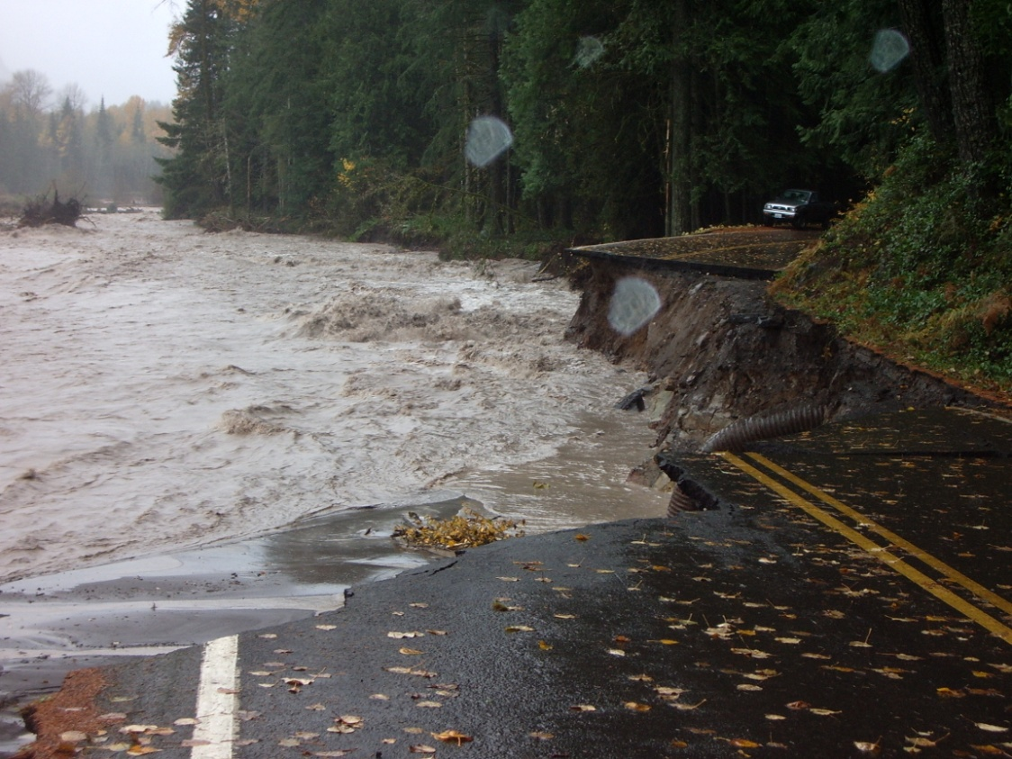
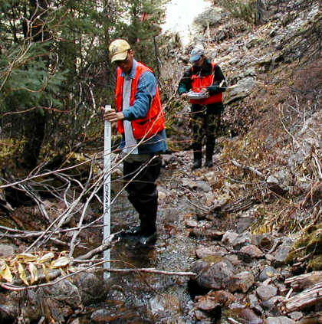
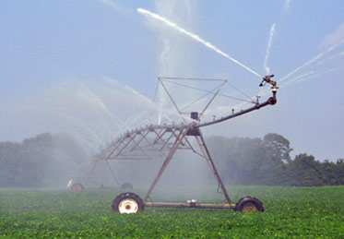

Slide 10
