Slide 1
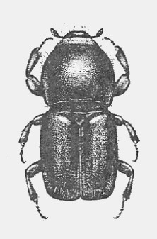

Slide 2
Bark beetles further impact living trees by infecting them with a fungal infection called “Blue Stain” that can also weaken a tree’s defenses. Trees infected with bark beetles and fungal infections eventually die. Trees are stressed by warmer temperatures, drier soil conditions, and earlier spring peak runoff (due to a shorter snow season) and produce less of the resin that repels bark beetles.

Slide 3
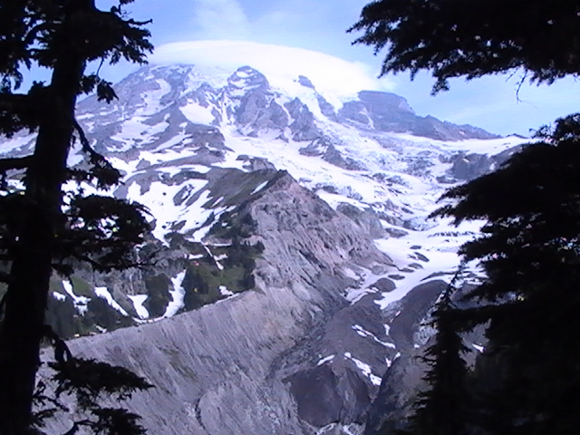

Slide 4
With less snow during the winter, warmer temperatures in the summer and longer snow-free seasons causing more melting, glaciers are getting smaller and thinner.

Slide 5
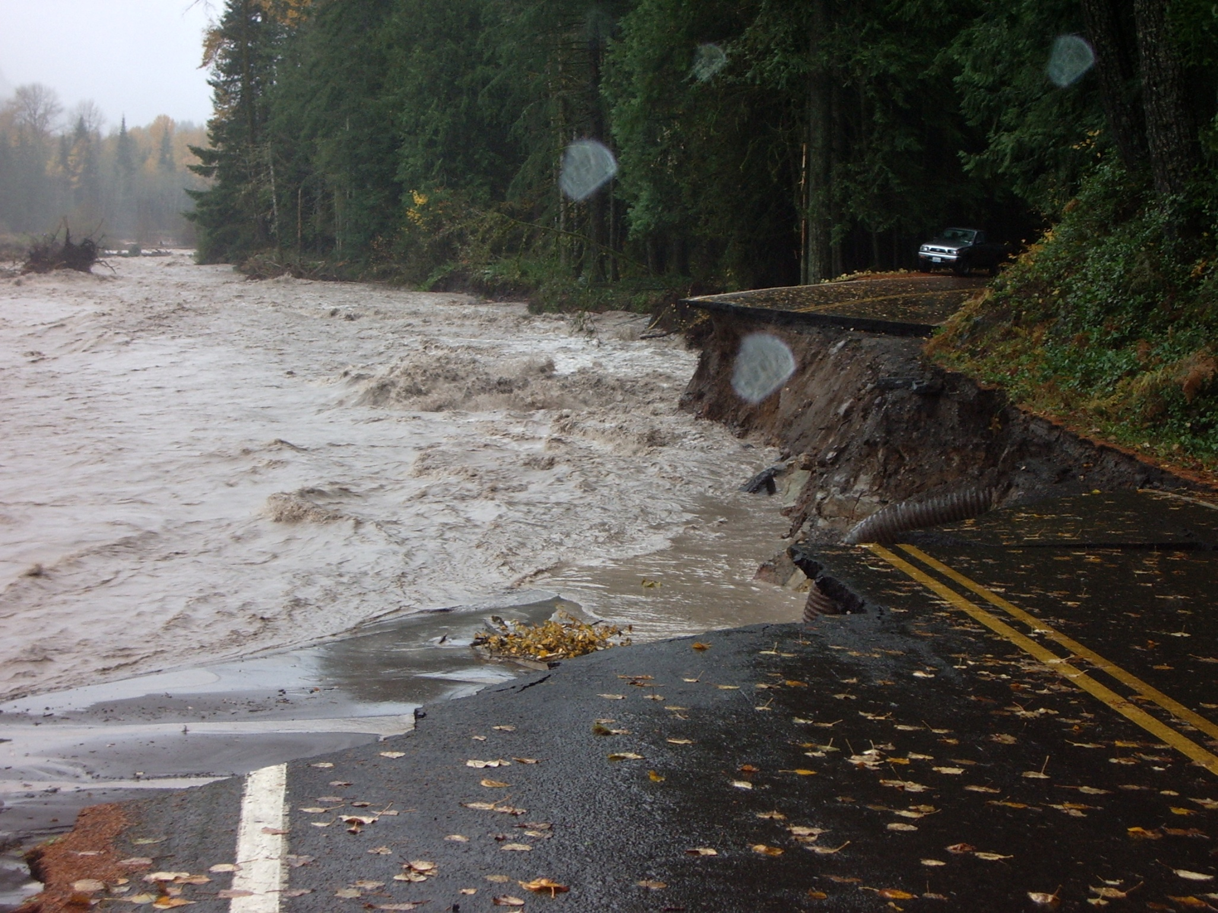

Slide 6
With more precipitation falling as rain and increases in the frequency of extreme storms, loose sediments lead to debris flows and floods. Flooding and increased sediment also negatively impact native fish populations such as salmon species.

Slide 7
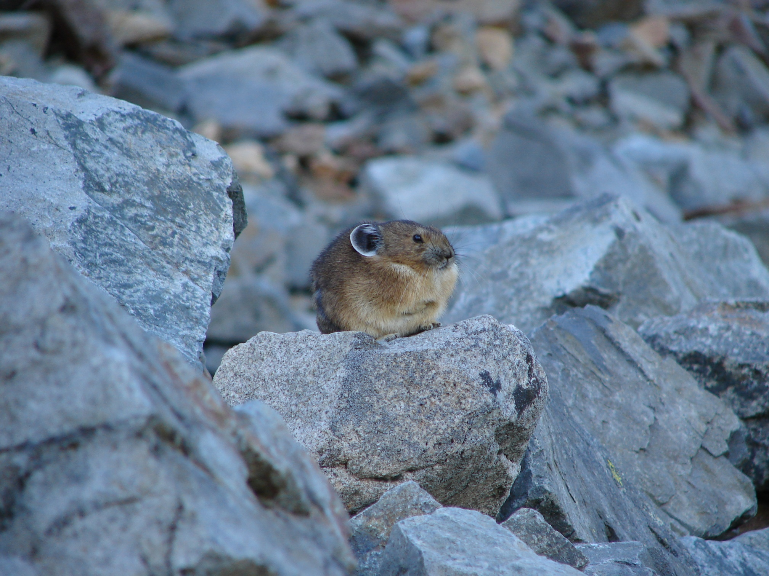

Slide 8
Warmer temperatures cause the pika’s alpine habitat to move to higher elevations because of forest encroachment. Eventually, their habitat could be pushed off the mountain or ridge top. Pikas cannot easily migrate laterally in response to climate change.

Slide 9
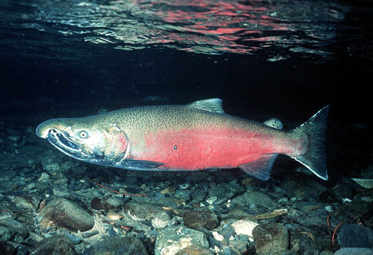

Slide 10
Higher winter stream temperatures accelerate development of embryos and cause premature birth of fry before their food source (insects) hatch. Increasing water temperatures affect the availability of dissolved oxygen for respiration and decrease salmon health.

Slide 11
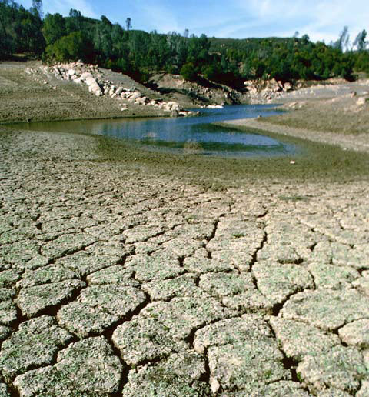

Slide 12
Late summer stream flow is predominantly fed by glaciers. More winter precipitation and less summer precipitation, combined with less snow and glacial melt-off, reduces stream flow, especially in the late summer when temperatures are at their highest. Lower stream flow and higher air temperature together raise stream temperatures, impacting fish and amphibian species.

