Slide 1
Great Egret – 10 Years Later
Don McCrimmon
Cazenovia College

Slide 2
No. 570 in The Birds of North America
The species account for the Great Egret (Ardea alba)
First published in 2001
For 2011, updated and expanded,
total of 276 references
59 are new – a 27% increase.

Slide 3
Much New Information on Food Habits (18 New Citations)
Foraging Microhabitat
Will forage at both shallow and deeper water depths but preference may be for shallower areas (Gawlik 2002).
In contrast to White Ibis (Eudocimus albus) that forages in areas only when prey availability is high, Great Egrets will continue foraging in areas where prey availability is reduced (Gawlik 2002, Herring et al. 2010, Lance et al. 2010).

Slide 4
Much New Information on Food Habits
Foraging Microhabitat
Rhode Island, Great Egrets strongly preferred salt marsh pools, mosquito control ditches were rarely used for foraging and the species was never detected in Phragmites australis stands (Trocki,C. L. and P. W. C. Paton 2006)
wildphotosphotography.com

Slide 5
Most studies of foraging habitat conducted during breeding season.
In winter in Texas, non-breeding Great Egrets open water feeding habitats overlapped extensively with Reddish Egrets and Tricolored Herons, showing preferences for salt-marsh lakes (areas > 100 m²) and pools (< 4 m²) (Chavez-Ramirez and Slack 1995).
http://www.flickr.com/photos/barloventomagico/with/4265166636/

Slide 6
The spatial scale at which data are collected and analyzed is important for the interpretation of foraging habitat
Stolen et al. (2007) partitioned Indian River, Florida habitat at scales of five, ten and 15 km from nesting colonies
At the broadest spatial scale Great Egrets used impounded salt marsh and estuarine edge habitat more than expected based on availability of those habitat types.
However, at more local scales, habitat use more closely matched availability.
Thus, selection patterns can depend both upon the scale chosen for analysis, in addition to the habitat categories used per se.

Slide 7
Energetics!
In Kansas, Great Egrets (49.6 W ± 10.9 SE) had a higher rate of gross energy intake than Snowy Egrets (15.5 W ± 2.9 SE) when foraging principally on sand shiners (Notropis stramineus) and red shiners (Cyprinella lutrensis). (Maccarone and Brzorad 2007)

Slide 8
Energetics!
In an estuarine environment in New York-New Jersey, showed greatest energetic gain (227.0 W) from Fundulus heteroclitus in May (spring) than August (summer). Brzorad and Maccrone (2004)
Compared to Snowy Egrets, Great Egrets expended more energy in striking prey (0.34 J, 0.30 W/strike vs 4.15 J, 4.88 W/strike). Brzorad and Maccrone (2004)
During the breeding season, flight comprised 25.9% of the total energy budget for Great Egrets (Maccarone et al. 2008).

Slide 9
Conservation (20 New Citations)
Everglades Population Estimates
Comprehensive, multisource data base subsequently compiled and analyzed by Crozier and Gawlik (2003)
Mean of 1,010 nests ± 608 SD between 1930 and 1940
Mean of 3,762 nests ± 1,842 SD. from 1990 to 2000
State Archives of Florida

Slide 10
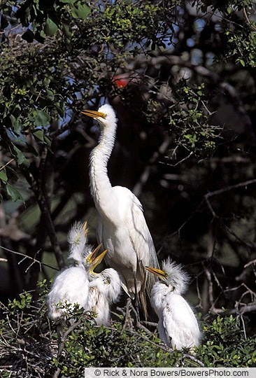
Present and Future Everglades
Populations continued to increase in the first decade of the 21st Century, though among-year variation has also been significant.
6,000-7,000 pairs (Ogden 1999. Cook & Kobza 2009).

Slide 11
Present and Future Everglades
The Everglades restoration program will
increase flows of water into the Park
reduce the unnatural effects resulting from impoundments
removal of many internal Everglades levees may cause disruptions in Great Egret nesting patterns.
National Academies Press

Slide 12
Present and Future Everglades
Thus, there is a possible paradox or at least a lot of uncertainty
Re-establishment of higher volumes of uninterrupted sheet flow will also alter current patterns of abundance, distribution and availability of small fishes.
It is possible that increased numbers of nesting Great Egrets beginning in the late 1980s has been due to hydrological and ecological patterns that were comparatively stable between 1980s-2000s

Slide 13
Additional Variables
In the 2001 publication, evaluation of mercury concentrations in eggs, livers, and feathers of Great Egrets from a variety of studies suggested the threshold for impaired reproduction may have been exceeded in some individuals (Rumbold et al. 1999)

Slide 14
Additional Variables
However, mercury concentrations in the aggregate diet of free ranging Everglades Great Egrets appear to have declined by 67% from 1994 – 2000, attributed to the decline in mercury availability in the wetland food web. (Frederick 2002),
Similarly, other data indicate that levels of total mercury in both eggs and feathers of Everglades Great Egrets in 1999 and 2000 were lower than for samples collected in 1993-1995. (Rumbold et al. 2001)

Slide 15
Population Monitoring
Conservation Status
Considered Threatened in Connecticut and Pennsylvania, but not in New York (McCrimmon 2008)
In Florida a Species of Special Concern because of wetland loss and alteration of natural hydrologic regimes.
Continent-wide, the North American Waterbird Conservation Plan considers Great Egret populations not currently at risk. (Kushlan et al. 2002)

Slide 16
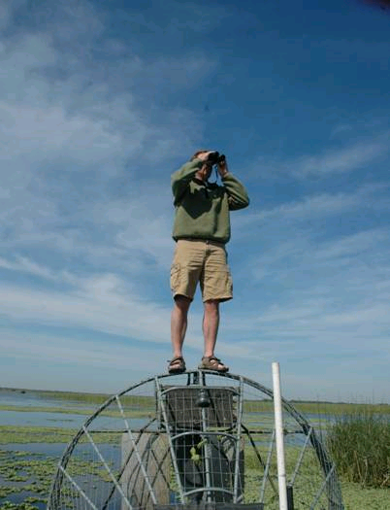
Population Monitoring
Monitoring of nesting colonies on a local basis is typically done by counts of active nests from the ground. Aerial surveys for larger areas are typical and cost effective.
Recent empirical studies strongly suggests that, when compared to ground counts, not only do aerial surveys often significantly undercount populations of very detectable species such as Great Egrets, there may be substantial variation in aerial surveys themselves. (Frederick et al. 2003, Conroy et al. 2008, Williams et al. 2008)
The use of dual observers, double counting, or other calibration methods to reduce such variation is recommended.

