Slide 1
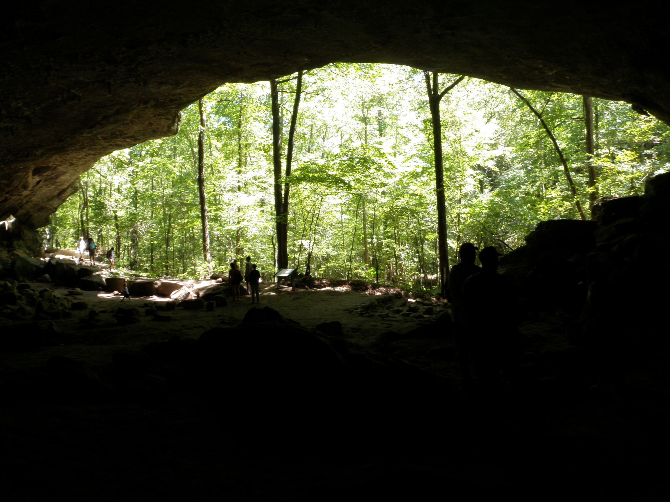
Hike to the Indian Rockhouse

Slide 2
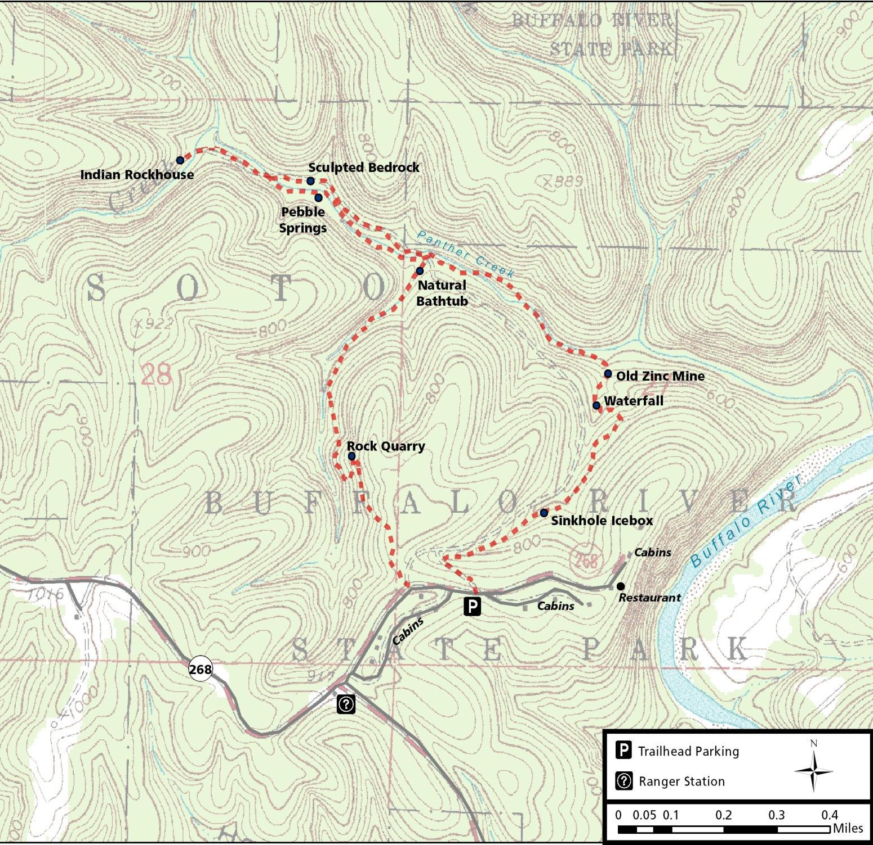
The trail is steep and strenuous in some areas. The hike usually takes 3-4 hours with a break for lunch. This trail travels down into the valley of Panther Creek so the return is mostly uphill to get back to the trailhead and bus.

Slide 3
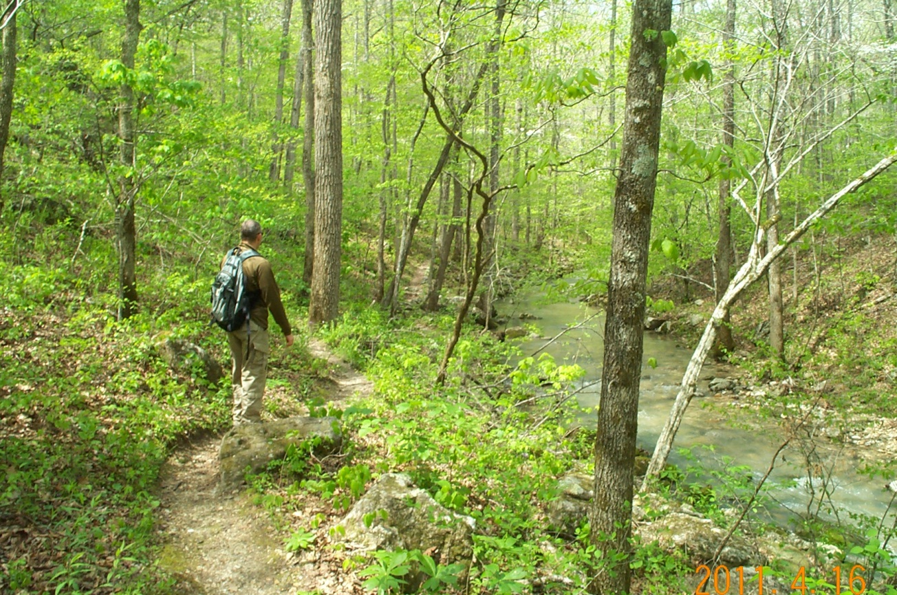
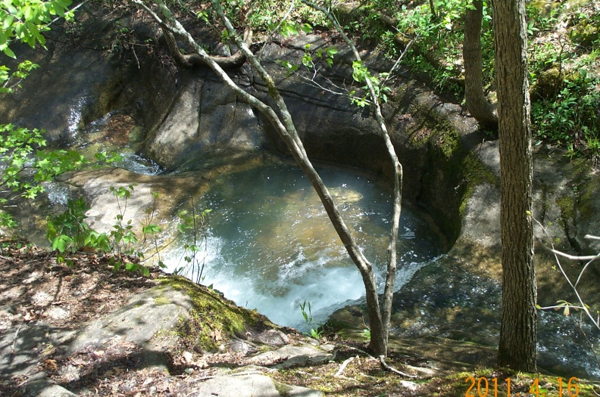
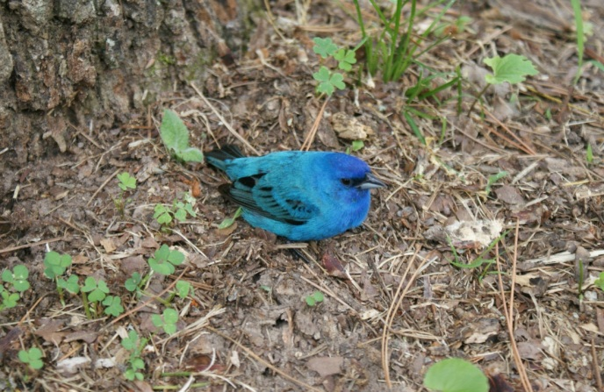
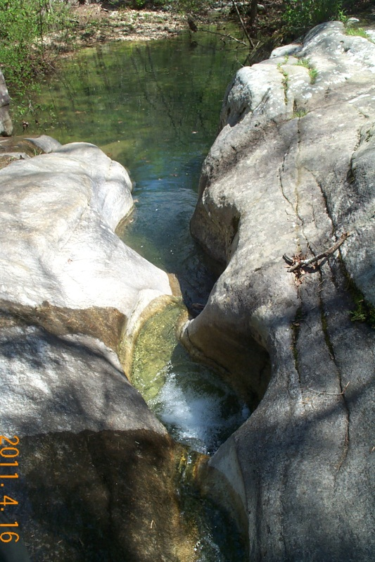
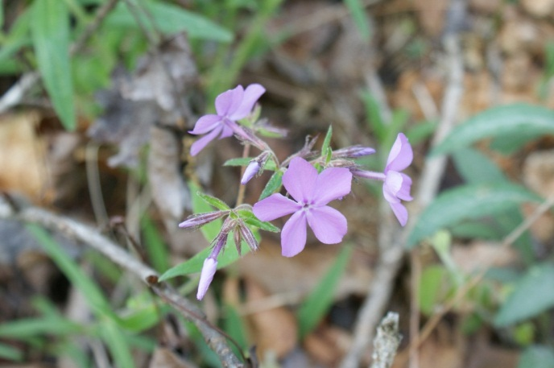
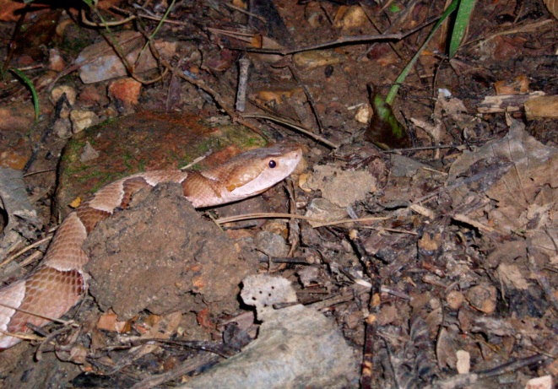
The three and a half mile trail weaves through several different micro-climates. The hike offers views of a wide variety of plant and animal species and showcases several geologic formations that have been carved by exposure to wind and water.

Slide 4
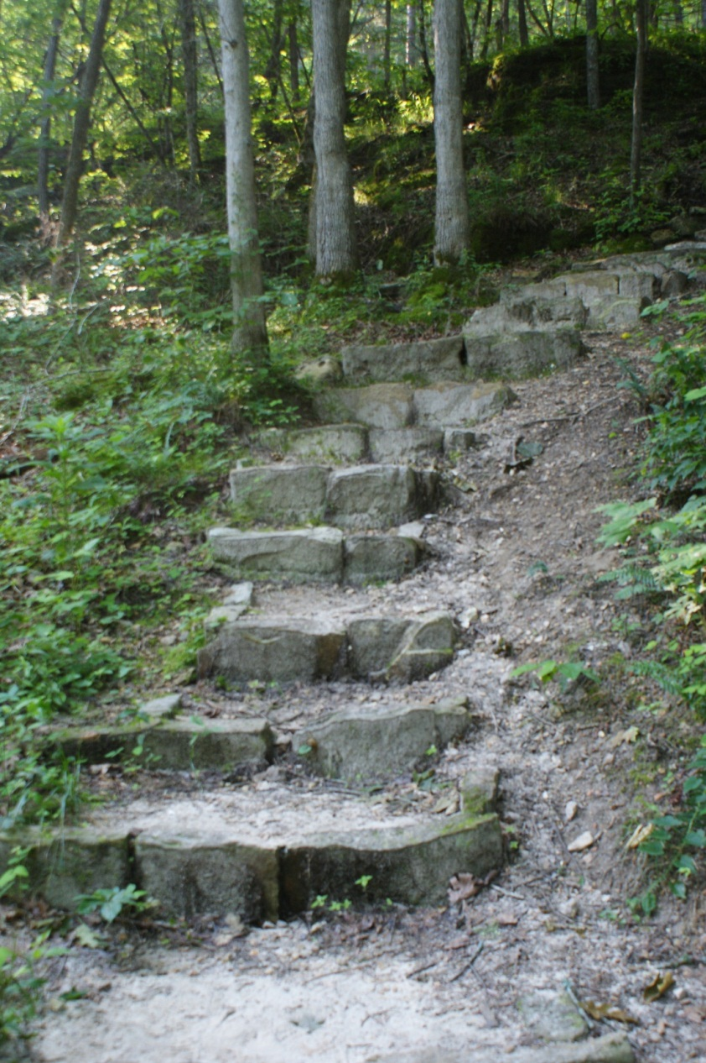
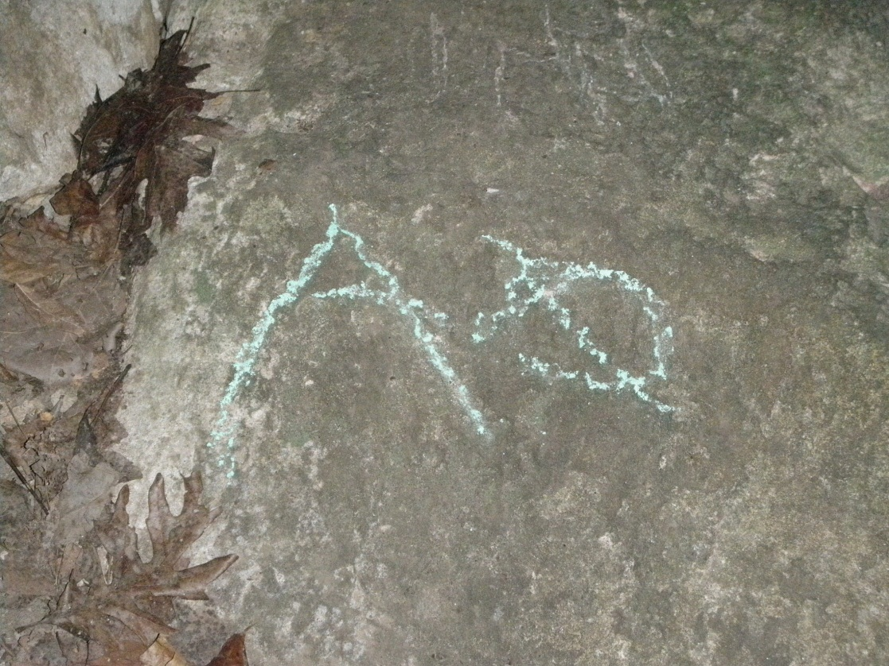
Because of a wide range of natural resources available in this area, people have used it for thousands of years.
The effect of human presence is visible along the trail.
Does this enhance your understanding and appreciation of the resource?
Should you use the steps or the trail beside them?

Slide 5
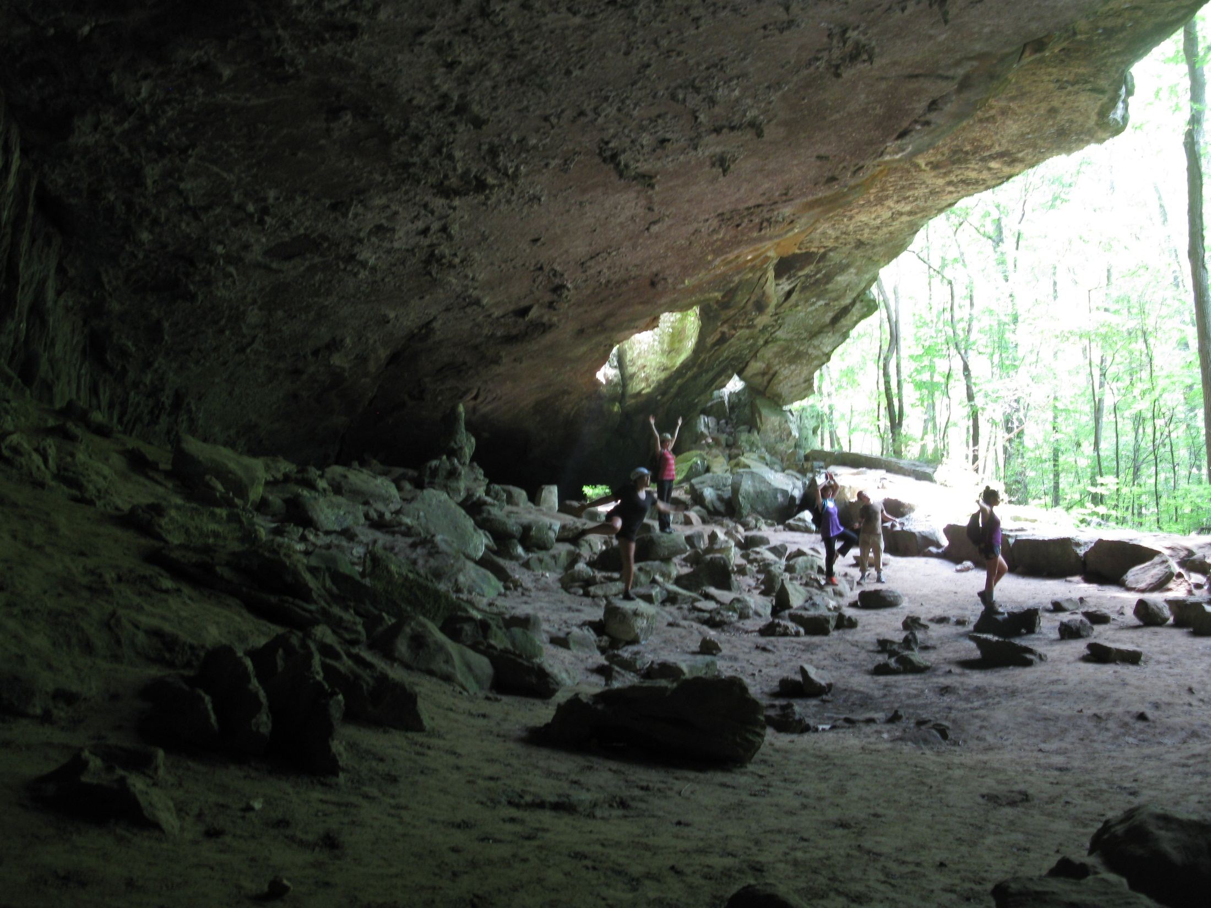
Arrival at Indian Rockhouse means it is lunchtime!
Once everyone has had lunch and a chance to explore, we learn about the National Park Service’s mission to protect and preserve these special places and how everyone can help. Then it’s time to hike back up to the trailhead and bus to return to school.

