Slide 1
Climate Change in the Boston Harbor Islands national park area
Photo: Eva Van Aken. Bumpkin Island 2010

Slide 2
Boston Harbor Islands national park area
Notes:
Boston Harbor Islands national park area is a partnership park comprised of 34 islands and peninsulas. The islands border the two port cities of Boston and Quincy busy with commerce and recreation. Their 1500 acres feature many natural and cultural resources, from Civil War forts to vibrant salt marshes. This park is the only place in North America where the coastline intersects a field of drumlins, glacially formed hills. The last great ice melt about 15,000 years ago partially flooded the hills to create the islands we know today. We are currently facing another climate change and in this module we will identify the components of climate change and how it may affect our park and communities.

Slide 3
Unit I. Climate Change Science
To begin this brief video, please advance the slide to begin; then click when complete. complete
Notes:
How do you explain climate science? This unit gives an overview of important climate science concepts. Many more in-depth resources are available through the NPS website, www.nps.gov/boha. The video shown, courtesy of NASA, displays the seasonal change in Arctic ice and snow cover.

Slide 4
Weather vs Climate
Weather = day to day data
Climate = long term pattern
Graph of precipitation in Boston Harbor. Courtesy of Kevin Morris, NETN
Notes:
People often confuse individual weather events with evidence for or against climate change. After a particularly snowy winter, for instance, they may be less likely to accept that the planet is warming, while an extreme summer heat wave is seen as convincing. However, both are examples of weather – not climate. Weather is a snapshot of information: temperature, precipitation, wind, etc. Weather changes by the day and even by the hour. Climate, on the other hand, is the long-term pattern of weather. To observe changes in climate, it is necessary to compare weather data from a period of many decades.

Slide 5
Climate Change is Happening
Increased temperature
air and oceans
How do we know?
Photo: NASA/Goddard. Arctic sea ice reached a record minimum area in August 2012.
Notes:
Earth’s average temperature has risen 1.6 degrees F in the last century, with 20% of the change occurring in the last decade. This may not seem like a big difference, but at the peak of the last ice age – when Boston was covered by glaciers nearly a mile deep – the climate was only about 10 degrees F cooler than today. In the current period of warming, winter temperatures have been increasing more than summer and the polar regions have been warming faster than more temperate zones. Studies show that 96% of NPS land has warmed significantly since the 20th century began.
One way of tracking global warming is by looking at day-to-day weather data over a long period of time. It is helpful to compare current rates of change with patterns reaching back before the human era. Layers of Arctic ice, frozen for millennia, still bear traces of ancient climates. Examining core samples of bedrock can also help determine what the climate was like long before we started measuring it.

Slide 6
Not Just Warming
Changes in precipitation: droughts and flooding
More frequent, more intense storms
Increase in extreme weather events
Photo: NASA Goddard/MODIS. Tropical storm Leslie and Hurricane Michael, 2012
Notes:
We say climate change instead of “global warming” because temperature is not the only factor that goes into our climate. Along with increased temperatures, the past fifty years have seen drastic changes in precipitation patterns. Coastal areas, like the Northeast, experience much more flooding, while the American Midwest faces severe droughts.
In addition, the added warmth in the atmosphere allows the air to hold about 4% more water vapor on average, leading to more frequent and intense storms. Overall, we are experiencing continued increases in extreme and dangerous weather events as our climate changes.

Slide 7
Greenhouse Effect
This effect is necessary to support life
Caused by heat-trapping gases in the atmosphere
Human activities (burning fossil fuels, deforestation) release more gases and increase the warming effect
93% of warming has been shown, by scientific modeling, to be because of human activity
Notes:
You have probably heard the term ‘greenhouse effect’ once or twice before. Contrary to popular belief, the greenhouse effect is not all bad. Without it our planet would have an average surface temperature of 0 degrees Fahrenheit, far too cold for life as we know it. When light from the Sun strikes the Earth’s surface, most of it bounces back towards outer space. Luckily, as it passes through the atmosphere, much of its energy is absorbed by gases such as carbon dioxide and methane.
Global warming occurs because of a human intensification of this effect. When there is more gas in the atmosphere, less energy escapes into outer space. This excess energy is stored as heat in the air, water, and land, causing the overall temperature of our environment to increase.
Many other explanations for this warming have been suggested, such as natural cycles, solar activity, and even volcanoes. However, scientists have used computer software to model a huge variety of possible scenarios and concluded that our current rate of warming cannot be explained without human contributions.

Slide 8
Questions
Which of these events are evidence of climate change?
Cold winter, major snow storm, heat wave, hot decade, hurricane, increased storms
What contributes to the greenhouse effect?
Notes:
Answers
A. Extreme summer heat waves, last winter’s snowstorms in DC, and new record rainfalls, on their own, are weather events - not evidence for climate change. Higher average temperatures by decade are evidence of changing climate.
B. Deforestation, coal power plants, driving a car, and natural carbon emissions all contribute to the greenhouse effect.

Slide 9
Unit II. Effects of Climate Change on our Islands
Photo: Mallory. Arial photo of Little Brewster and the harbor
Notes:
The global effects of climate change include higher temperatures, rising sea levels, and new precipitation patterns. This unit explores the impact of these changes on the islands and on the many species that call them home.

Slide 10
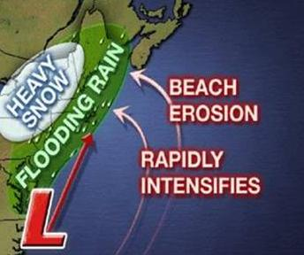
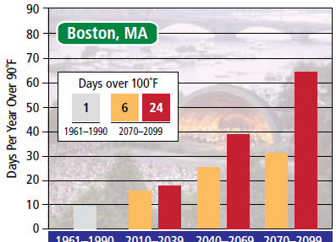
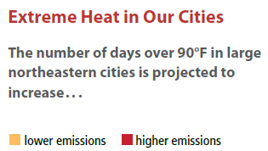
More Weather
Increased extreme weather: flooding, nor’easters, etc
Human health threats
Loss of winter activities like skating or skiing
Graph courtesy of NECIA and UCS
Notes:
Extra water vapor in the air increases storm activity. Our harbor will see more nor’easters and violent storms. Recent dramatic rainfall, flooding, hurricanes, heat waves, and droughts have all been linked to climate change.
These new and unpredictable weather patterns pose a threat to human populations. Coastal dwellers are at risk from flood damage. We are all endangered by extended heat waves, but children, the elderly, and the poor are especially vulnerable.
Other effects of changing weather do not threaten our health, but still impact our lives. Warmer winters in New England will mean the loss of activities like skating and sledding. In addition, shorter snow seasons will put many jobs in the ski industry at risk.

Slide 11
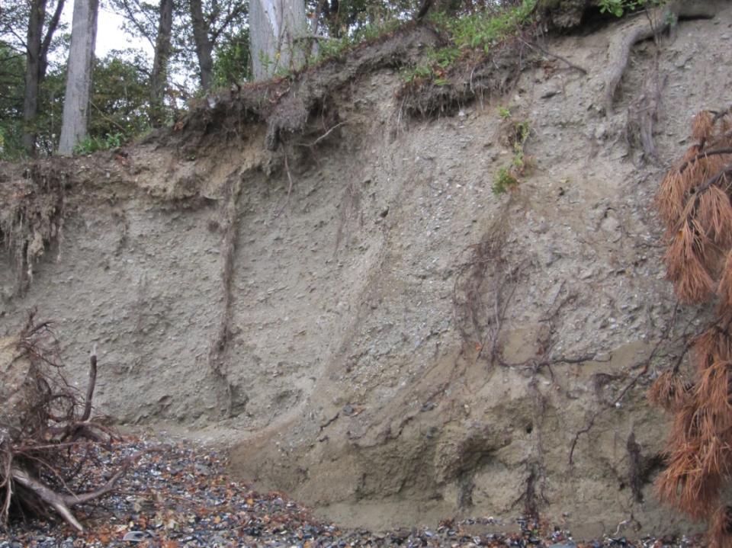
Erosion
Sea level rise
Increased storms and rainfall
Habitat loss
Photo: Eroding cliffs on Thompson Island
Notes:
The new weather is also hard on other species, as it affects their habitats. Combined with rising sea levels, more vigorous and frequent storm surges are speeding the pace of erosion on the islands.
Waters in Boston Harbor have risen about 10 inches in the last century, largely due to two factors. As global temperatures rise, the polar ice caps are melting, causing more water to flow into the oceans. At the same time the oceans are warming up, causing the water to expand. By the end of this century, the water in the harbor is projected to rise another 2-6 feet. These drumlin islands were formed by rising oceans, and a continued increase in sea level will simply flood the remaining land.
Many valuable habitats lie along the islands’ edges. Intertidal zones, mudflats and marshes, tide pools, and bird breeding zones are all important places that contribute to the biodiversity of the islands and the harbor. Erosion will affect these habitats first, threatening the survival of the many species that call them home.

Slide 12
Changing Species
Biome shifts
Rising temperatures drive species north or deeper
Invasives
Native
Rock crab
Asian Shore crab
Notes:
Erosion is only one of many threats climate change poses to local species. Habitat can be lost in other ways as well. Most species have a specific geographical range within which they thrive, due to factors like temperature, predation, and availability of food. As temperatures increase, species are forced to migrate in order to remain within their preferred climate range. Massachusetts Bay has long been a perfect habitat for lobsters, but as ocean temperatures increase the lobsters are moving to colder, deeper waters, damaging the fishery.
Such migrations have very complicated effects on local food webs. Since the Asian Shore crab is used to warmth, it usurps the niche of our cold-water rock crabs. Moreover, these Asian crabs have no predators here – human or otherwise.
Due to milder winters and fewer cold snaps, the populations of ticks, mosquitoes, and poison ivy also explode.

Slide 13
Questions
Why does the greenhouse effect increase the number and severity of storms?
What are some factors that contribute to erosion?
How does warming affect species’ habitats?
Notes:
Answers
As the greenhouse effect warms the atmosphere, the air can and does hold more water vapor, increasing the likelihood of severe storms.
Sea level rise, higher storm surges, unpredictable rain and flooding , and deforestation all contribute to erosion.
Global warming causes species’ preferred ranges to move geographically. It can also lead to erosion of shoreline habitats and increased threat from invasive species.

Slide 14
Unit III. What is the NPS Doing?
Notes:
As the National Park Service approaches its hundredth anniversary in 2016, our superintendent Jon Jarvis calls climate change ‘one of the greatest challenges that has ever faced the system’. Both at the national level and in each individual park, the NPS is making many changes and spearheading new efforts to respond to this challenge.

Slide 15
National Response Plan
Notes:
The national Climate Change Response plan focuses in four areas: science, adaptation, mitigation, and communication.
Through park science, we learn more about the environment and understand the past, present, and future of our climate. We will adapt and respond to that new climate with new policies. By reducing emissions and operating sustainably, we can mitigate the worst effects of climate change. We will communicate through the “power of place”, raise awareness, and create new stewards.
The reality of climate change seems distant to many people, but the Park Service is uniquely positioned. With nearly 400 parks and more than 300 million visitors each year, the NPS has an unparalleled ability to connect people to places they care about and make climate change real, immediate, and relevant for the public.
Climate Friendly Parks is a nation-wide program providing tools and resources for local parks to protect their resources and model climate friendly behavior. To join the CFP program parks calculate their greenhouse gas emissions, develop a plan to reduce them, and continually educate the public on their progress.
Program initiatives have included partnerships such as one with the Dept. of Energy to obtain additional funding: new high-efficiency buses replace visitor cars in large parks like Yosemite, significantly reducing the emissions involved in a park visit.

Slide 16
Our Carbon Footprint
Deer Island: PV panels, wind, hydroelectric
Management/facilities
Transportation
Notes:
NPS and DCR are partners in the Climate Friendly Parks program. They are implementing an action plan to reduce or offset greenhouse gas emissions 50% by 2016. The team is making every effort to act more sustainably and to become a carbon-neutral park by 2020.
Many aspects of park operations help towards that goal: using renewable energy, reducing consumption, and producing electricity from clean sources help lessen the dependence on fossil fuels. Deer Island, for example, features three wind turbines, photovoltaic solar panels, and a hydroelectric generator.
The majority of carbon emissions in the park come from the ferries used to transport visitors to the islands. These ferries use high efficiency diesel engine. While consolidating ferry schedules across organizations has helped make fewer trips and decrease emissions, increasing fuel efficiency for the motor vehicles that support water transportation and park operations is the single greatest impact to curb GHG emissions. Wherever possible, land managers have switched to electric vehicles for on-island transportation. The park will benchmark existing motor vessel fleet-wide hours per gallon average and raise the average through vessel replacement to further reduce the park’s impact.

Slide 17
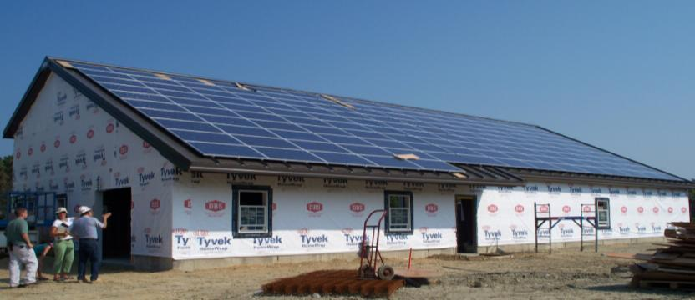
Renewable Energy Generation System
Georges Island Maintenance Facility (2010)
Solar panels (32 kW ) saves $52,500 annually
Reduces use of diesel generators
Clean and sustainable energy for visitor center and food service
Notes:
Incorporating energy-efficient criteria into renovations and new build, Georges Island relies on photovoltaic panels to supplement nearly 30% of its energy needs. Spectacle produces about 8% of their energy on-site as well. Mowing the lawns of Spectacle Island less frequently conserves gasoline, as well as contributes to habitats for migrating monarch butterflies and birds.
17

Slide 18
Inventory and Monitoring
North East Temperate Network (NETN) and other programs
Gather data now to provide a base for the future
Observe effects already happening
Photo: Aya Rothwell. Scientists on Thompson Island, 2008
Notes:
The NPS, in accordance with the mission to preserve nature "unimpaired for future generations," continues to record and analyze data, and encourage the use of parks as laboratories for basic research. The Northeast Temperate Network monitors the ecological conditions in 12 local parks and on the Appalachian Trail. This park is included.
In addition, many academic institutions conduct research in the park on a variety of topics. For example, a graduate student at the Univ. of RI and a hydrologist from University of Massachusetts, Boston are currently mapping and modeling sea level rise in Boston Harbor. Their project will help us to understand the challenges we face.

Slide 19
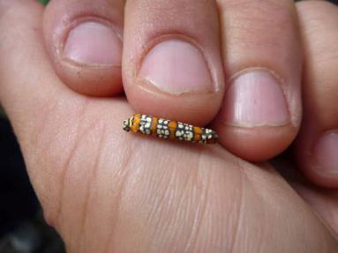
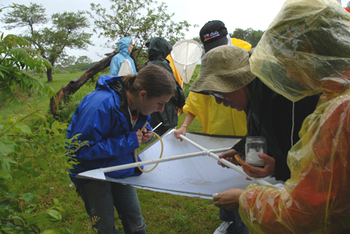
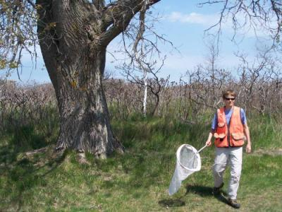
ATBI Insect and Invertebrate Bioblitz
Notes:
Other projects include ‘bioblitzes’ during which scientists, students, and volunteers work together to catalogue the park’s biodiversity, through an all taxa biodiversity inventory. Under the leadership of Harvard University and their Museum of Comparative Zoology, we have identified over 1700 insect and other invertebrate species across the park. We can use this knowledge of our “microwilderness” as a baseline for future studies on climate, habitat change, and our environment.

Slide 20
Questions
What are the 4 parts of the NPS Climate Change Response?
What is our park doing to reduce energy use?
How does monitoring contribute to the NPS CCRP goals?
Notes:
Answers
The NPS Climate Change Response encompasses science, adaptation, mitigation, and communication.
Our park is increasing use of solar and wind energy, switching to electric vehicles, consolidating ferry schedules, and practicing Leave No Trace.
Monitoring the environment helps us to understand what is happening to our park and what we may be able to expect in the future. It also provides a way to engage visitors as volunteer stewards and instill a sense of place in them.

Slide 21
Unit IV. What You Can Do
Photo: Archibald
Notes:
Climate change may seem like an overwhelming problem, but there are many ways we can reduce and mitigate its effects. About 93% of the past century’s warming has been shown to be human-caused. This means there’s a lot of room for improvement! Preventing greenhouse gas emissions now will help to preserve the Earth for generations to come.

Slide 22
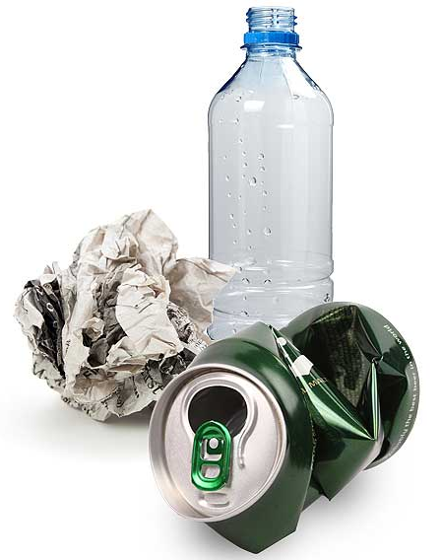
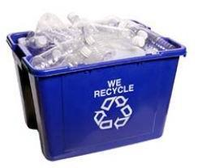
Leave No Trace
Pack it in, pack it out
Carry a trash bag – leave the site better than you found it
Choose reusable waterbottles and containers
Recycle and compost
Notes:
When enjoying any national or local park, you are encouraged to follow the principles of Leave No Trace: to use the place in a way that keeps resource intact for others after you, and not to use it up. On our islands we ask that you do not leave trash behind. Whatever you pack in, you pack back out again when you leave. You might even practice great stewardship by carrying a trash bag and picking up any debris you find. Leaving the site better than you found it is a gift to the community.
Other decisions you make will help reduce the overall amount of trash that is produced – for instance, to choose reusable water bottles instead of disposable plastic ones. If you must use disposable plastic, PLEASE recycle it. The energy saved by recycling one water bottle can power a 60 watt light bulb for 6 hours!

Slide 23
Reduce Your Carbon Footprint
Conserve energy
Unplug at home, in the office, and at school
Avoid driving
Use public transit
Carpool
Make green choices
Buy efficient appliances, cars, and homes
www.climatecounts.org
Notes:
Reducing emissions is a way of practicing Leave No Trace principles – except instead of a single park, try to protect the entire Earth. If individuals work together to leave no trace on the climate, the world will remain inhabitable for generations to come.
Even small choices, such as turning off appliances when not in use, can add up to a big savings. For example, did you know an elevator uses 17 times as much energy going up one story than your body does on one flight of stairs? Taking the stairs is good for your health, and for the planet as well. Some other easy ways to save money and energy: only run washing machines when full, turn off computers, lights, and TVs, and set your thermostat at or below 68 degrees in winter.
A major segment of carbon emissions could be cut out by driving less. The average passenger car releases a pound of carbon dioxide every mile – about as much volume as a dishwasher. Options like public transit, carpooling, walking, or biking make an enormous difference to the planet.
You can also build savings into each purchase you make. If you choose energy-efficient appliances and cars – over years, the difference is huge! Visit climatecounts.org to find environmentally responsible companies, so you can choose products that protect the earth.

Slide 24
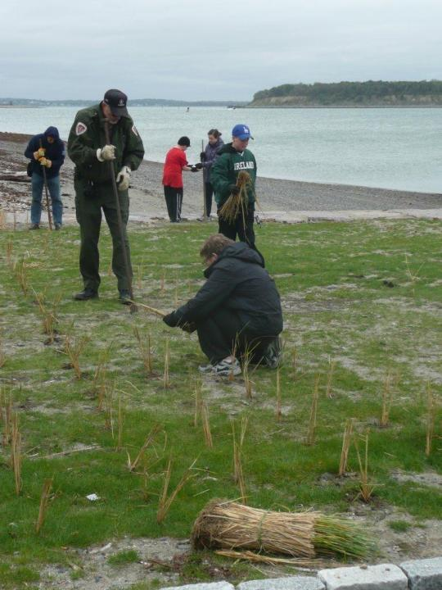
Hands-On Help
Volunteer with the Stewardship program
Fight invasives
Identify and count birds
Phenology studies
Catalogue species
Citizen scientists
Photo: Ranger Ray Watkins and volunteers planting beach grass on Georges Island, 2011.
Notes:
In addition to choosing green products, you can actively protect our islands. There are lots of exciting programs in the park that contribute to knowledge of climate science. On Saturdays during the park’s season, and Thursdays in the summer, a team of volunteer stewards travels to the islands. They participate in a variety of hands-on activities like restoring native habitats by removing invasive species from the marsh, or looking for rare birds to record on the eBird site. Volunteers also take phenology data that adds to the understanding of climate change and might include recording daily air and water temperatures or timing the flowering of certain trees. If you are interested in any of these initiatives, check the citizen science page and join the team!

Slide 25
Questions
What is Leave No Trace?
How can you use less energy at home?
What do volunteer stewards do on the islands?
Notes:
Answers
Leave No Trace means to use and enjoy a natural place without damaging it, and to leave it intact for the next visitor.
At home, try to turn off and unplug all electronics when not in use, minimize heating and cooling through insulation and thermostat setting, and buying energy-efficient appliances.
Volunteer stewards fight invasives, observe and record the diversity of species, clean up beaches and trails, and take phenology data.

Slide 26
Unit V. Communicating
Notes:
Climate change is a difficult topic to interpret for several reasons.
First, global warming is scary. It poses a very real threat to public health and current way of life. Rather than face this threat head-on, some ignore or deny it.
Second, politicians have polarized climate science, making it a question of belief and values. Either you are with the scientists or against them; it is very difficult to develop a deep understanding of the issue.
And third, many Americans simply are not comfortable with scientific concepts. Data charts and complicated vocabulary make us glaze over, leaving even more room for politicians to offer the interpretation that suits their short-term needs.
However, understanding these three challenges can help you to successfully engage your visitors on the topic of climate change.

Slide 27
Frame the Issue
Pick your angle
Connect to the visitor’s ‘group’ identity
Notes:
When disasters are vague, we are unlikely to act if we do not perceive an immediate and personal threat. Climate change, in the abstract, is always someone else’s problem. A major part of interpretation is connecting the issue to the visitors’ own experience. We call this ‘framing’.
For instance, if your audience is particularly interested in nature you might focus on the harmful effects of climate change on plants and animals. For a group of businesspeople, you might explain the financial costs to major cities and infrastructures. Parents care about the world their children will inhabit, while those living in coastal regions worry about the effects of increased flooding.
Psychological studies have shown that people are more receptive to ideas when they are addressed as part of a group. Visitors will hear you better if you remind them that they are a part of the Boston community, their school, church, or workplace, or even the group of ‘people who like islands’. Rather than telling them what they ought to do, you can suggest what others like them are already doing to reduce the impacts of climate change. This reminds visitors that helping the planet will also strengthen their personal relationships.

Slide 28
A Variety Of Styles
Use metaphors and universal images
Notes:
Using metaphors can make abstract issues like climate change feel more concrete. The more visual and creative, the better – especially for children. People process information in a variety of different ways, so the more styles you present in, the more likely you will be to reach them. Images allow many visitors to ‘translate’ information they might not otherwise absorb.
For example, you could tell your audience that burning a gallon of gasoline releases 19.6 pounds of carbon dioxide into the atmosphere. However, 19.6 pounds of gas is a very abstract concept and won’t mean much to most listeners. A good follow-up would be to provide them with a way of visualizing this gas. Since one pound takes up about 8 cubic feet in the atmosphere, the carbon dioxide from one gallon of gasoline fills 160 cubic feet – about the size of 4 ½ refrigerators.

Slide 29
Keep it Real
Balance emotion and fact
Don’t exaggerate
Accept complexity – don’t oversimplify
Use specific data
Cite trusted sources
Scientists
The Park Service
Photo: National Geographic. Mile-high dust storm in Phoenix, AZ, 2011
Notes:
Another way of appealing to multiple areas of the brain is to make sure you include emotional appeals as well as hard facts. This will prevent the information from seeming either too dry or too sensational.
It is important that your climate change messages be accurate, and presented at an appropriate level of complexity. Lying or exaggerating, intentionally or not, damages not only your own reputation but the reputation of climate science as a whole. For instance, it is true that global temperature is increasing – but don’t tell visitors that every summer gets hotter than the last. This oversimplifies the issue and can cause them to lose confidence in climate science. Instead, provide your audience with concrete and specific facts. Cite a source for your information whenever possible. Studies have shown that Americans have very high confidence in scientists and in the Park Service. Enlist this authority to help get your message across!

Slide 30
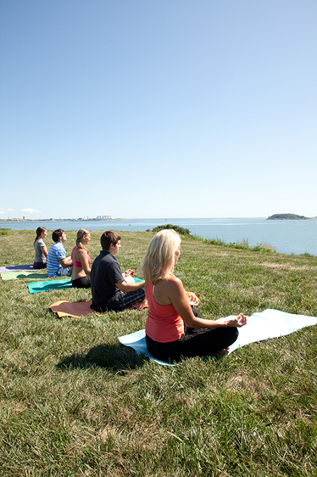
Don’t Overwhelm
Focus on one message
Keep the science simple
Use precise, easy vocabulary
Stay positive and action-focused
Notes:
Even if the issue is properly framed and accurately presented, people can easily get overwhelmed by climate change. They will lose hope and tune out any further messages. With a global problem, they say, what good can my actions possibly do?
To prevent this alienation, the presentation has to be simple. Choose the most important message – whether that is Leave No Trace, carpooling, or using less water – and try not to complicate it with additional demands.
In addition, scientific concepts must be presented at the appropriate level. Use everyday vocabulary whenever possible to avoid confusion – most Americans are not familiar with scientific writing, and using obscure words will distract them unnecessarily.
No matter what you are telling the visitor, though, focus on the positive aspect of what they can do. Your ultimate goal is to raise their consciousness and provide them with a practical and useful way of preventing climate change. Describing positive actions empowers the visitor to make a difference and, hopefully, inspires others to act as well.

Slide 31
Questions
What strategies make your communication more effective?
What is your goal when interpreting climate change for visitors?
Notes:
Metaphors, framing, checking your facts, and engaging visitors as part of a group all help your communication to be more effective. Exaggeration, dramatic emotional scenarios, and overwhelming the visitor with facts will reduce your educational power.
When interpreting climate change for visitors, you are trying to connect them personally to the issue and give them a concrete tool kit they can use to make a difference.
Thank you for taking the time to learn more about climate change. Please see the attached pdf for more resources.

Slide 32
Resources/Links
NPS, Climate Change Response
http://nature.nps.gov/climatechange
EPA
http://www.epa.gov/climatechange
NASA
http://climate.nasa.gov/
NPCA
http://staging.doyourpartparks.org/
Blue Planet
http://www.liveblueinitiative.org/
Northeast Climate Impact Assessment
http://climatechoices.org/ne/
Notes:
Metaphors, framing, checking your facts, and engaging visitors as part of a group all help your communication to be more effective. Exaggeration, dramatic emotional scenarios, and overwhelming the visitor with facts will reduce your educational power.
When interpreting climate change for visitors, you are trying to connect them personally to the issue and give them a concrete tool kit they can use to make a difference.
Thank you for taking the time to learn more about climate change. Please see the attached pdf for more resources.

